Slide 1
PRESENTED BY ATS
2022-23 Test Administration Training
Presenters:
Brad Hansen – Service Desk
Charles Turner – Service Desk
Notes:
Welcome and thank you for joining the Test Administration Training.
Everyone introduces themselves

Slide 2
Our Agenda
Kite Educator Portal
User Account Management
Setting Student Accommodations
Roster Management
Retrieving Student Logins
Monitor Test Sessions
Reporting
Kite Student Portal Install
Kite Student Portal Navigation
Notes:
For our agenda today, we will be discussing some of the processes of Kite Educator Portal and Kite Student Portal in more depth.

Slide 3
Kite Educator Portal
Notes:
Kite Educator Portal is used by educators for entering student accommodations, monitoring test sessions, and retrieving student/class data through data extracts.

Slide 4
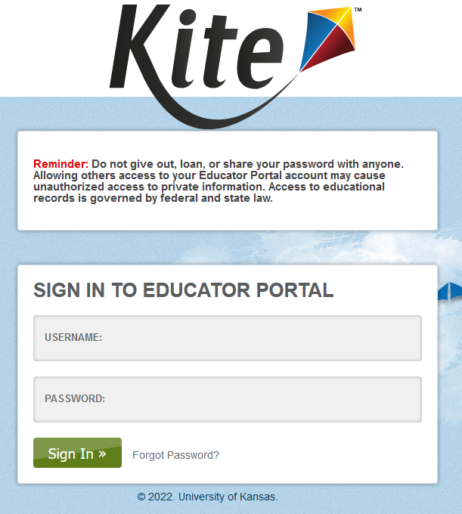
Introduction to Educator Portal
Logging In
Landing Page
Navigation
Announcements
Notes:
URL: https://educator-testlet.kiteaai.org
The image shown is what users will see at the login page of Kite Educator Portal.
Users will use their full email for the username. Password they set when activating their account.
Users can request a reset password link if they have forgotten their password.
- Account must be active in order to use this function.

Slide 5
Introduction to Educator Portal​
Notes:
Here is the view of the Educator Portal Homepage. From top to Bottom we have the “Role” dropdowns that allow users with multiple locations and/or multiple roles to easily switch between them. Below that is our blue navigation button set. These buttons and their sub-menus will take users through everything Educator Portal has to offer including student and roster information, user modification in some roles and data extracts on testing status.
Below that and to the right is the link to “My Profile” which contains personal settings changes like password modification, display name change and per-user security agreements.
Quick links is below that and provides users with some common shortcuts to specifics areas. They are set by role. In the image you can see this role example has links to rosters and extracts.
Take a look at the right example image. We also have a system for showing announcements on the Educator Portal home page. This is primary used for informing users of a new Student Portal version or other user-focused news.

Slide 6
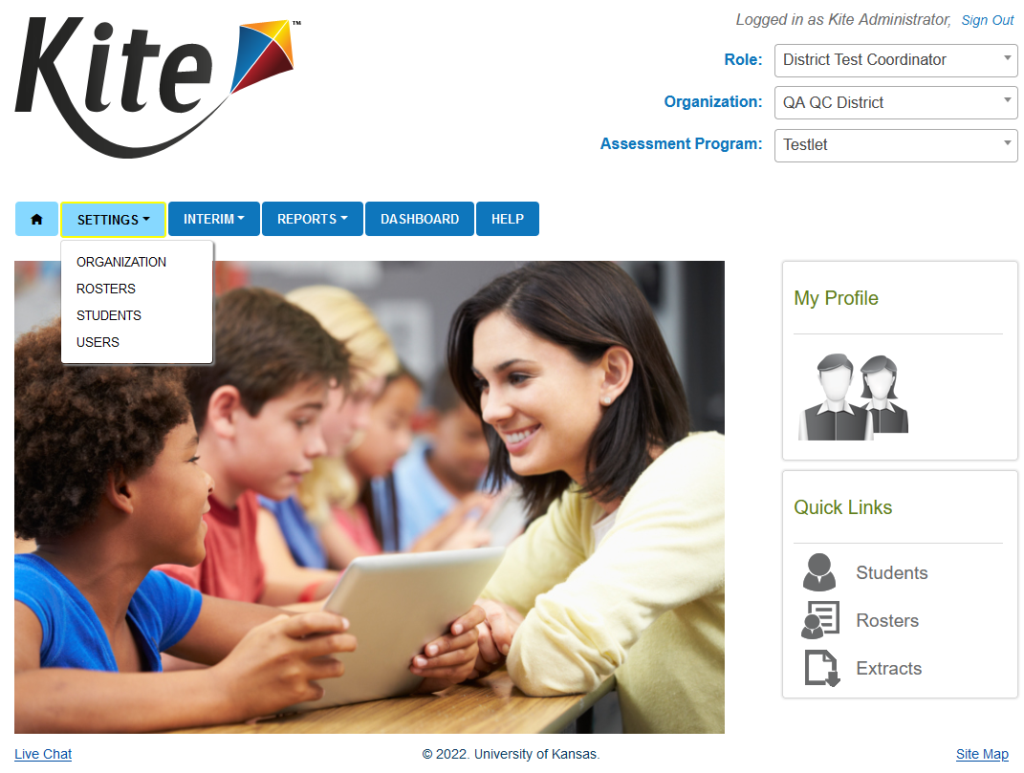
Navigation
Settings Tab
Organization
View the organizations listed in your district
Rosters
View rosters
Students
View student data
Users
Manage User data
Notes:
The settings tab is where users will view and manage various types of data.
The organization page allows you to view the organization id and name, which is useful when uploading users, students and rosters.
The roster page is where users tie the students to their teacher.
The students page is where users will view student data and modify personal needs profiles for the students.
The users page is where everyone gets added and accounts are managed.

Slide 7
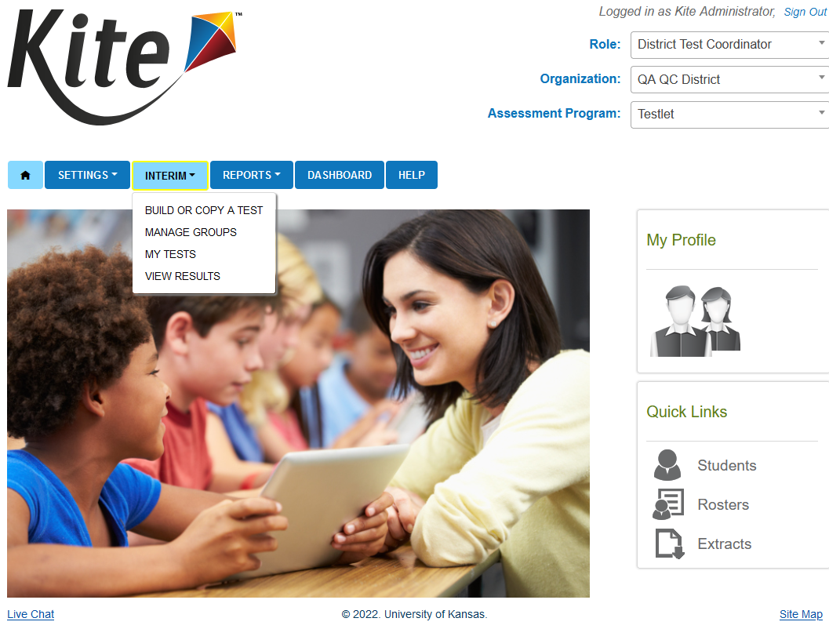
Navigation cont.
Interim Tab
Build or Copy Test
Not used for the Testlet program
Manage Groups
Not used for the Testlet program
My Tests
Assign tests - Not used for the Testlet program
Manage tests
View Results
View the different reports available after tests are completed
Notes:
Within the interim tab Build or Copy test, manage groups and assign tests are not currently being used for the testlet program.
Within the manage test tab, you can view the Interim test sessions, monitor students progress on the Interim tests and view and print the test tickets
View Results, contains the reports for the Interim predictive and Interim Mini-tests.

Slide 8
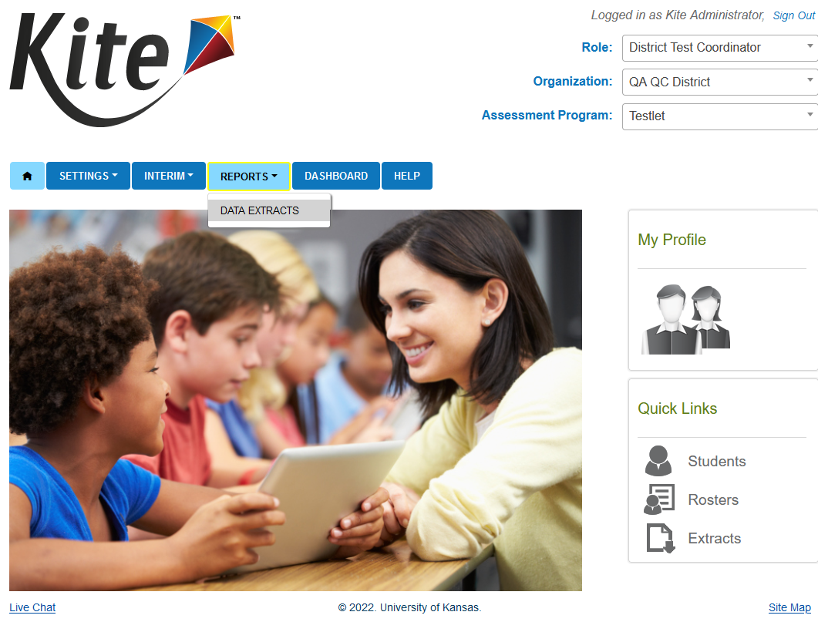
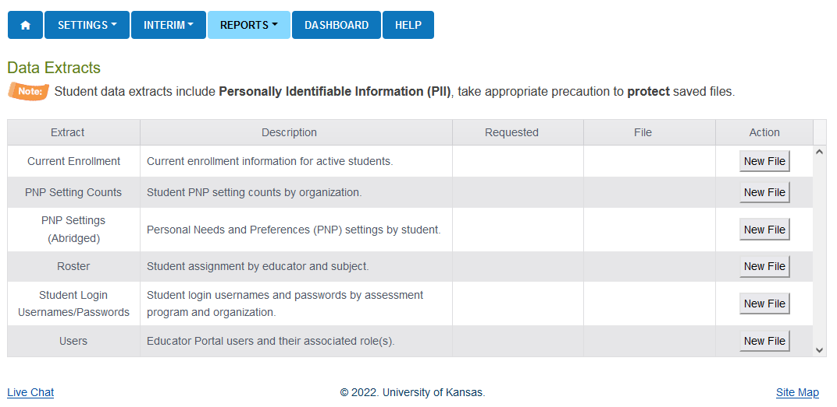
Navigation cont.
Reports Tab
Data Extracts – pull extracts for data management and student logins
Current Enrollment
PNP Setting Counts
PNP Settings (Abridged)
Roster
Student Login Usernames/Passwords
Users
Notes:
The reports tab contains several different extracts, such as the Current Enrollment, PNP Settings(Abridged)​, Roster, and Users extract.
- These extracts are useful for maintaining data within Educator Portal.
-Extracts come in .csv format. It is recommended to use Excel as that is what is used when uploading data.
-You can also use the Users extract to upload to the User Upload tab if you need to correct multiple users at once

Slide 9
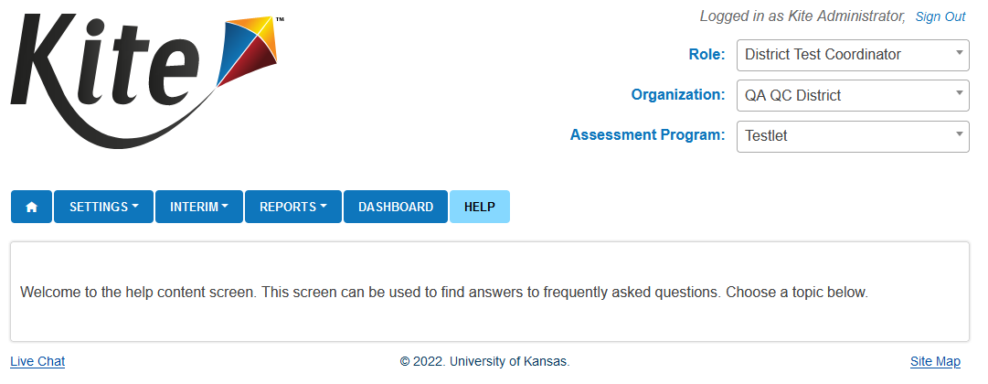
Navigation cont.
Help Tab
Provides FAQs and other helpful information
Notes:
The Help tab allows user access to some answers to common questions. We also can put in assessment program or role specific documentation or content.

Slide 10
User Account Management

Slide 11
Users – Hierarchy: State Level
State
District Users
Building Users
Role Function
Role Titles
State Users can see all districts and schools in the state. Assigned by request.
State Assessment
Administrator
(SAA)
Notes:
First off, with the greatest level of access, state level users can see all districts and schools tied to the state. This role is only assigned to select users and an account with this level of access must be requested.

Slide 12
Users – Hierarchy: District Level
State
District Users
Building Users
Role Function
Role Titles​
DTC- Data Management and coordination at a district and building level. Has to be created by the state.
DU – Similar to DTC, but used by more people with a focus on data management. Can be assigned by either the DTC or the state.
District Test Coordinator (DTC)
District User (DU)
Notes:
Right below state-level users, users with district-level roles have access to reports and data at either the district or building level for all organizations contained within their district. The district test coordinator role must be assigned by the state. The district user role has slightly more limited permissions, but it can be assigned by either the District Test Coordinator or the state.

Slide 13
Users – Hierarchy: Building Level
State
District Users
Building Users
Role Function
Role Titles
BTC– Data Management and coordination at a building level
BU– Similar to BTC, but used by more people with a focus on data management
Teacher – View students that are rostered to them. Access to student logins. No access to student reports from prior years.
Building Test Coordinator (BTC)
Building User (BU)
Teacher
Notes:
Right below district-level users, users with building-level roles have access to reports and data for the building they have selected. Building Test Coordinator is the building-level role with the highest level of permissions available for building users. It can be assigned by district or state level users. The building user role has slightly more limited permissions and access to view certain reports, but it can be assigned by the Building Test Coordinator, district level users, or the state. Finally the teacher role has the lowest level of permissions available within Educator Portal. They can only view students that have been rostered to them in Kite Educator Portal. Additionally teachers will have access to student logins, but will not have access to student reports from prior years.

Slide 14
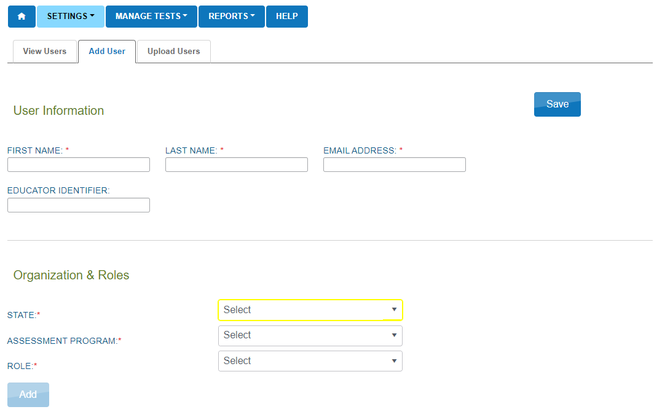
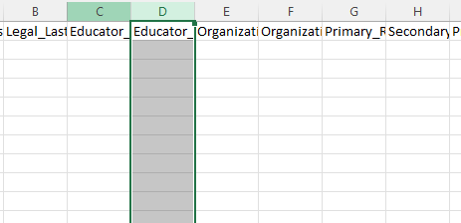
Setting up Users​
There are two methods for building user accounts in Educator Portal
UI Manual Creation
User Upload
Notes:
Now that we have a solid understanding of how roles work, let’s take a look at how you can add them. We offer Manual addition using the Kite Educator Portal User Manual or also we offer the CSV spreadsheet upload option. The choice will often depend on how many users you want to add and how many roles they will end up needing. If there are more than 10 users, it’s suggested to use the upload for speed. If you’re adding a few users or these users will utilize multiple roles, it is an easy process to use the UI.

Slide 15
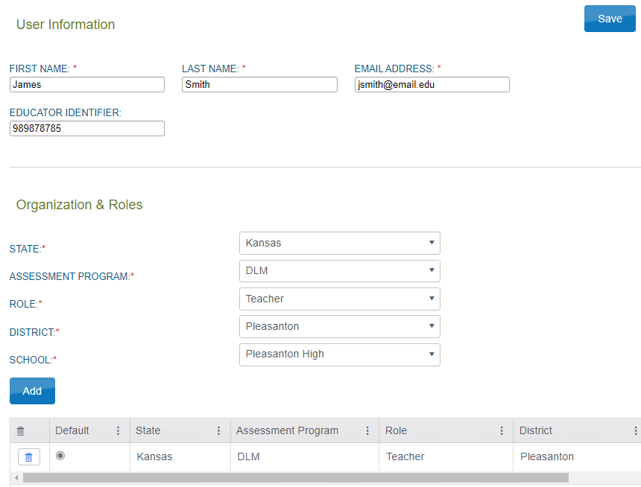
Setting up Users – UI Manual Creation
Settings Users Add User
Fill out all required fields under User Information (Including Educator Identifier if creating a Teacher account)
Use the dropdowns to add the desired role to the user's account at the correct organization
Click Add.
Verify that all information is showing correctly under User Information and table of roles
Click Save
Best when adding small (four or fewer) quantities of users
5
2
3
4
Notes:
If you’ve decided to go ahead and use the User Interface provided in Kite Educator Portal, here is what you will see. You’ll need to start by filling out all of the User Information fields with an asterisk. Please also note that because Rosters, which we will cover soon, utilize the Educator Identifier field that field is also required if the user you’re adding is being given the “teacher” role.
The next area we have the Organization and Roles section. You will fill need to fill out the dropdowns from top to bottom, first choosing your assessment program. Once you’ve filled all of the dropdowns, click the blue add button. You’ll see the organization you selected is then shown just under the add button. Double check before you continue and then click “save.”

Slide 16
Setting up Users – User Upload
Settings Users Upload Users
Complete csv template* with user information for the accounts being created/modified
Upload template by clicking "Select File" then choosing your file
Click Upload
Look for Complete status
If any errors, open error csv, correct issues then reupload
*New template can be acquired by clicking on blue '?' Next to 'File:'
Multiple users can be added/modified with a single CSV upload. Best when adding ten or more users
3
4
5
6
Example of upload error message:
Notes:
Doing a user upload is an efficient way to get groups of user’s into the system. You’ll use the template file that is downloadable from the Upload User’s tab page. That file can be found by clicking the blue question mark next to the file icon about step 3, the file select. You’ll fill in the information with a little help from the manuals that provide criteria for each column. Once complete, you can submit using the select file button in step 3 and then upload in step 4.
The upload will process as normal and then the status will update to “completed, created, rejected or failed.” If your upload fails or if any of the users in the upload get rejected, you can click the file icon to the right to open a csv that provides explicit information on what errors the system encountered and how they can be corrected.

Slide 17
Roster Management
Notes:
As a part of the Test Administration process, it is important to review rosters to ensure students are associated with the correct teacher.
Rosters are an important step when it comes to test generation and assigning correct tests. Without rosters, students will not receive tests.

Slide 18
Roster Overview
Functions of Rostering
Tests are generated using the roster data.
Rosters determine which subjects should be generated for the student
Allows Teacher-level users to access student data such as login information and Personal Needs and Preferences Accommodations
Student
ELA Roster
ELA Teacher Connection
Math Roster
Math Teacher Connection
Notes:
While “enrolling” simply states the student exists, this is their age and location; Rostering actually provides the system with what subjects the students will test and provides connections to teachers. While it may seem straightforward that all students take Subject X and Subject Y, there are exceptions and the rostering process allows us to build that out.
What do teachers get? Teachers can then access the student’s login information and also have access to the student’s profile in Educator Portal. The teacher can then use that to add personal needs accommodations and enter other student-specific data.

Slide 19
Roster Creation- Manual
Manually Creation – User Interface on Web
Only one Teacher can be associated with a given roster
Only one Subject can be associated to a given roster
Identifiable
Name
Tested Subject
Specific Location
Notes:
As we’ve seen before, we give a couple of ways to enter data. Rosters are no different. We have the “manual” way which utilizes the Educator Portal’s web interface, often called a UI. This allows users to click through defined dropdowns and build out the roster step-by-step.
The first steps are entering a good name for the roster. We often suggest using the teacher’s surname and the subject if not also the grade. It *can* get a little confusing when you have several rosters if you’ve only put the teacher’s surname. We don’t limit what you name it so find a method that works for you!

Slide 20
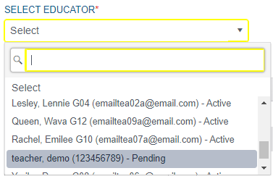
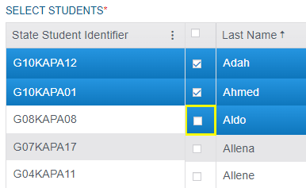
Roster Creation- Manual
Manually Creation – User Interface on Web
Select a Teacher using Dropdown
Select Student using checkbox
Notes:
The next two steps will include selecting the “Educator.” The list of users in that dropdown are all users who have “teacher” roles at the location you’ve specified in the first step. Once you’ve got your teacher selected, you can select students.
We don’t limit this either and you can select entire pages or specific students. Using the table you can filter and search for specific students or groups of students to ensure all are added. If you miss one, don’t worry. You can always modify the roster later by either adding students using the checkbox or removing them by unchecking the box.
Another thing we don’t limit is the number of rosters you can have per teacher. One teacher could have 12 ELA rosters if they needed. We *DO* limit it by student, so a student can only be in a given subject’s roster ONCE.

Slide 21
Roster Creation- CSV Upload
CSV Upload
Advantages
Allows upload of multiple rosters, simultaneously
Allows verbose explanations of errors in uploads for corrections
Notes:
The alternative to the manual creation is the CSV upload. We utilize CSV spreadsheets often and encourage their use especially for larger groups. You could, in one sheet, build a school’s worth of rostering connections and submit them at once. Our manuals have explicit instructions of what each column is looking for as well as a Service Desk happy to provide guidance.
Since no one’s perfect, if your upload has any number of alerts or failures we provide a handy CSV file that gives verbose information on what happened as well as how to fix it in some cases. A common use is if a teacher has a name change and email change and they was updated on the CSV to be uploaded but not on the Educator Portal. You’ll find an error explaining that there is an email mismatch on X line for Y teacher and it encourages you to make corrections and resubmit.
If you do choose to resubmit, you only need to make changes for the line or lines that need it. Submitting the same, unchanged information more than once simply flags the information as providing nothing new and makes no changes.

Slide 22
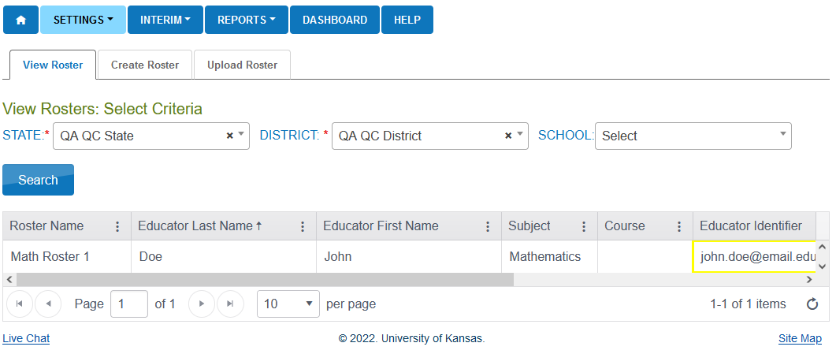
View Roster Page
Ensure students are assigned to the correct teacher
View Roster page allows the user to view the roster name, subject, and other information that pertains to the identified roster
Notes:
Users can review rosters when going to the 'View Roster" tab when going to Settings > Rosters > View Rosters.
From this view, users can view the roster name, subject and other information that pertains to rosters.

Slide 23
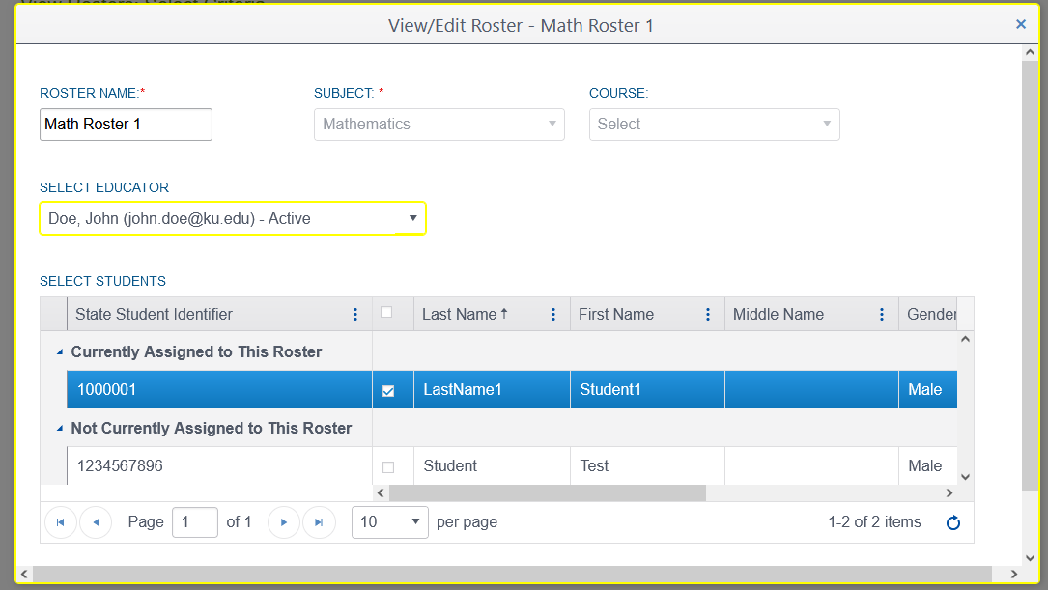
Roster Details
Select the roster by clicking on the row on View Rosters tab
View students that are currently assigned to the roster.
Fast Educator Swapping as needed
Adding/Removal of student individually
Subject cannot be edited
Removing Rosters
Remove/Uncheck all students > Click Save
Notes:
To see what students are on a specific roster, select the roster by clicking on the row of the roster you want to view.
This will open a separate window that will view students currently assigned to your roster, along with the roster name and subject.
If you are making any changes to the roster, please note that the subject cannot be changed
In the next slide we'll go into more detail about the view/edit roster page

Slide 24
Setting Student Accommodations
Notes:
Some students require additional supports during test administration. The Kite system allows for educators to identify those supports that are used in the classroom and enter them into the Personal Needs Profile (PNP).

Slide 25
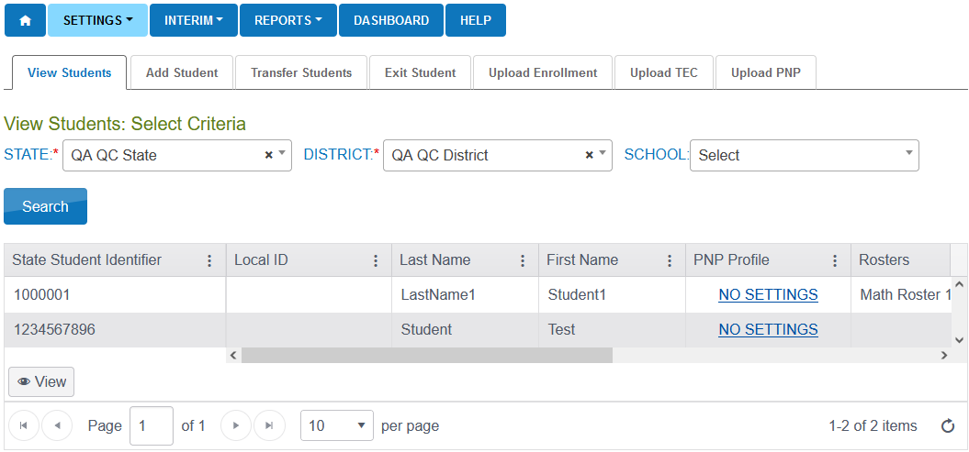
Setting Up Student Accommodations(PNP)
Test Assignment Impact
Accommodations such as Text to Speech and Spanish-language forms (Keyword Translation Display) require different tests be assigned to the student
Overnight Process
Settings > Students > View Students
Select the Organization and enter Search
Statuses
No Settings – Nothing has been set
Custom – Student has accommodations set
Notes:
Personal Needs and Preferences, (PNP)s should be set 24-hours before beginning an assessment for accommodations such as Spoken Audio (TTS) and Keyword Translation Display. Other accommodations like Color Overlay and Magnification can be set shortly before beginning an assessment. PNPs can be entered manually or through an upload.
To navigate to set accommodations for student in the PNP profile, you would go to settings > Students > View Students, select the needed organization information in the drop-downs and click search. In the table you will see the student information and the PNP Profile with the blue hyperlink to set the accommodation. Alternatively, select the link in the PNP Profile column to go into that student’s PNP, but we'll go into more details on that in a couple slides.
In the PNP Profile column there are two statuses that the PNP profile can be in. Either "No Settings" if the PNP has not been started yet and no settings have been selected or '"Custom", when the student has accommodations that have been set.

Slide 26
Setting Up PNPs Cont.
Find the student you need
Click on the status link under the PNP Profile Column
View the Summary page to see what has been set
Notes:
To set or modify the PNP accommodations click on the status link under the PNP Profile Column. You will then be brought to the summary page to view what has already been set or it will be blank showing no accommodations have been selected yet.

Slide 27
Setting Up PNPs Cont.
Review options available and briefly discuss them
Make selections
Save Settings
Notes:
The basic process of making PNPs are to Review what needs to be selected, Make the selections, and then Save the settings.
As you'll see in the next slide, you can move through the tabs to view the available accommodation.

Slide 28
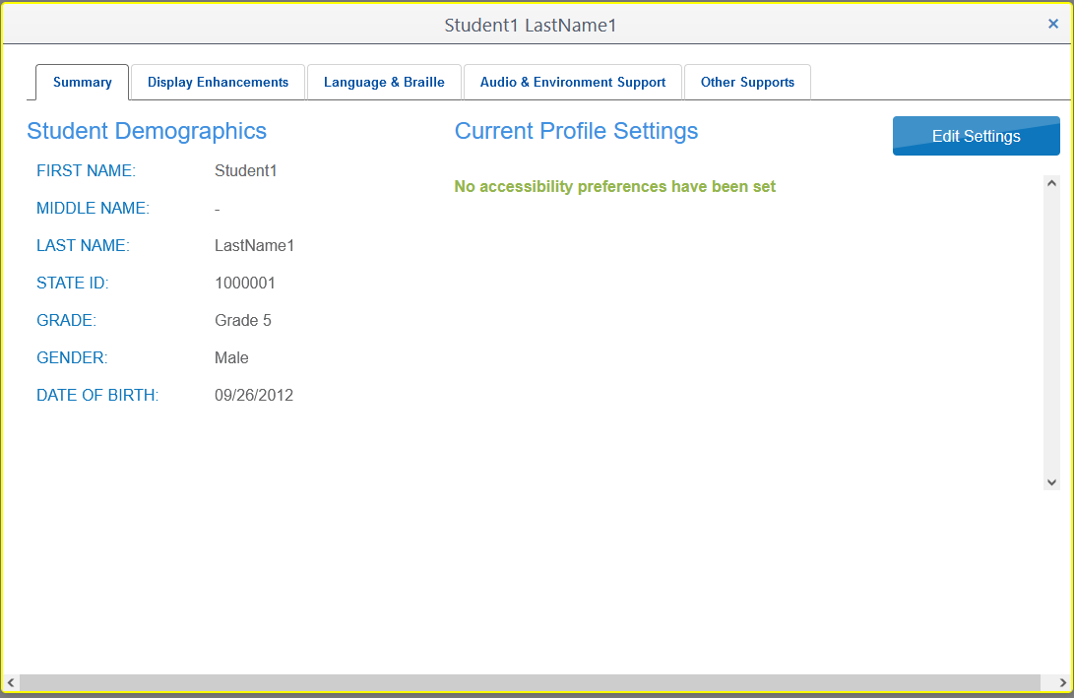
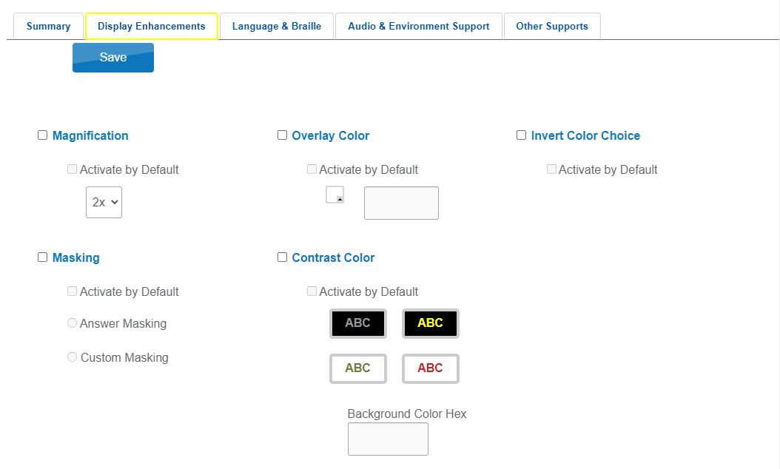
Setting Up PNPs Cont.
Notes:
Here is what it looks like when applying PNPs
You'll need to select the Edit Settings button first to make any changes
Use the tabs at the top to navigate between different accommodations
Select the Save button when finished.

Slide 29
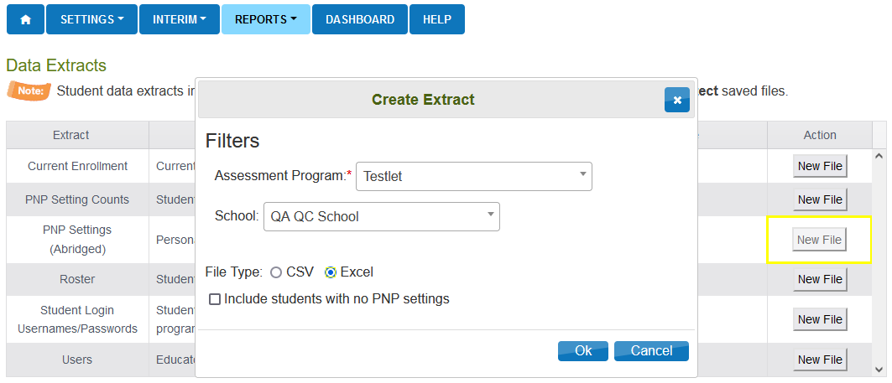
Setting Up PNPs Cont.
PNP Upload Option
Reports > Data Extracts > PNP Settings(Abridged)> Click New File
Select drop downs as needed
Use Excel. This provides the accepted options via drop downs in the file instead of referencing the manual
Select "Include students with no PNP settings"
This shows all students so you can make selections needed for students who did not previously have settings
Notes:
Another option to set or edit multiple students PNP settings at one time is with the PNP Setting (Abridged) Upload.
You would go to Reports > Data Extracts > PNP Settings (Abridged), Click new File in the Action column. In the create extract pop up you select any needed drop downs and Excel as this will provide the accepted options in dropdowns.
Click okay and the file will generate. Initially it will be in Queue and once it has generated you will see the Excel file icon. Select this icon to open the file.
There are a few columns that need to be left blank that do not apply to Testlet.

Slide 30
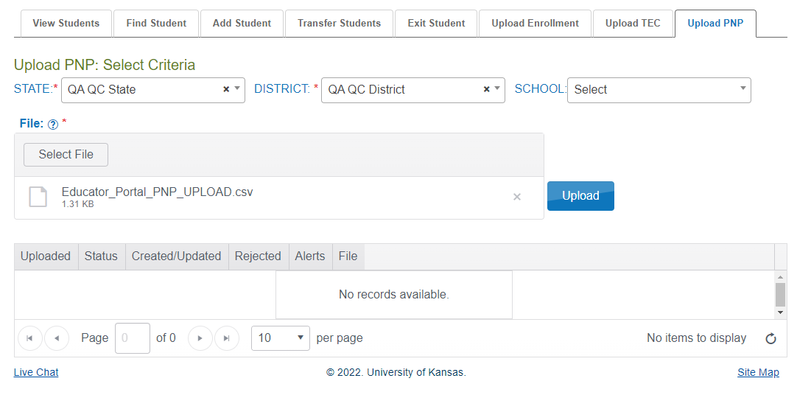
Setting Up PNPs Cont.
PNP Upload Option
Edit the Excel file to include the needed PNP settings
Save the file in the CSV format
Once saved it is ready to be uploaded
Setting > Students > Upload PNP
Click "Select File"
Locate the file that had been edited and saved as a CSV and click open
Click Upload
The file will go in pending and then change to complete once finished. The table will state how many were created and if any were rejected.
Notes:
Once all changes have been made to the PNP Settings (Abridged) Excel file you will need to save the file in the CSV format and then you are ready to upload it to Educator Portal.
Go to Settings > Students > Upload PNP tab, Click "Select File" and locate the file that you have edited and saved in the CSV format, Click open and then the Upload button.
The file will first be in a pending status as it is being uploaded and then once it is finished the table will state how many rows were completed and if any row were rejected. If there were rejected rows a file will generate with the explanation in the File column.

Slide 31
Retrieving Student Logins
Notes:
In order for students to take our tests, they must have a username and password to access tests in Kite Student Portal.

Slide 32
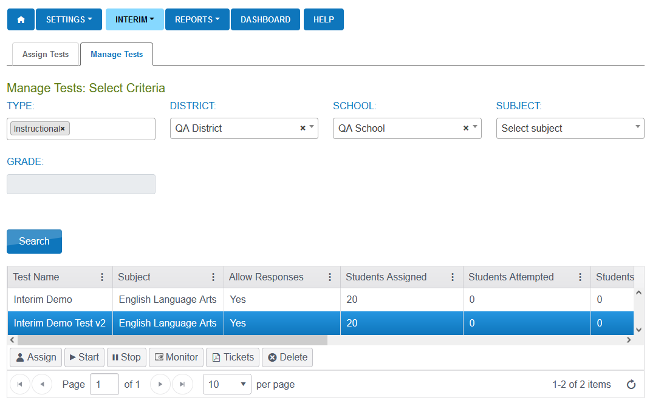
Retrieving Student Logins
Interim
My Tests > Manage Tests
Select the row
Click on the Tickets button
*not used for testlets
Notes:
Student logins for interim testing can be found under the interim tab when going to Interim > My Tests > Manage Tests > Click search > Select a row > Click on the tickets button located at the bottom of the grid
This will download a PDF with student logins who are assigned to that interim test.
You can also access student usernames and passwords from an extract on the Data Extracts page, which we'll talk about in the next slide.

Slide 33
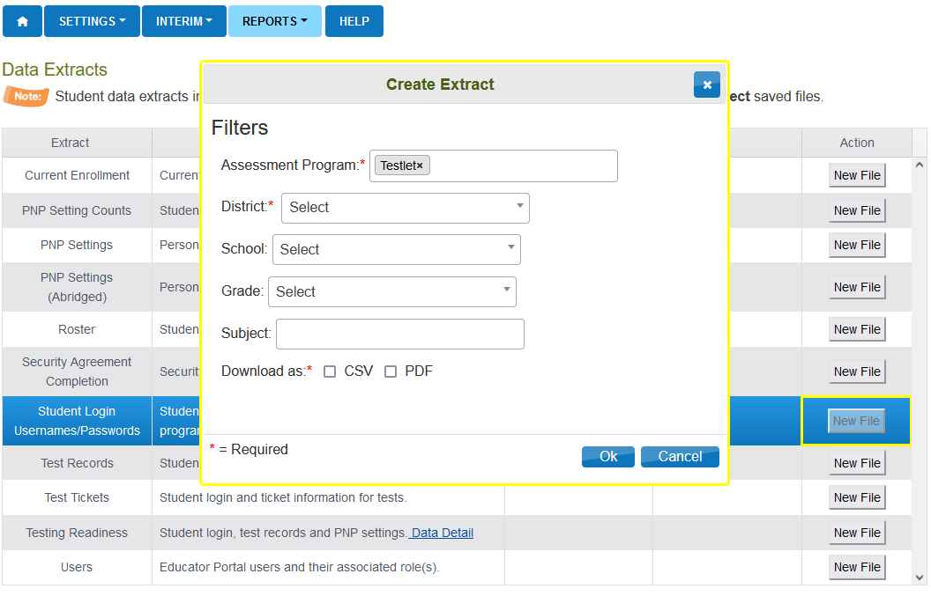
Retrieving Student Logins cont.
Extracts
Reports > Data Extracts > Student Login Username/Passwords
Select New File
Select Dropdowns and file type
Can be downloaded as a .csv or .pdf file
Notes:
Student Logins can also be available in an extract.
To download the extract to your computer, you can go to Reports > Data Extracts > Student Usernames and Passwords.
Once the extract request has processed, a CSV or PDF icon will appear in the row along with the date in which the extract was requested.
If you are downloading as a PDF, it will display with cut out marks. Up to 6 students will display on each page.
Student usernames and passwords will stay the same throughout testing.

Slide 34
Monitor Test Sessions
Notes:
Educator Portal offers the ability for some roles to monitor test sessions in real time. We’re going to take a look at how it works and it’s usefulness.

Slide 35
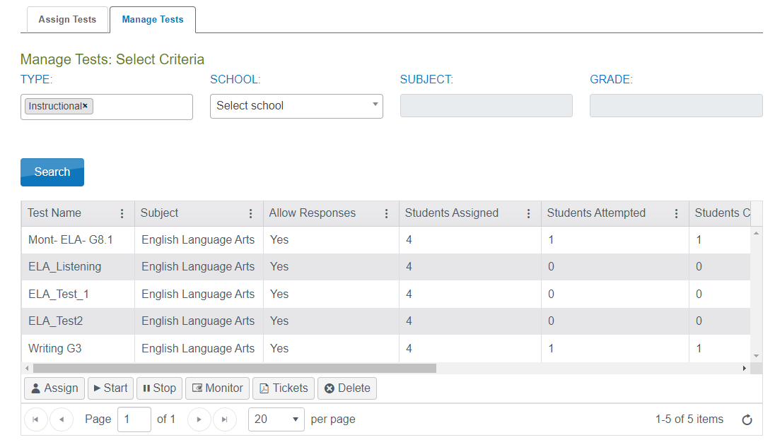
Monitoring Test Sessions
Interim Tab
My Tests > Manage Tests
Select the section to monitor
Click on the Monitor button
*not used for testlets
Notes:
When monitoring tests, you will be able to see which students have started the test and whether they have completed various sections of the test.
Monitoring interim testing can be done under the interim tab when going to Interim > My tests > Manage Tests > Select section to monitor > Click the Monitor located at the bottom the gird.

Slide 36
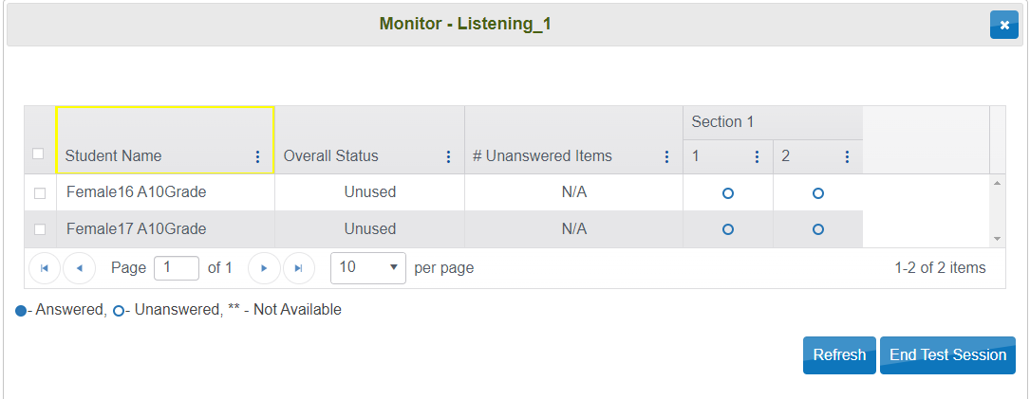
Monitoring Test Sessions Cont.
Understanding the Monitoring screen
Student Name
Lists every student who are assigned to the selected test
Overall Status of the session
Quickly view who hasn’t started, who are currently in the test, and who have completed the test
Notes:
On the Monitor Test Session overlay screen, it will list the students name and show the "Overall Status" which will indicate whether or not the student has started a test.

Slide 37
Monitoring Test Sessions Cont.
Number of unanswered questions
Answer legend
If there are any unanswered items, test administrators can see which specific item has not yet been answered for individual students.
Many test administrators will have the students wait to submit the test until they can confirm everything is answered.
Notes:
As we'll see in the next slide, test administrators can see the number of unanswered questions and the answer legend.
If there are any unanswered items, test administrators can see which specific item has not yet been answered for individual students.
Many educators will have students wait to submit the test until they can confirm everything is answered

Slide 38
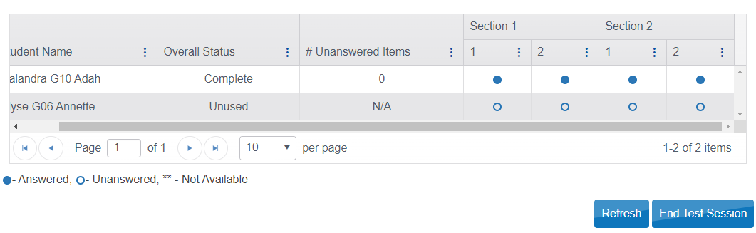
Monitoring Test Sessions Cont.
Notes:
As we view this monitoring session you can see the student name, Status, number of unanswered questions and then the status on a per question and per section basis. We’ll touch on the importance of status later. The image shows a complete status with zero unanswered questions. That student has then responded to every question in this test and has gone though the review process to finalize their answers. This is the most common status and outcome.
The student below has a status of unusued and progress is N/A. This status indicates the student has not began testing.
Make sure to check the legend at the bottom as it corresponds to the blue circles on each column. They represent individual questions. The test shown is ONE test that has TWO sections and each section has TWO items within. Filled is answered, hollow is unanswered.

Slide 39
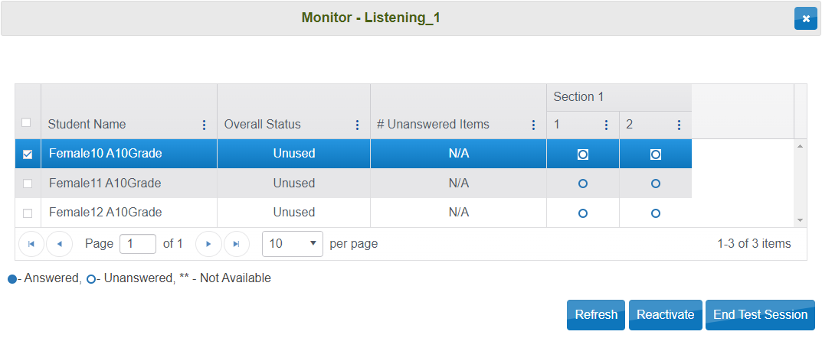
Monitoring Test Sessions Cont.
Different Questions and sections
Indicates the number of questions and the different sections the test may contain
End Test Session
Proctors can manually end the test session for students by clicking on the End Test session button.
Test Sessions can be ended for just 1 student, multiple students, or all students assigned to the test.
Reactivate Test Session
Please contact the Service Desk for Reactivation
Notes:
There will be breaks showing different sections to help you see where the student actually is or how far they have gotten.
We show here some of the button options in the bottom left. The Reactivate button and the End Test Session button. While the test will automatically end after the student completes it or after a set timeout period, it may become necessary to reactivate the test session. Only a “complete” status will be able to be reactivated. So it will often be needed to end the test session so that reactivation can be done.

Slide 40
Reporting
Notes:
We provide various levels and types of report on student progress as well as various other metrics.

Slide 41
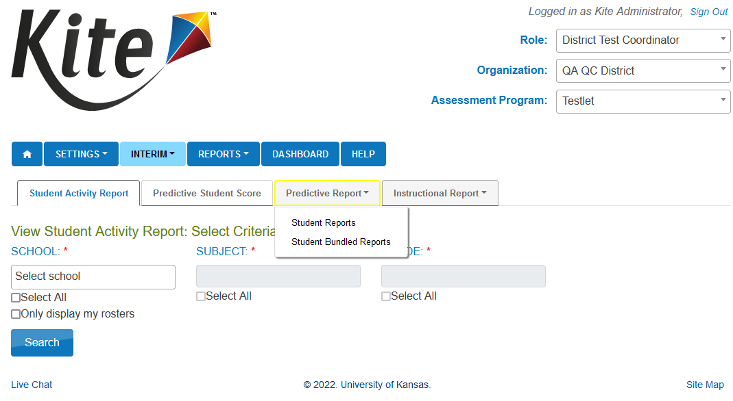
Reporting
Interim tab
Interim > View Results > Predictive Report
Student Reports
Student Bundled Report
Notes:
Inside the interim tab we have a section for showing the predictive reports associated with the predictive assessments. We allow individual student reports as well as an enhanced bundling function allowing higher level users to choose from various locations and criteria to pull data together in one report.

Slide 42
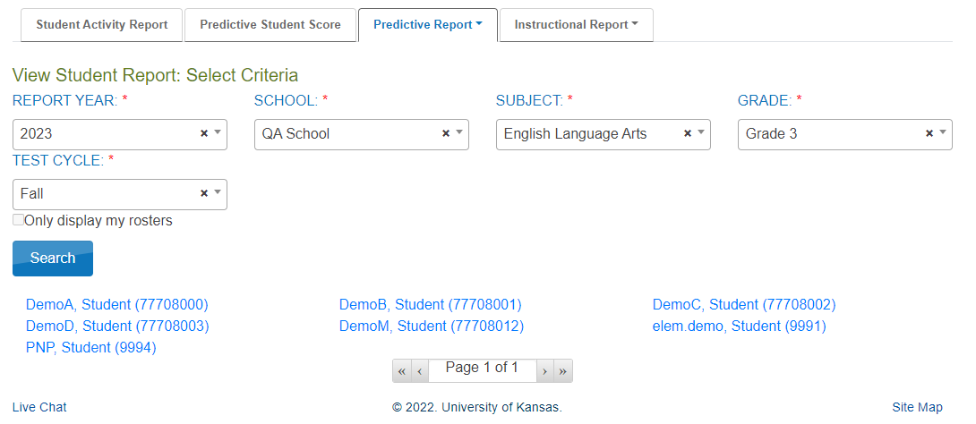
Reporting Cont.
Individual Student Report
Shows how the student did on each question
Select the dropdowns
Click on “Search”
Click on the hyperlink to generate report
Notes:
The Individual Student Report will give information only on the student that is associated with that report. You will use the process of dropdowns we’ve shown before in various other areas of Educator Portal to select criteria and narrow down the location of the student and testing season. You’ll be presented with all applicable students with reports. Clicking one of the student’s names provides the PDF copy of the student’s testing results, also based off of the criteria you select in the dropdowns.

Slide 43
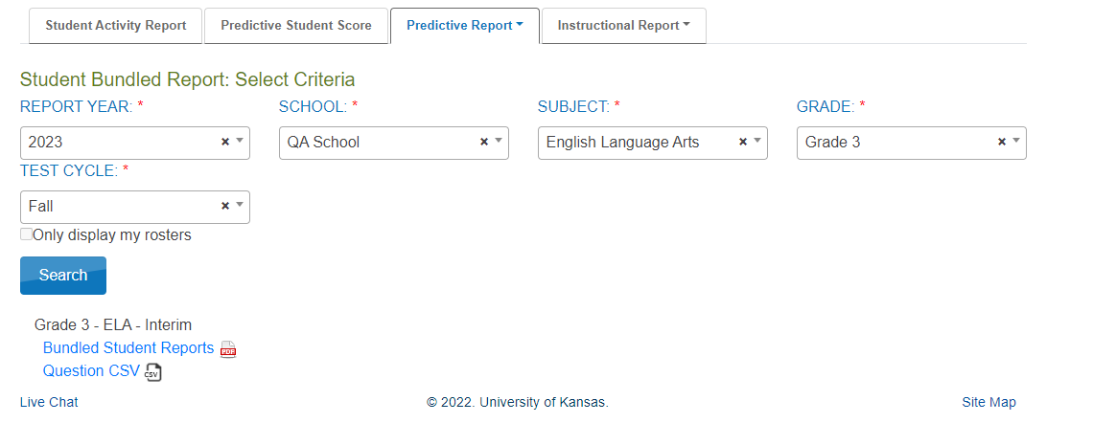
Reporting Cont.
Student Bundled Reports
Bundles all the reports either at the District or School level depending on your role and selection
Select the dropdowns
Click on “Search”
Click on the hyperlink to generate report
Notes:
Bundled reports are great for District and upper level Building or School roles. They allow those users to select similar criteria as the last slide to simply get a collection of the reports shown on the last slide.

Slide 44
Kite Student Portal Install
Notes:
Kite Student Portal is an application that must be installed for the students to take tests using our system. We provide applications, support and documentation for Pc, Mac, Chromebook and iPad.

Slide 45
Supported Operating System Versions
*The following devices and operating systems are supported:
ChromeOS 91+
iPadOS 14.3 - 15.5
macOS 11.1 – 12.0.1
Windows 8.1, 10 & 11
Mac and Windows
The current version is 10.0.0
iPad and Chromebook
Current version is 10.0.0 for Chromebooks and 10.0.0 for iPad
If enabled, Kite Student Portal will auto-update
*This is the current list but not the exhaustive list for the year. We work to verify updates while they are still in Beta so that when the stable release comes out, we can do a quick check that nothing is broken and update our supported list.
Notes:
Please remember this is not an absolute list for the school year. As updates are released for operating systems, we work quickly verifying things work as they should and have them added to the list as soon as they check out.
For the 22-23 school year, Kite Student Portal is currently on version 10.0.0

Slide 46
Installers
ChromeOS
Still to be determined
iPadOS
Available in the App Store
Can be installed individually or through MDM software
Mac
Available in .dmg
Can be pushed or installed on a single computer
Windows
Available in .exe and .msi
Can be pushed or installed on a single computer
Notes:
The install for Chromebooks is still to be determined.
For iPads the Testlet Kite Student Portal is available in the App Store to be downloaded. The app can be installed individually or push to the devices with MDM software.
For Mac the install is available as a .dmg and it can be installed individually or pushed to the devices.
Windows install is available as an .exe and .msi and it can be installed individually or pushed to the devices.

Slide 47
Install Links
Mac
https://files.kiteaai.org/installers/test/New%20Meridian/1.0.0/Testlet%20Kite%20Student%20Portal.dmg
Windows
.exe
https://files.kiteaai.org/installers/test/New%20Meridian/1.0.0/Testlet%20Kite%20Student%20Portal.exe
.msi
https://files.kiteaai.org/installers/test/New%20Meridian/1.0.0/Testlet%20Kite%20Student%20Portal.msi
Provide this to your Technology Director/IT Team to get the whitelisting and application installed
Notes:
Here are a list of the current installation links available for the Testlet Kite Student Portal application.

Slide 48
Kite Student Portal Navigation
Notes:
The Kite Suite captures telemetry data through Kite Student Portal including testing time, response time, and click histories.
Whenever the student starts and ends the test, the start and end times are captured and stored in our database. In addition, the test status is updated to in-progress or completed to reflect the student’s testing status. The student responses are saved to the database as the student answers the question and navigates to the next question. This ensures all the student responses are saved to the database. The student login and click history information is captured and stored onto S3 periodically without affecting the performance or student experience in taking the test.

Slide 49
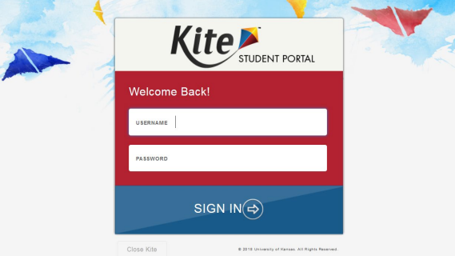
Introduction to Student Portal
Student Portal Login
Enter Username
Enter Password
Sign In
Notes:
Students will launch the Testlet Kite Student Portal on their testing device. Enter the username and password that the test administrator got from Educator Portal and click sign in.
This will bring the student to the Student Portal Landing page where they will select Take a test to begin testing.

Slide 50
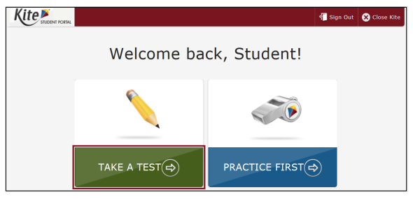
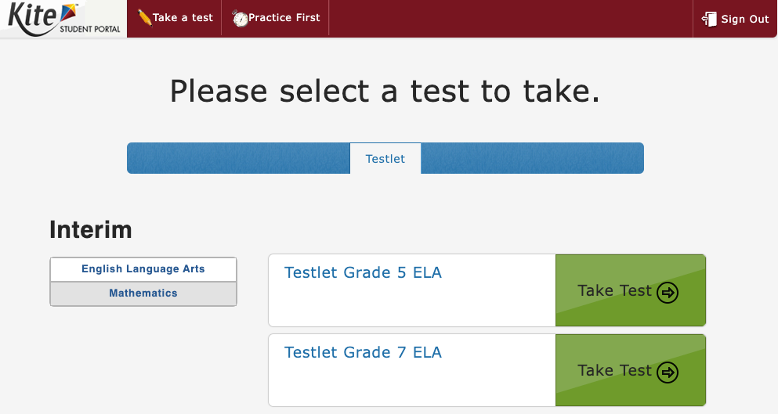
Student Portal landing page​
Take a Test​
Practice First​
Sign out​
Close Kite​
Notes:
The App is easy to use and provides the user with options to take a test, practice first, sign out which will take you back to that login page noted on the previous slide or to “close” Kite which will close the app and return you to your normal desktop environment.
If a student has multiple tests, they will show. If a student has tests available from different testing subjects or programs they will also show.

Slide 51
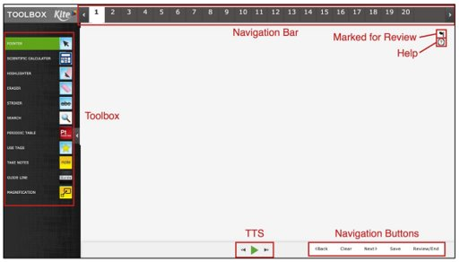
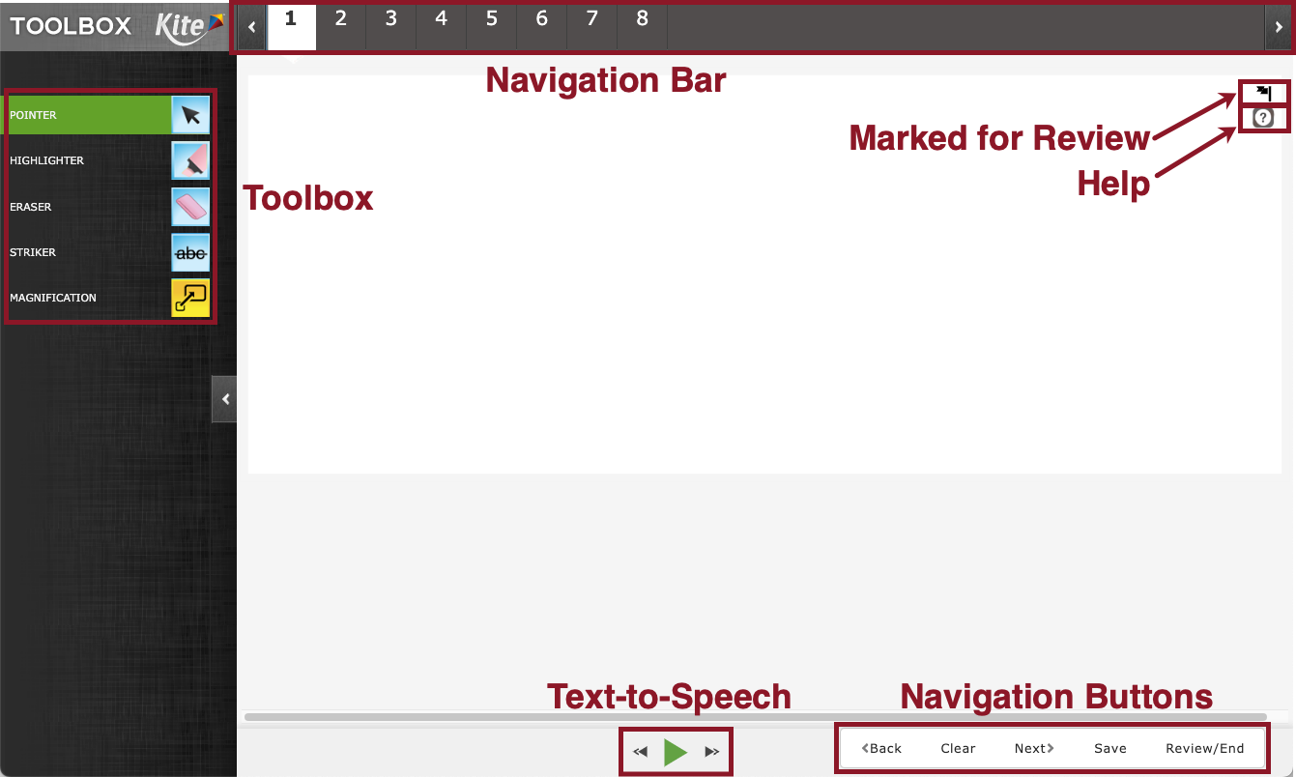
Student Portal Navigation
Test Features and functionality
Toolbox
TTS (Text to Speech)
Help Icon
Flag Questions
Test Navigation
Click on the “Back” and "Next” buttons
Can also choose specific questions with the numbers along the top
Clear will clear the answer that was selected
Save will save the Testlet to be continued later
Notes:
There are various tool within Student Portal these are found with the Tool box on the left side of the screen.
If TTS is set within the PNP profile the play and forward and back controls will be available at the bottom of the screen.
In the upper right corner there is the help icon that will provide the student guidance on how to answer the question. There is also the flag icon to mark items for review.
In the bottom left there are the navigation buttons to move through the test. Additionally, the navigation bar at the top of the screen allows a specific question to be selected and the student is then brought to that question.

Slide 52
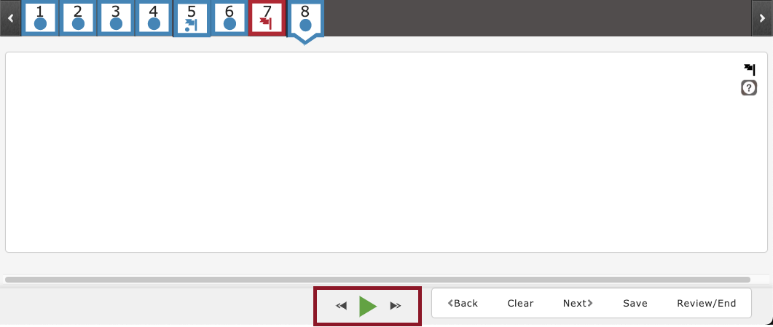
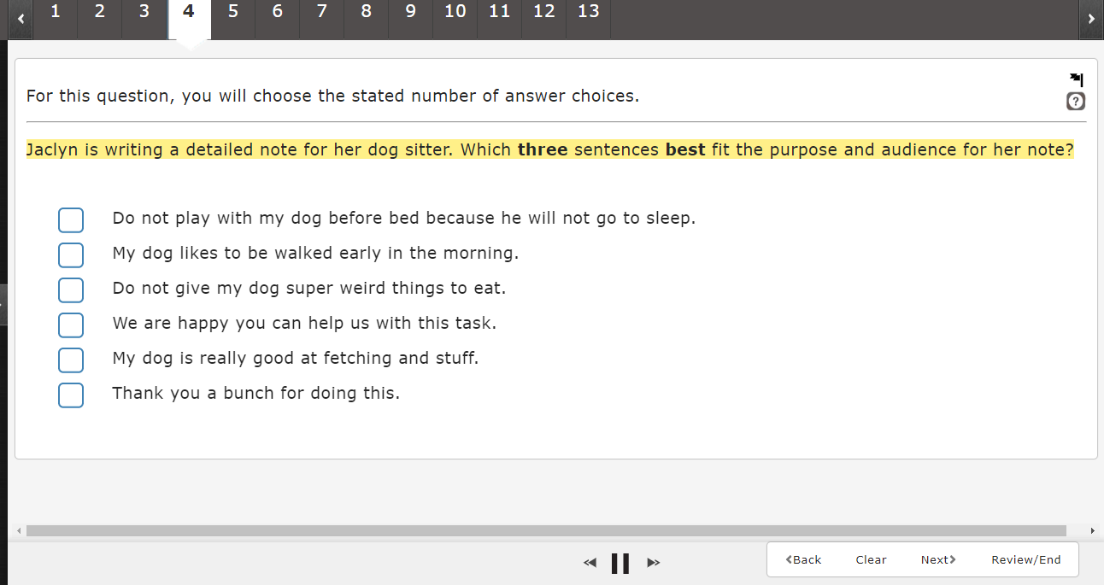
Student Portal Navigation Cont.
TTS (Text to Speech)
Student can select the play button to start the TTS and the pause button to stop the TTS.
The next and back buttons on either side of the play will advance the TTS to the next section of the question.
As the text is read it is highlighted yellow.
Note: Screenshot from practice test.
Notes:
The Test to Speech accommodation is powerful for the students that need it. The user is able to simply press the green play button at the bottom center of the screen to being playing audio. The buttons on either side allow the use to skip ahead or reply sentences or sections.
The text will highlight in yellow to show what is being read. Again, typically sentences or portions depending on the question type.

Slide 53
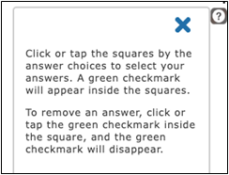
Student Portal Navigation Cont.
Help button
Displays additional information about how to manipulate and respond to the particular question type.
Does not cover content.
Close the help box with the X to continue answering the question.
Notes:
The help button displays additional information about how to manipulate and respond to the particular question type, although this does not cover the content itself.
To exit out of the help window, students can select the 'X' in the top right.

Slide 54
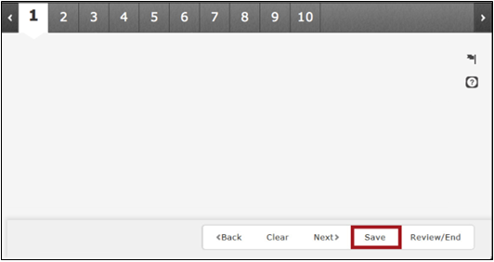
Student Portal Navigation Cont.
Save button
The save button will save the Testlet and all of the work that has been completed
After clicking save the student will receive a pop up to confirm that they are saving the Testlet and not submitting
Notes:
The save button will save the Testlet and all of the work that has been completed
This is useful if the session needs to be interrupted at any point. Students can pick up where they left off once they get back into the test.

Slide 55
Student Portal Navigation Cont.
Blue dot: question has been answered
Red box: questions has not been answered
Blue dot and blue flag: question has been answered and has been marked for review
Red flag: question has not been answered and has been marked for review
Notes:
During a test, the student will have tools to track if they need to come back to a question. We provide a system of flagging. Answered questions will have a blue dot. Unanswered questions get a red box at the end or in this view of the header they would be shown simply without any color or dot.
The student can then flag the question using the flag icon in the top right of the screen on every question. Flagging a question that has been answered will provide a blue flag icon as shown in the image for item 7. Item 10 on the other hand shows a flagged item that has not yet been answered.
At the end of the test session the student will be provided a review of their work and each question will have a similar box system to allow the student to visualize where they may want to return to before ending the test fully.

Slide 56
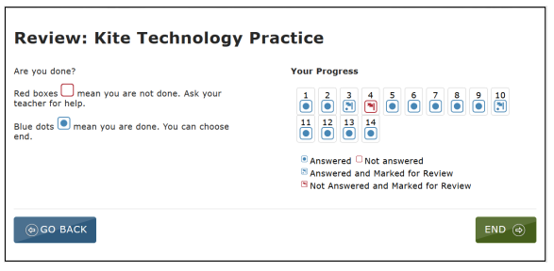
Student Portal Navigation
Ending Test Session
Review and End Page
Answered vs Unanswered
Flagged Items
Once students have reviewed their answers, they will click on the “End" button
Confirm screen to end the session
Taken back to the landing page
Notes:
When the student has completed testing they are brought to the Review and End Page. This allows the student to view which questions have been left un answered, which have been flagged and which questions have been answered and not marked for review. Students can select the number in the "Your Progress" section and they will be brought back to that question to review or answer the question.
Once the student has reviewed their answers they will click on the "End" button, they will receive a confirmation screen that they are ending the test and once confirmed the student will be taken back to the landing page.

Slide 57
Student Portal Navigation Cont.
Log out and closing of Student Portal.
Varies depending on the testing platform
PC, Macs, iPads
Once the test session has been ended, select and then the button or just click the Sign Out button
Chromebook
Reboot the device
Notes:
Once testing is completed students will log out and close Student Portal. This process looks slightly different depending on device. On PC, Macs and iPads, once the test session have been ended select the signout and then choose the close Kite button or just click the Sign out button.
On Chromebook reboot the device by holding down the power button. This will exit the student portal application.

Slide 58
Student Portal Navigation Cont.
Test Interruptions
Internet connection issues
Should the internet connection drop during testing, progress will automatically be saved.
Student Portal may lock up if it detects no internet connection and the device might need to be restarted.
Testing can resume once a connection has been re-established.
Notes:
If the internet connection were to drop during testing, the progress will automatically be saved and when the student logs back into Student Portal the student will be able to continue testing where they left off.
Student Portal may also lock up on a loading screen if the application detects that there is no internet connection. The device may need to be restarted to exit the loading screen and testing can resume once the connection has been re-established.

Slide 59
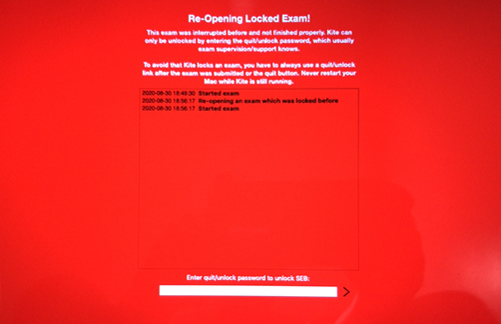
Student Portal Navigation Cont.
Quit Password
If Student Portal is not closed out properly, or if there is no internet connection upon launching the application, users might encounter a screen asking for a Quit Password to unlock the device.
Users with an account in Educator Portal will need to contact the Kite Service Desk in order to obtain the password.
Notes:
Should Kite Student Portal lock up or display an error message on any device, you may need to quit the application by entering Ctrl+Q and entering the quit password.
This can happen when student portal is not closed out properly or if there is no internet connection upon launching the application. To obtain the most current quit password, please call the Kite Service Desk

Slide 60
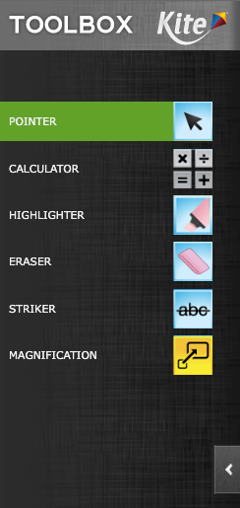
Tool Box
Pointer
Calculator (Grade 7 Math)
Basic
Highlighter
Eraser
Striker
Guideline
Magnification
Select within the PNP to have available in Student Portal
Color Overlays
Color Contrast
Masking
Reverse Contrast
Notes:
Here is a list of the tools that may be available in the toolbox within Student Portal. This will depend on what test the student is being given, and if the accommodation was added in the PNP profile settings for the student.

Slide 61
Tool Box Cont.
Pointer
The Pointer tool is the tool that the students will use most.
This tools allows a student to select items and click to answer questions
Notes:
The Pointer tool is the tool that the students will use most. This tools allows a student to select items and click to answer questions.

Slide 62
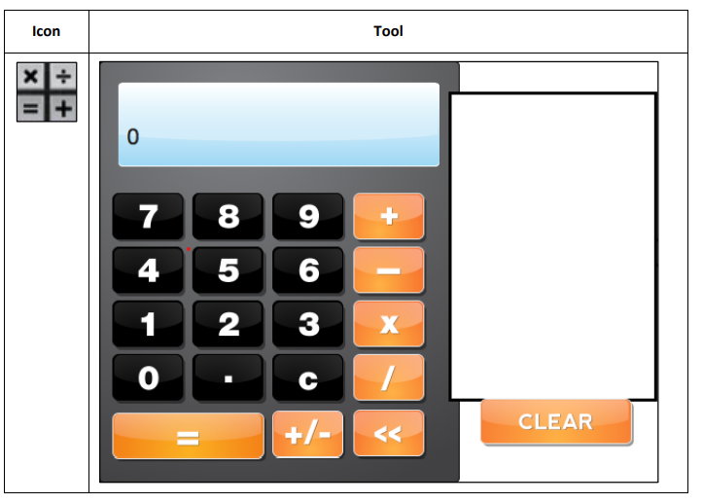
Tool Box Cont.
Basic Calculator
Available for Grade 7 Math
The basic calculator tool allows students to perform simple mathematical calculations
Notes:
The basic calculator tool allows students to perform simple mathematical calculations.

Slide 63
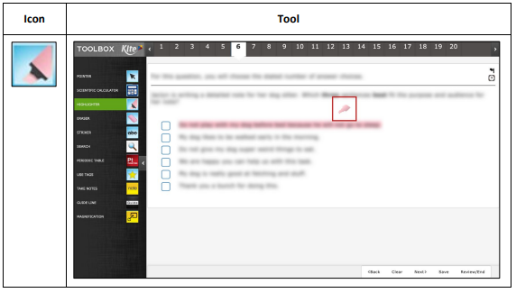
Tool Box Cont.
Highlighter
The highlighter tool allows a student to select and highlight text within the question.
The student can drag the highlight a word or area.
This tool changes the cursor to a pink highlighter.
Notes:
The highlighter tool allows a student to select and highlight text within the question or answer.
The student can drag the tool to highlight a word or section of text.
This tool changes the cursor to a pink highlighter.

Slide 64
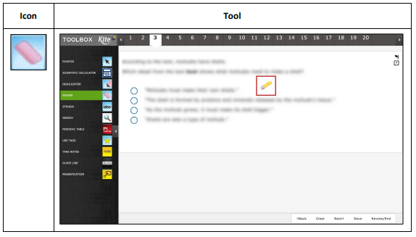
Tool Box Cont.
Eraser
The eraser tool allows the student to remove highlighter and strikethrough effects from the selected text.
To switch off from using the eraser, click the eraser icon or the pointer tool.
This tool changes the cursor from an arrow or marker to pencil.
Notes:
The eraser tool allows the student to remove highlighter and strikethrough effects from the selected text.
To switch off from using the eraser, click the eraser icon or the pointer tool.
This tool changes the cursor from an arrow or marker to pencil.

Slide 65
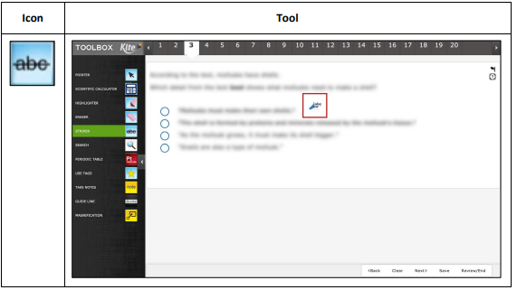
Tool Box Cont.
Striker
The striker tool allows a student to select a multiple choice or muti select answer choice and mark a line through the middle of the text to cross it out.
The striker tool changes the cursor from an arrow to a blue marker.
Notes:
The striker tool allows a student to select a multiple choice or muti select answer choice and mark a line through the middle of the text to cross it out.
The striker tool changes the cursor from an arrow to a blue marker.
Clicking again will “un-strike” the item, or if the student uses the pointer to select it, it will also become un-stricken.

Slide 66
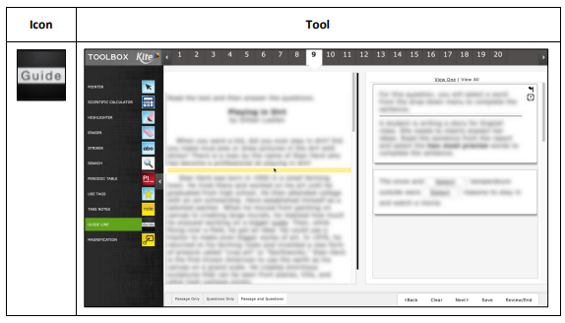
Tool Box Cont.
Guideline
The guideline tool displays a yellow line that the student can move horizontally through a text passage.
To switch off from using the guideline, click the guideline icon or the pointer in the tool bar
This tool changes the cursor from an arrow to a yellow line
iPad has a dragger icon to move the guideline
Notes:
The guideline tool displays a yellow line that the student can move horizontally through a text passage.
To switch off from using the guideline, click the guideline icon or the pointer in the tool bar
This tool changes the cursor from an arrow to a yellow line

Slide 67
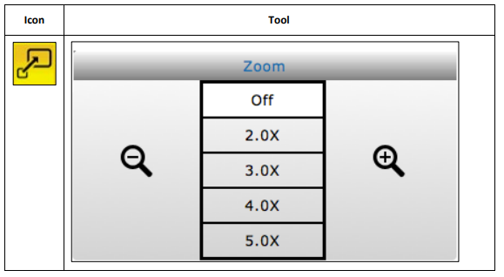
Tool Box Cont.
Magnification
The magnification tool allows a student to enlarge the screen during the test.
Students can click on a magnification level or use the magnifying glass to zoom in and out.
Notes:
The magnification tool allows a student to enlarge the screen during the test.
Students can click on a magnification level or use the magnifying glass to zoom in and out.

Slide 68
Tool Box Cont.
Color Overlay
The color overlay tool allows a student to change the background color of the test.
The standard background color is white.
Notes:
The color overlay tool allows a student to change the background color of the test.
The standard background color is white.

Slide 69
Tool Box Cont.
Color Contrast
The color contrast tool allows a student to change the color of the assessment font and the background color.
The upper (left) portion of the circle indicates the text color and the lower (right) portion of the circle indicated background color.
Notes:
The color contrast tool allows a student to change the color of the assessment font and the background color.
The upper (left) portion of the circle indicates the text color and the lower (right) portion of the circle indicated background color.

Slide 70
Tool Box Cont.
Reverse Contrast
The reverse contrast tool allows a student to change the assessment back ground to black and the text to white.
Notes:
The reverse contrast tool allows a student to change the assessment back ground to black and the text to white.

Slide 71
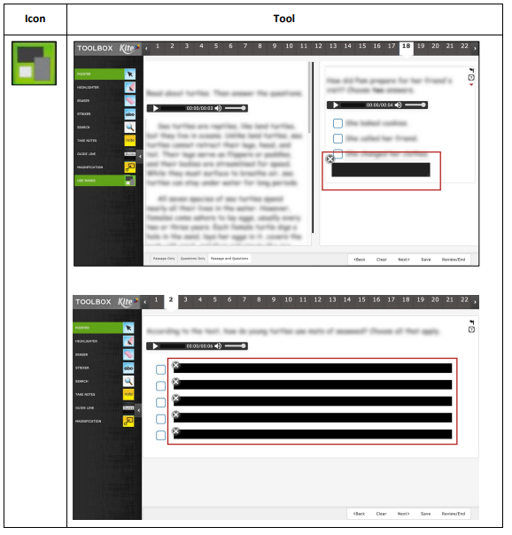
Tool Box Cont.
Masking
The masking tool allows a student to mask, or cover part of the test.
After a student clicks the making button, a black box appears on the screen and the student can move the masking box by dragging it to different areas of the screen.
Notes:
The masking tool allows a student to mask, or cover part of the test.
After a student clicks the making button, a black box appears on the screen and the student can move the masking box by dragging it to different areas of the screen.

Slide 72
Any Questions?
Notes:
Please feel free to ask any questions you have.

Slide 73
Contact
Kite Service Desk
855-277-9752 7:30 a.m. – 5:00 p.m. Central
7:30 a.m. – 5:30 p.m. Central (During Assessment Window)
Kite-support@ku.edu
Notes:
If you think of any question after this training please contact the service desk at the contact information on this slide. Please take note of the Service Desk hours and that they are extended to 5:30pm during the assessment window.

