Slide 1
Interactive Reports Training
2025-2026 School Year
Notes:
Welcome everyone, and thank you for joining us for the Interactive Reports Training. Today we're going to walk through how to access and navigate the interactive reports available in Waypoint for the 2025-2026 school year. This should take about 20 minutes, and we'll have time for questions at the end. Let's get started!

Slide 2
What is Waypoint?
Waypoint Educator is the online platform used to schedule and report on MAST testlet assessments
It includes tools for scheduling testlets, managing users, and accessing interactive reports
Interactive Reporting gives educators earlier access to student performance data at multiple levels
Reports are available for Math and ELA across four levels: Student, Classroom, School, and District
Access Waypoint at newmeridian.io
Notes:
Let me start with a quick overview of what Waypoint is for anyone who may be new to it. Waypoint Educator is the online platform where MAST testlet assessments are administered and reported. It handles everything from scheduling testlets and managing user accounts to the interactive reporting features we will be focusing on today. Interactive Reporting gives you earlier access to student performance data at multiple levels -- student, classroom, school, and district -- for both Math and ELA. You access everything through newmeridian.io, which we will walk through shortly.

Slide 3
Waypoint Interactive Reporting
Data Availability
  Provisional data will generally be available on Mondays by 12:00
  Final data will be available on Tuesdays by 4:00
Interactive reports display the same information as PDF reports, with the added ability to sort, filter, and drill down into results
Results are most effective when used alongside classroom observations, formative assessments, and professional judgment
Notes:
Now that you know what Waypoint is, let me cover a few specifics about how interactive reporting works. Provisional data will generally be available on Mondays by noon, and final data will be available on Tuesdays by four. The interactive reports display the same content as the downloadable PDF reports, but with the added ability to sort, filter, and drill down into results directly within the platform. These reports are most effective when used alongside other instructional evidence such as classroom observations and formative assessments.

Slide 4
Platform Basics
Before You Begin
Required Software
Logging In
Passwords & Unlock User Account
Supported OS:
  Windows 11, ChromeOS
Supported Browsers:
  Chrome, Edge, Firefox
Additional:
  Active internet connection
  JavaScript enabled
  1024x768+ screen resolution
Go to newmeridian.io
Enter email and password
Click 'Log In'
Forgot password?
Click 'Forgot Your Password' on the login page
Need help?
Email: help@newmeridian.org
Passwords
  At least 8 characters
  Mix of uppercase, lowercase, numbers, and special characters
Unlock User Account
  Newmeridian.io login page
  Click 'Forgot Your Password'
Notes:
Before accessing reports, please ensure your system meets these requirements. The platform supports Windows 11 and ChromeOS, and is compatible with Chrome, Edge, and Firefox. You will also need an active internet connection, JavaScript enabled, and a screen resolution of 1024x768 or higher. To log in, navigate to newmeridian.io, enter your email and password, and click Log In. Passwords must be at least 8 characters and include a mix of uppercase and lowercase letters, numbers, and special characters. If you forget your password, click "Forgot Your Password" on the login page to receive a reset code via email. If your account becomes locked, contact support at help@newmeridian.org.

Slide 5

Newmeridian.io
Access to Waypoint Educator
Notes:
This is the login page at newmeridian.io. Enter your credentials here to access Waypoint. Once logged in, you will land on your dashboard, where you can navigate to the reporting features.

Slide 6
User Roles and Report Access
Who Can See What
Report Type | Teachers | School Coordinators | District Coordinators
Student Reports | ✔ | ✔ | ✔
Classroom Reports | ✔ | ✔ | ✔
School Reports |  | ✔ | ✔
District Reports |  |  | ✔
Notes:
Report access is determined by your assigned role. Teachers can access Student and Classroom Reports for their own classrooms. School Coordinators can additionally access School Reports. District Coordinators have access to all four report types across the district. All users can only view reports for students, classrooms, and schools within their assigned scope.

Slide 7
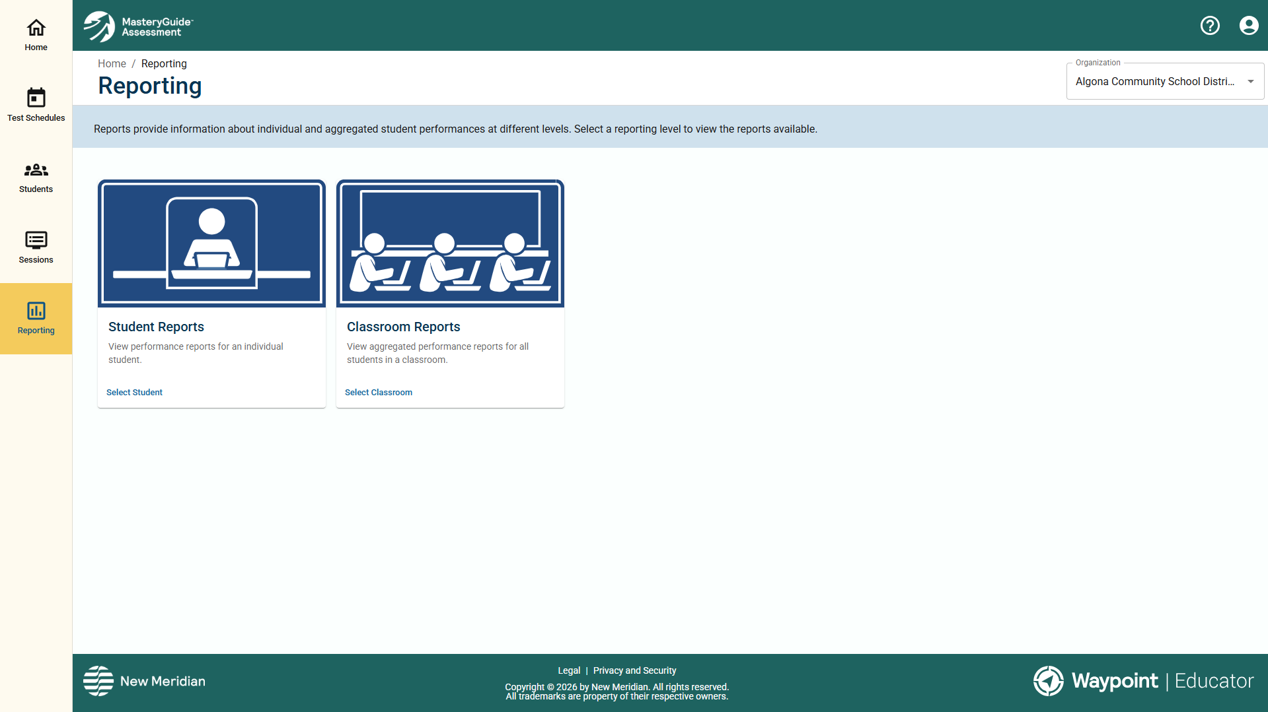
Report Types Overview
Four Levels of Reporting
Student Reports – Performance data for an individual student.
  Teachers can view reports only for students assigned to their classrooms.
  School and district coordinators can view reports for students within their organizations.
Classroom Reports – Aggregated performance data for a classroom.
  Available to teachers for their own classrooms and to school and district coordinators for classrooms within their organizations.
School Reports – Aggregated performance data for a school.
  Available to school coordinators and district coordinators.
District Reports – Aggregated performance data across an entire district.
  Available only to district coordinators.
Notes:
There are four levels of reporting. Student Reports show individual student performance on a specific testlet. Classroom Reports aggregate performance for an entire classroom. School Reports aggregate performance at the school level and are available to school and district coordinators. District Reports provide performance data across the entire district and are available only to district coordinators. Reports are available for both Math and ELA.

Slide 8
Understanding Your Results
Performance Levels, Standards, and Clusters
Performance Levels
  Levels are standards-referenced to the end-of-year proficiency requirements
    Level 3: Performance consistent with grade-level expectations for proficiency
    Level 2: Approaching proficiency, not yet fully meeting grade-level expectations
    Level 1: Performance below grade-level expectations for proficiency
  Because testlets vary in difficulty, the number of items needed to reach Level 2 or Level 3 may differ from one testlet to another
Math Reports include standards-level data and misconceptions (common errors based on response patterns)
ELA Reports include cluster-level data (groups of related standards) and performance task writing scores
Reports are a snapshot and should be used alongside classroom observations, formative assessments, and professional judgment
For detailed guidance, refer to the Testlet Report Interpretation Guides
Notes:
Before we look at the individual reports, I want to briefly cover what you will see in the results. Every report categorizes student performance into three levels. Level 3 means performance is consistent with grade-level expectations. Level 2 means the student is approaching but not yet meeting expectations. Level 1 means performance is below grade-level expectations. These levels are standards-referenced, meaning they are based on the specific content assessed in each testlet. One important thing to keep in mind is that testlets vary in difficulty depending on the standards they cover. Because of that, the number of items a student needs to answer correctly to reach Level 2 or Level 3 may differ from one testlet to another. So you should avoid comparing raw scores across testlets and instead focus on the performance level itself. For Math reports, you will also see standards-level data showing how students performed on each assessed standard, and misconceptions, which are common errors identified from patterns in incorrect responses. For ELA reports, performance is broken down by clusters, which are groups of related standards like Key Ideas and Details or Craft and Structure. ELA Performance Task reports also include scores across three writing dimensions. Keep in mind that these reports provide a snapshot, not a complete picture. They are most useful when considered alongside your own classroom observations, formative assessments, and professional judgment. For more detailed guidance on interpreting each report type, refer to the Testlet Report Interpretation Guides listed in your available resources.

Slide 9

Accessing Reports
Getting to the Reporting Main Page
From the left-hand navigation menu, click Reporting
The Reporting main page displays report tiles based on your role
Select the report type you want to view
If a report type is not visible, it is not available for your role
Notes:
To access reports, select Reporting from the left-hand navigation menu. The Reporting main page displays tiles for each report type available to your role. Select the report type you wish to view. If a report type is not visible on this page, it is not available for your role.

Slide 10
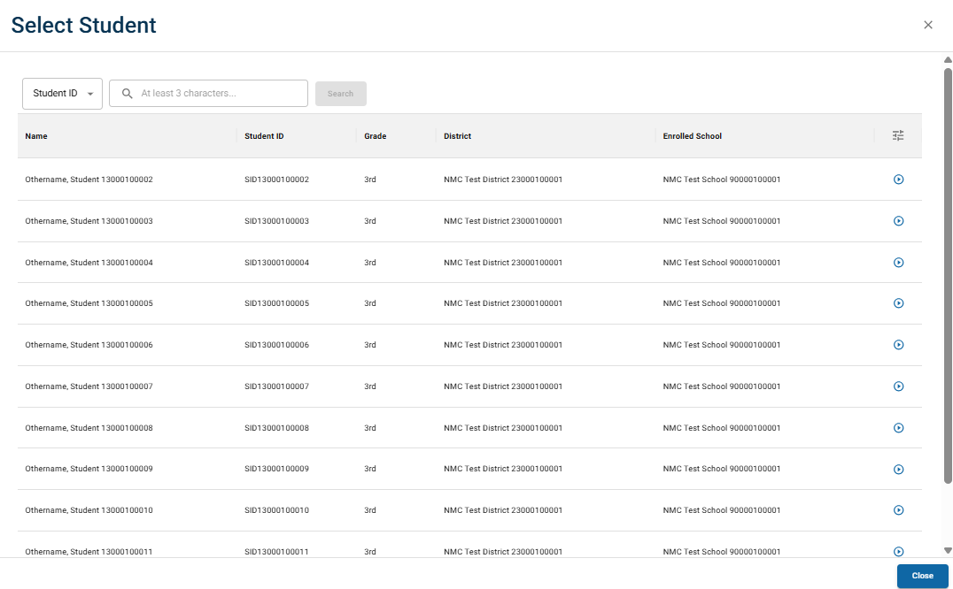
Student Reports
Accessing and Navigating
Click Reporting on the main navigation menu
Select Student Reports
Search for the student (enter at least 3 characters)
Select the arrow icon next to the student's name
Select the testlet you want to view
Notes:
To view a Student Report, select Reporting, then Student Reports. Search for the student by entering at least three characters of their name or ID, then click the arrow icon next to their name. Select the testlet you wish to view. The report displays the student's performance level, standards or clusters assessed, misconceptions identified (Math only), and question-level details.

Slide 11
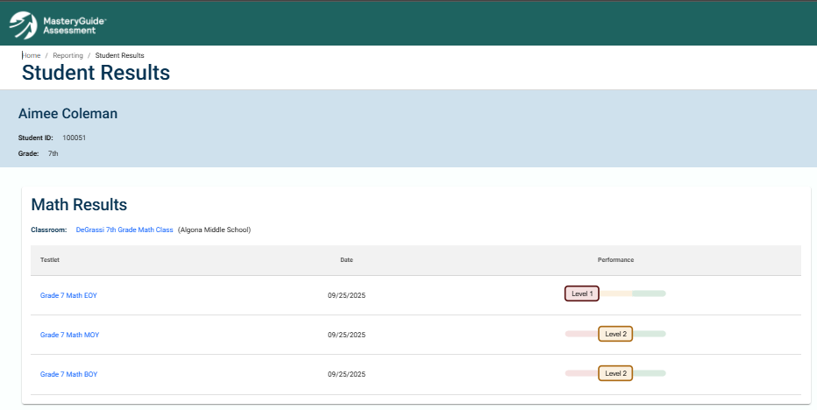
Student Reports
Accessing and Navigating
Notes:
Here is what the Student Results page looks like once you have selected a student. You can see the student’s name, ID, and grade at the top, along with their classroom assignment. Below that, the Math Results section lists each testlet the student has taken, the date it was administered, and the student’s performance level for that testlet. You can click on any testlet name to drill into the detailed report, which we will look at on the next slide.

Slide 12
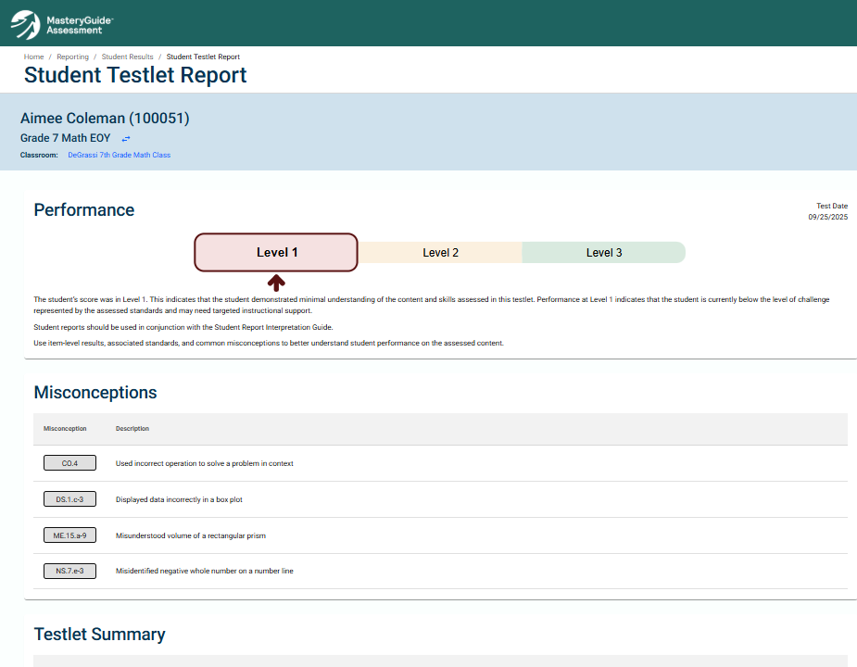
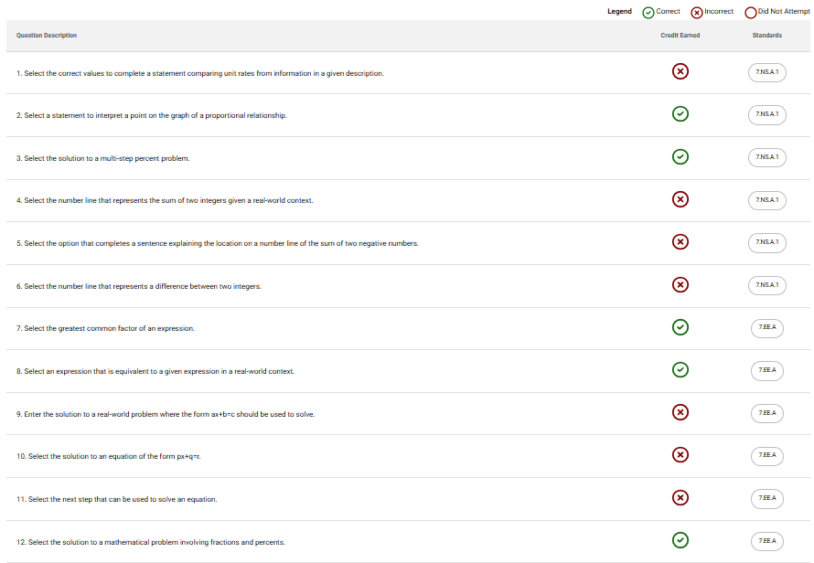
Student Reports
Accessing and Navigating
Notes:
When you click into a specific testlet, this is the detailed Student Testlet Report. At the top, you see the performance level indicator showing where the student falls across Levels 1, 2, and 3. Below that is the Misconceptions section, which is available for Math reports. This shows common error patterns identified from the student’s incorrect responses, with a code and description for each. Further down, the Testlet Summary provides question-level detail, showing whether each item was answered correctly, incorrectly, or not attempted, along with the associated state standard. This level of detail can help you pinpoint exactly where a student may need additional support.

Slide 13
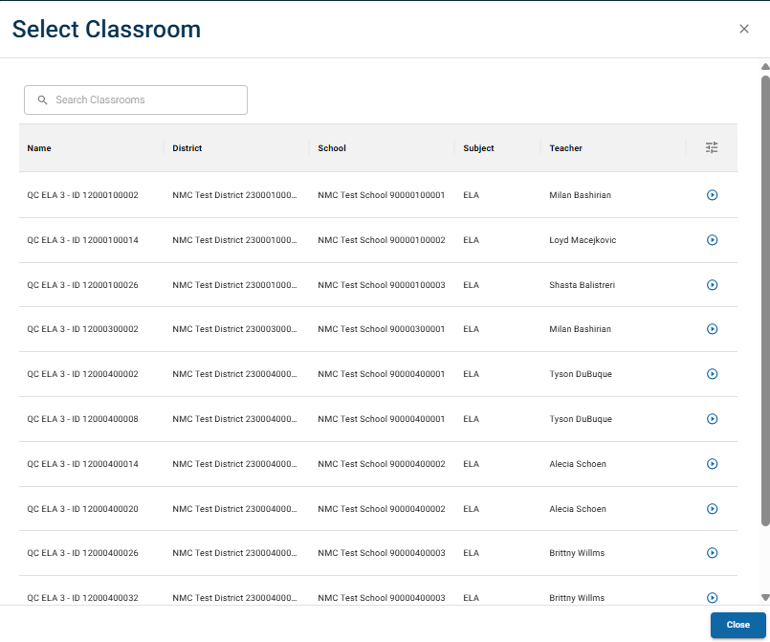
Classroom Reports
Accessing and Navigating
Click Reporting on the main navigation menu
Select Classroom Reports
Locate and select the classroom
Select the arrow icon next to the classroom name
Select the testlet you want to view
Notes:
To view a Classroom Report, select Reporting, then Classroom Reports. Locate the classroom, click the arrow icon, and select the testlet. The report provides a performance level summary, average performance by standard or cluster, individual student performance levels, and common misconceptions for Math reports.

Slide 14
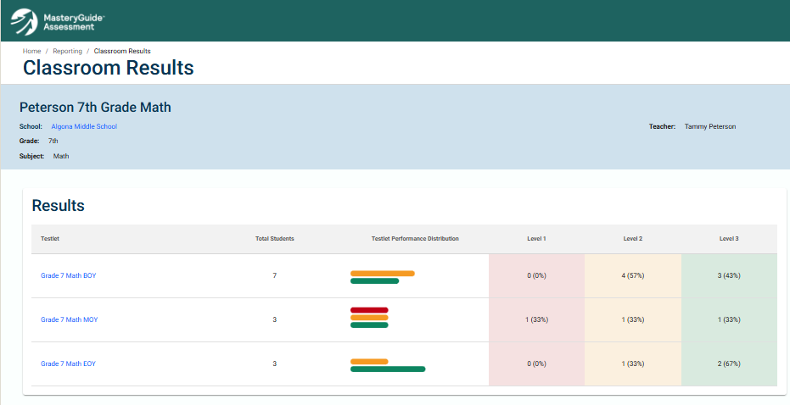
Classroom Reports
Accessing and Navigating
Notes:
Here is the Classroom Results page. Once you have selected a classroom and subject, you see a table listing each testlet that has been administered, the total number of students who took it, a visual performance distribution bar, and the count and percentage of students at each performance level. This gives you a quick overview of how the class performed across testlets. Click on a testlet name to drill into the detailed Classroom Testlet Report, which we will look at next.

Slide 15
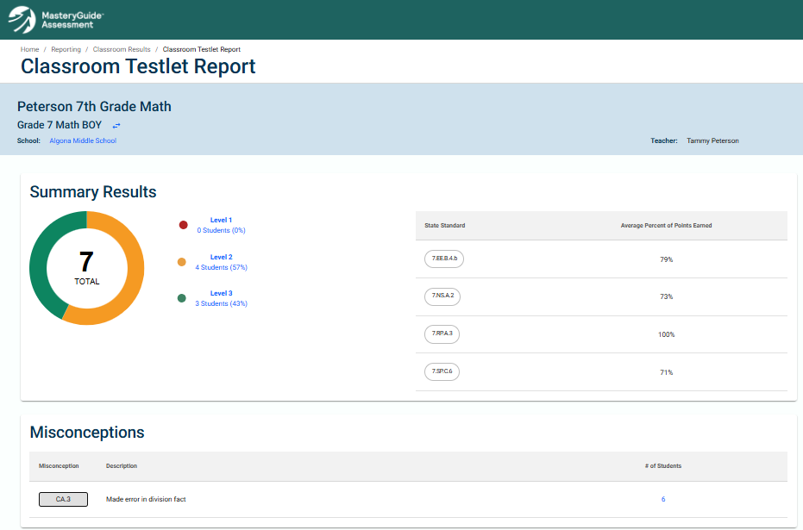
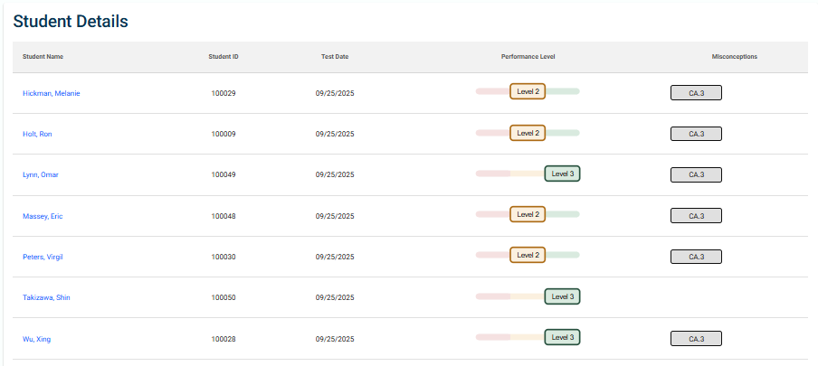
Classroom Reports
Accessing and Navigating
Notes:
This is the detailed Classroom Testlet Report. On the left, you see the Summary Results displayed as a donut chart, showing the number and percentage of students at each performance level. On the right, the report shows the state standards assessed in this testlet along with the average percent of points earned by the class on each standard. This can help you identify which standards your students are strongest in and where they may need more support. Below that is the Misconceptions section, which for Math reports lists common error patterns and how many students exhibited each one. You can click the number in the student count column to filter the Student Details table to just those students. The Student Details table at the bottom lists each student individually with their performance level and any misconceptions identified.

Slide 16
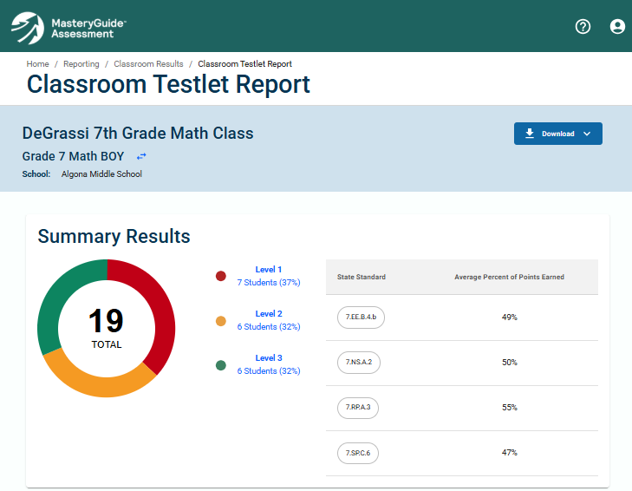
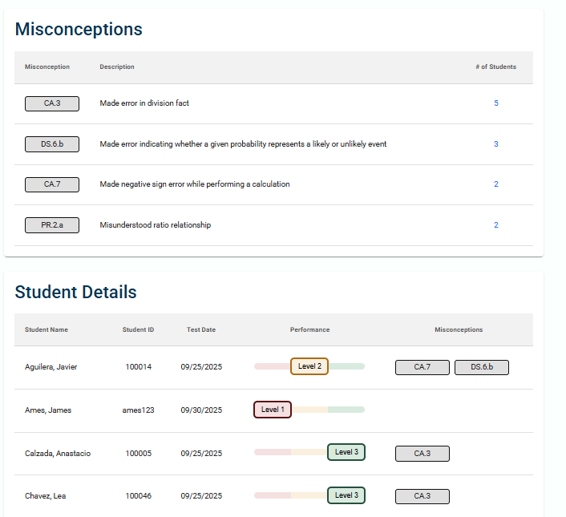
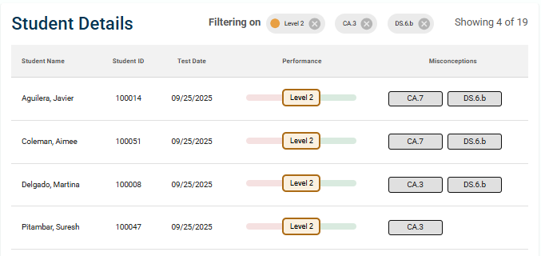
Grouping Students
Filtering in Classroom Reports
By Performance Level
  Click one or more performance levels (Level 1, 2, and/or 3) in the Summary Results section
  The Student Details table updates to show only those students
By Misconception (Math Only)
  Click the number in the '# of Students' column for a misconception
  Combine with performance level filters for targeted grouping
Removing Filters
  Click the X next to any active filter above the Student Details table to remove it.
Notes:
Classroom Reports include the ability to group students for targeted analysis. To group by performance level, click one or more levels in the Summary Results section. For Math reports, you can also group by misconception by clicking the student count next to a misconception. These filters can be combined. Active filters appear above the Student Details table and can be removed by clicking the X next to each filter.

Slide 17
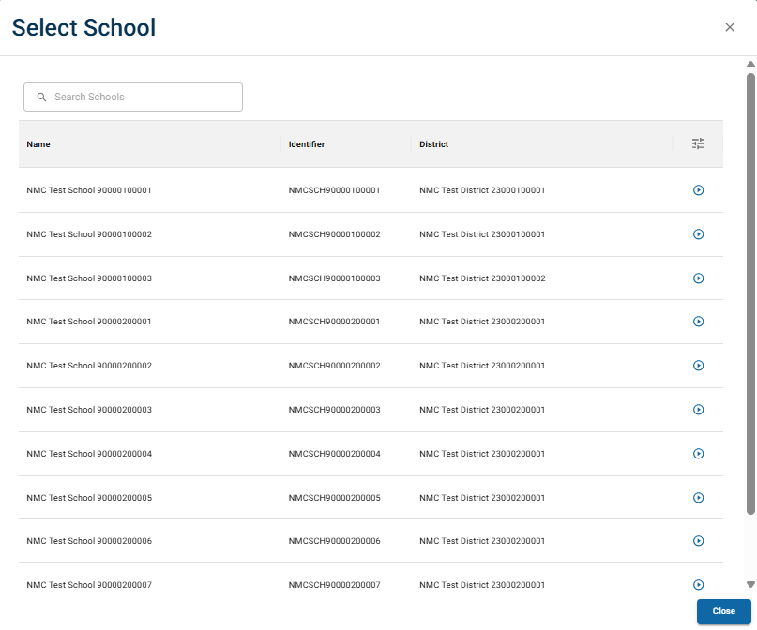
School Reports
Accessing and Navigating
Click Reporting, then locate the School Reports tile
Click Select School, then choose your school
Select the subject tab (Math or ELA)
Review grades and testlets with available results
Select the testlet you want to view
Notes:
To view a School Report, select Reporting, then School Reports. Click Select School, choose your school, and select the subject tab. Review the available grades and testlets, and select the one you wish to view. The report includes a performance level summary, average performance by standard, misconceptions for Math, and a breakdown of results by classroom.

Slide 18
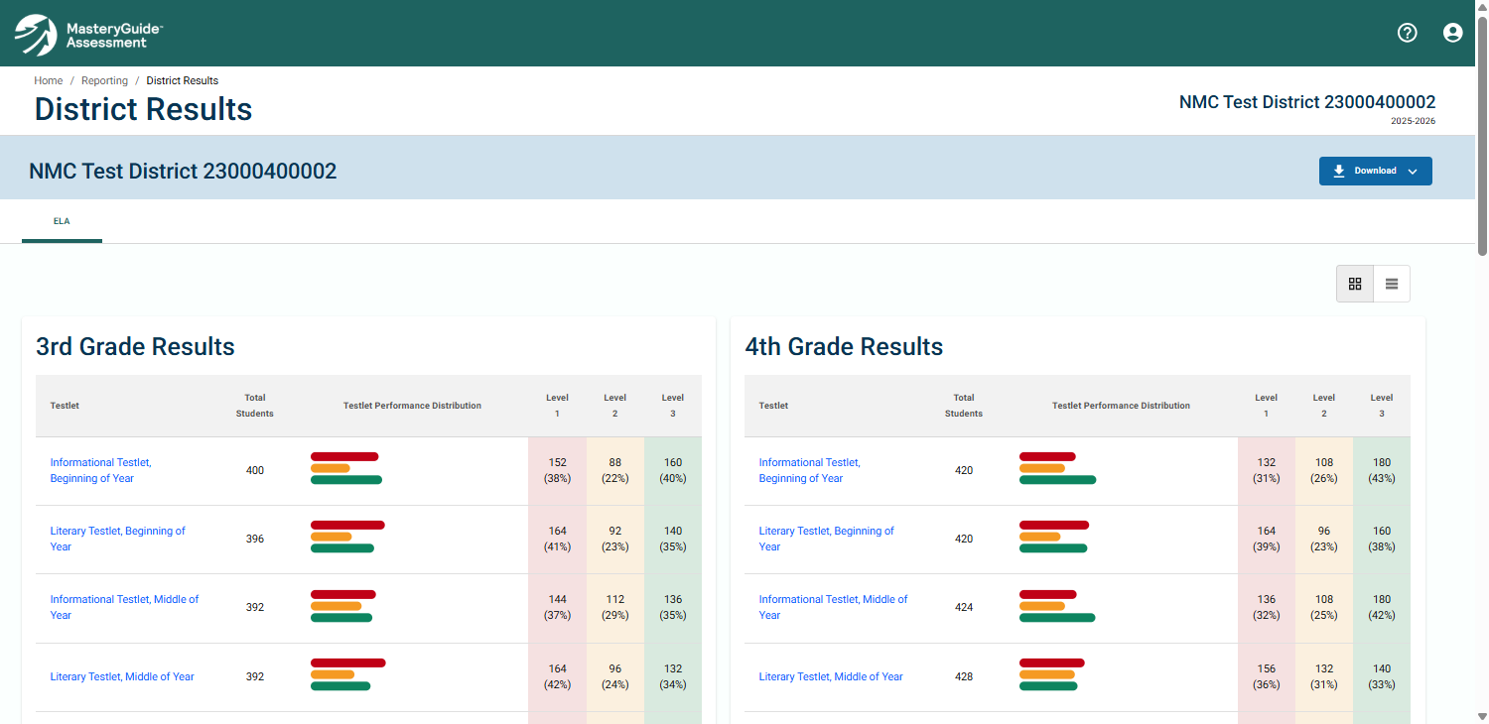
District Reports
Accessing and Navigating
Click Reporting, then locate the District Reports tile
Click View Report
Select the subject tab (Math or ELA)
Review grades and testlets with available results
Select the testlet you want to view
Notes:
District Reports are available only to District Coordinators. Select Reporting, locate the District Reports tile, and click View Report. Select the subject tab and testlet. The report provides the same core sections as the School Report, aggregated at the district level with a breakdown by school.

Slide 19
Downloading Reports
Save and Share
All interactive reports include a Download option in the top right corner of the report page
Click Download to generate a PDF or excel version of the report
Use your browser's options to save the file or print it
The PDF and excel file contain the unfiltered report data
Useful for offline review or sharing with colleagues
Notes:
All interactive reports include a Download option in the top right corner of the report page. Clicking Download generates a PDF or excel version of the report, which can be saved or printed using your browser's options. The PDF contains the same information displayed on screen and is suitable for offline review or sharing.

Slide 20
Troubleshooting
Common Issues and Solutions
I can’t see my reports
  Verify your Waypoint email matches your Kite email exactly
  Teachers must be associated with a roster in Kite; coordinators must be associated with their organization
I didn’t receive my account setup email
  Check your spam or junk folder for an email from noreply@newmeridian.org
My account is locked
  Use “Forgot Your Password” on the login page to reset, or contact help@newmeridian.org
A report type is missing from my Reporting page
  Report visibility is based on your assigned role. Contact your coordinator if you believe your access is incorrect.
For all other issues, contact help@newmeridian.org
Notes:
Here are some common issues you or your users may run into. The most frequent one is not being able to see reports. This almost always comes down to an email mismatch -- the email address in Waypoint must be identical to the one used in Kite. For teachers, they also need to be associated with a roster in Kite. For coordinators, they need to be associated with their organization. If someone did not receive their account setup email, have them check their spam or junk folder for an email from noreply@newmeridian.org. If an account gets locked after too many login attempts, they can use the Forgot Your Password link on the login page to reset it, or contact our support team. And if a report type is not showing up on someone's Reporting page, it is likely a role issue -- report visibility is determined by the user's assigned role. For anything else, our support team is available at help@newmeridian.org.

Slide 21
Live Demonstration
Access to Waypoint Educator
Notes:
Now let’s take a look at Waypoint Interactive Reporting live. I’ll walk through the key features we just covered, starting with navigating to the reports, and then we’ll look at a few examples together. Feel free to follow along and please ask questions as we go.

Slide 22
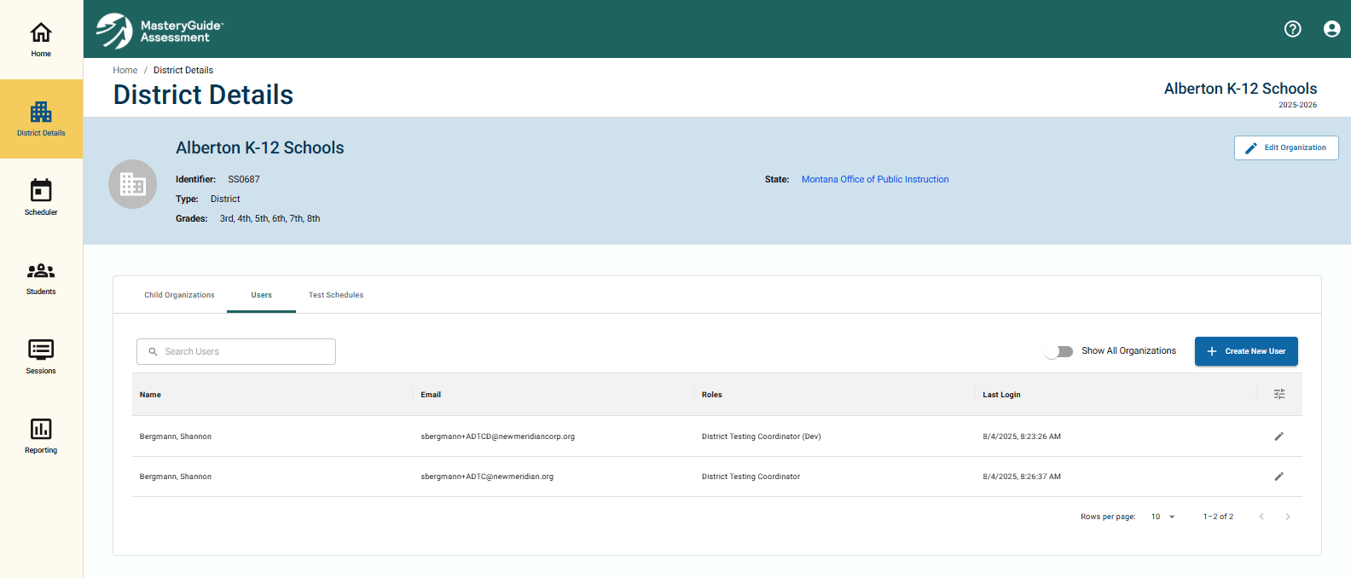
User Management
Using the Interface to add, remove, or edit users
A user file has been uploaded for all districts.
The email addresses used here must be identical to those used in Kite.
New users can be added via the User interface the same way they can be added for the Scheduler.
Teachers will require association with a roster to view the reports for that roster.
Notes:
Now let's talk about user management. A user file has been uploaded for all identified users in all districts, so most of your users should already be in the system. There are a couple of important things to keep in mind here. First, the email addresses used in Waypoint must be identical to the ones used in Kite. If there's a mismatch, users won't be able to see their reports. Second, if you need to add new users, you can do so directly through the User interface -- it works the same way it does for the Scheduler. And for teachers specifically, they'll need to be associated with a roster in Kite in order to view the reports for that roster. For school and district coordinators, the user will need to be associated with the organization in Kite as well, but they don't need to be tied to an individual roster

Slide 23
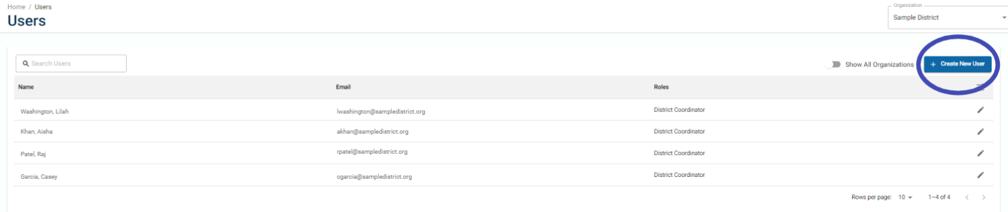
User Management
New Users
Add New User
Select 'Users'
Click '+Create New User'
Notes:
To add a new user, start by selecting 'Users' from the navigation menu, then click the '+Create New User' button. This will open the user creation window, which we'll walk through on the next slide.

Slide 24
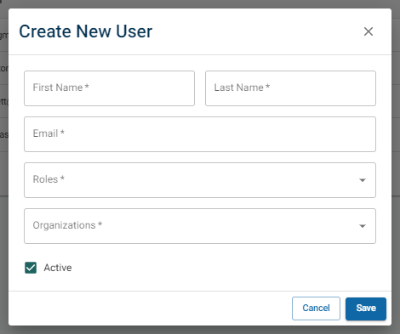
User Management
New Users
Add New User
Select 'Users'
Click '+Create New User'
See Create New User window
Enter first and last name
Enter email address
Select role(s)
Select organization(s)
Click 'Save'
Important Note:
The new user’s email address must be identical to their email address that is used for Kite login
Notes:
Once the Create New User window opens, you'll enter the user's first and last name, their email address, and then select the appropriate role or roles and organization or organizations for that user. When you're done, click 'Save.' And again, I want to stress this -- the email address you enter here must be identical to the one the user has in Kite. If those don't match, the system won't be able to connect their account to their data

Slide 25
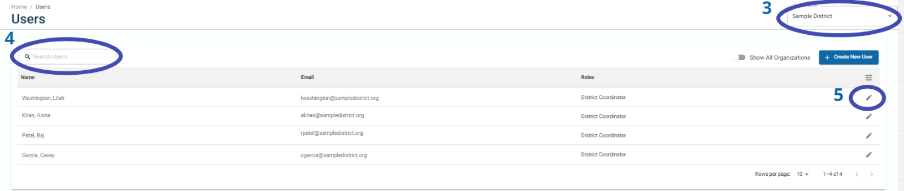
User Management
Edit or Deactivate Existing User
Edit User
Select 'Users'
See Users page
Select school
Type user's name
Click pencil icon
Notes:
If you need to edit or deactivate an existing user, go to the Users page, select the school, and then type the user's name to search for them. Once you find them, click the pencil icon next to their name to open the editing window.

Slide 26
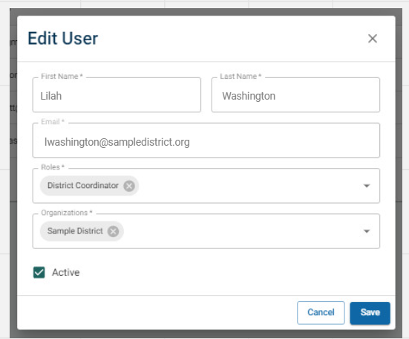
User Management
Important Note:
Users that are assigned a teacher role must also have the same email address associated with a roster in Kite to view their reports.
Edit or Deactivate Existing User
Edit User
Select 'Users'
See Users page
Select school
Type user's name
Click pencil icon
See Edit User window
Make edits
To deactivate, deselect Active checkbox
Click 'Save'
Notes:
From the Edit User window, you can make any changes you need -- update their name, email, roles, or organizations. If you need to deactivate a user, just deselect the Active checkbox. Then click 'Save.' One important reminder: users with a teacher role must have the same email address associated with a roster in Kite. Without that association, they won't be able to see their reports, even if their account is set up correctly in Waypoint.

Slide 27
Key Takeaways
What to Remember
All reports are accessed through the Reporting menu in the left-hand navigation
The workflow is consistent across all report types: select your level, select the entity, select the testlet, and review results
Use Classroom Report filters to group students by performance level and misconception for targeted instructional planning
All reports can be downloaded for offline review or sharing
Available Resources
  Waypoint Interactive Report User Guide
  Testlet Report Interpretation Guides
  Interactive Reporting FAQ
For support, contact help@newmeridian.org
A feedback survey will be sent to all users after the testing window to help us improve the reporting experience
Notes:
Before we wrap up, here are the key points to take with you. All reports are accessed from the same Reporting menu in the left-hand navigation. The workflow is consistent regardless of which report type you are viewing. Classroom Reports offer filtering capabilities that can help you identify groups of students for targeted instruction. Any report can be downloaded as a PDF for offline use or sharing. Also, please keep an eye out for a feedback survey that will be sent to all users after each testing window -- your input helps us continue to improve the reporting experience. And if you need assistance at any point, our support team is available at help@newmeridian.org.

Slide 28
Thank You
Notes:
Thank you for joining us today. If you have any questions or need further assistance, please contact our support team at help@newmeridian.org. We're here to help you make the most out of Waypoint Interactive Reporting. Have a great day!

