Slide 1

Education Savings Account
District Webinar – August 12, 2025

Slide 2
What is the Education Savings Account?
The Education Savings Account is a reimbursement program for parents of a child with a disability under IDEA. The purpose of this program is to provide parents with more flexibility when it comes to their child’s education outside of a public school system.
If a student is determined eligible and enrolls in the ESA program, they cannot be enrolled in a Montana public school at the same time. If a student were to re-enroll back into a public school, then it would terminate them from the program and any future funding they would receive.
If a student is approved for the program, funds will be deposited into the students trust account monthly. The parent of the approved ESA student can submit reimbursement requests for tutoring expenses, textbooks, tuition costs, or additional online courses that their child may require to succeed. For a full list of allowable and unallowable reimbursements, please visit our ESA website.
The team at OPI will review the requests monthly to determine if the expenses are allowable before reimbursements are drawn from the student’s trust account.
If the child remains enrolled in the ESA program, they will have access to these funds up until their 24th birthday.

Slide 3
What determines if a student is eligible for ESA?
To be eligible for the ESA program in May 2025 and November 2025 students must:
Be between the ages of 5-19 by September 10th
Be identified as a “child with a disability” under IDEA
Have been enrolled in a Montana public school in the 2024-2025 school year and counted for ANB purposes
Be eligible to enter kindergarten
Be a new to Montana resident
When applying for the program, the parent is asked to provide a copy of the child’s IEP, evaluation report, or private place service plan from the school district to review.
The Parent must provide two proof of residency documents to verify the students resident school district.
Parents will need to complete an address verification form for each year the student is enrolled in the program.

Slide 4
District Student Amounts:
District and student amounts for SY2025-2026 are located on our ESA website under “What do school districts need to know?”
ESA students approved in the May application window:
Receive full allocation award for SY25-26
Payments will be split into 10 equal payments for the fiscal year.
ESA students approved in the November application window:
Receive half allocation award for SY25-26
Payments will be split into 5 equal payments for the remainder of the fiscal year.
Allocation amounts will be calculated each year and posted to the website.

Slide 5
Payment Schedule
Districts will receive a monthly invoice from OPI following the distribution of the BASE aid payment.
The invoice will include all students and remit total.
Payments need to be remitted back to OPI by the 10th of each month.
OPI will deposit the funds into the students trust account for reimbursement.
Funds will remain in the account and roll over each year.
The following fiscal year, new allocations will be awarded to each student.
Districts will be notified of new allocation awards for students continuing enrollment.

Slide 6
School District Coding:
Fund: X01 General Fund
Program Code: 999 Transfers to OPI
Function Code: 62XX Resource Transfers
Object Code: 950 Transfer to the OPI for the ESA Program
Monthly invoices will include the coding to remit the funds back to the Office of Public Instruction.

Slide 7
What if the student is out of district or moved?
Per 20-7-1709, MCA, the resident school district will remit payment to OPI for the ESA student.
Parents will be required to submit an address verification form to OPI each year the student is enrolled in the program.
If a student moved, the parent must need to supply OPI with two updated proof of residency documents.

Slide 8
Year One Pre-Pay Form
A new repayment option for districts participating in in the ESA program was passed during the 2025 legislative session.
Districts may elect to have the OPI cover the ESA amount in the first year of a student's participation in the program in the school district.
If this option is chosen, the districts BASE aid will be reduced in a future year by the amount originally provided, plus an inflationary adjustment set by the legislature.
Offers districts short term financial flexibility while requiring repayment once the student exits the ESA program.
District’s must complete the ESA Year One Prepay form.
Link to form: ESA Year One Prepay Form
A signed letter from the board chair and authorized representative on official district letterhead must be uploaded within the form to indicate intent.
An ESA Year One Prepay form is required for each student.
Forms are due back to OPI by August 29, 2025.

Slide 9
District Responsibilities:
Ensure that OPI receives payment back by the 10th of the month to be deposited into the students trust account for reimbursements.
If a student were to enroll back into public school, the district will need to notify OPI as soon as possible as this terminates participation in ESA.
Provide a SSID # (if the student does not have one)
New to Montana students or students entering kindergarten.
Create enrollment to flag ESA students in AIM for ANB purposes.
AIMS Guidance
If the year one prepay form is requested, an additional flag will need to be set up in AIM.

Slide 10
Office of Public Instruction’s Responsibilities:
Invoice districts monthly.
Track student trust deposits and balances.
Verify that expenditures submitted to OPI are for allowable educational expenses.
Notify the district if a student is removed from ESA for any reason.
Verify student residency for each year they are enrolled in the ESA program.

Slide 11
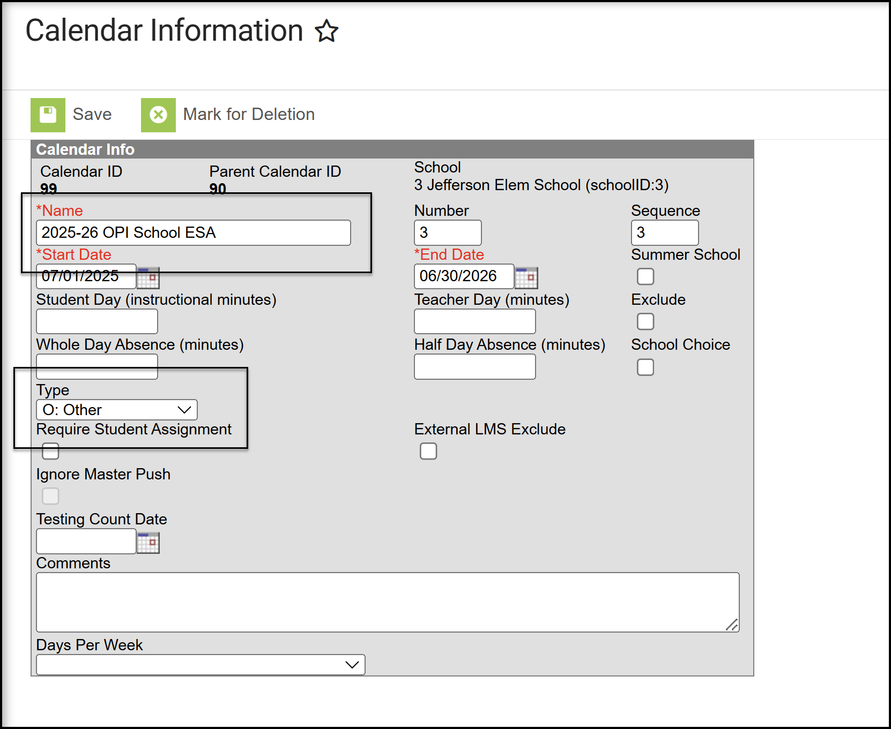
Infinite Campus Data Entry
It is highly recommended that districts create separate calendars for Educational Savings Account Enrollments.
Calendar Type should be set to O: Other (this is not a regular instructional calendar).

Slide 12
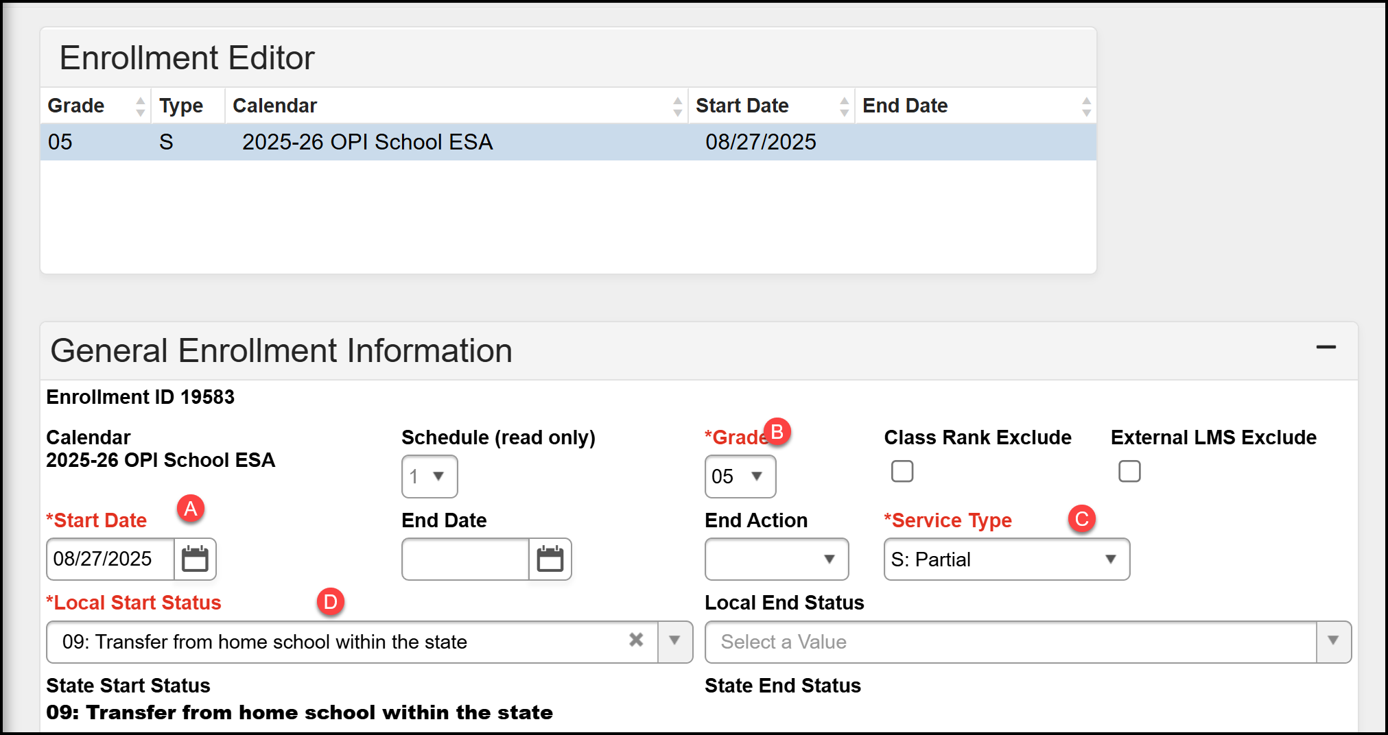
Infinite Campus Data Entry
A. Start Date – The first day of school in the fall.
B. Grade – The student's grade level for 25-26.
C. Service Type – S: Partial.
D. Local Start Status – 08: Transfer from home school within the state or 09: Transfer from private school within the state.

Slide 13
Infinite Campus Data Entry
Enter Aggregate Hours as Full-Time for Fall and Spring ANB.

Slide 14
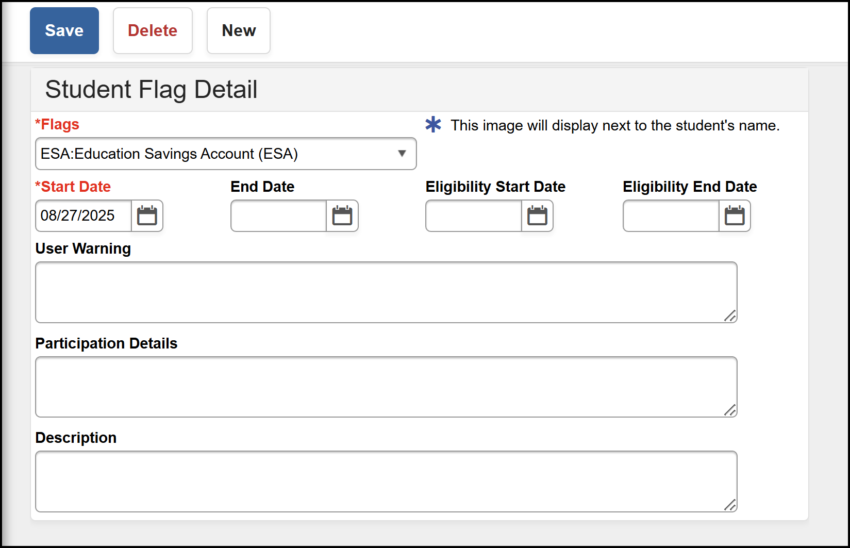
Infinite Campus Data Entry
Create a Flag to identify the student as an Educational Savings Account participant.
Flag – ESA: Educational Savings Account (ESA)
Start Date: First day of school
*Continuing students do not need a new flag for the 25-26 year.

Slide 15
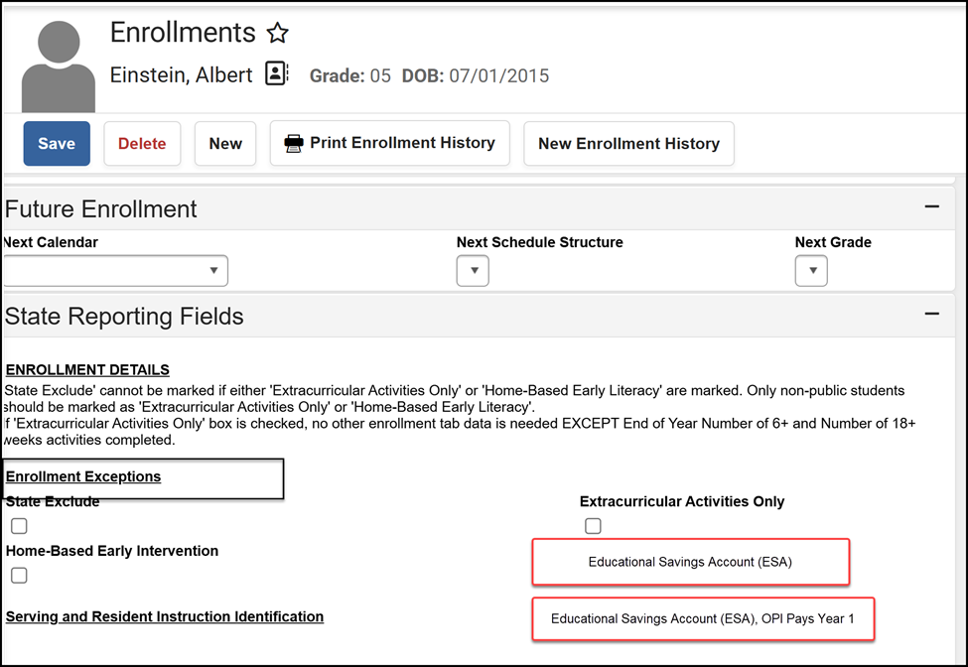
Infinite Campus Data Entry
**Coming Soon!!
We are moving the identifier for Educational Savings Account students from Flags to Enrollment:
Doesn't require the extra step of creating a flag
Functions like other enrollment exceptions
We will contact districts when it's time to switch.

Slide 16
Infinite Campus Data Entry
EDUCATE Unit (for Infinite Campus Questions)
opiaimhelp@mt.gov
(406) 444-3800 or (877) 424-6681
EDUCATE (Infinite Campus)

