Slide 1
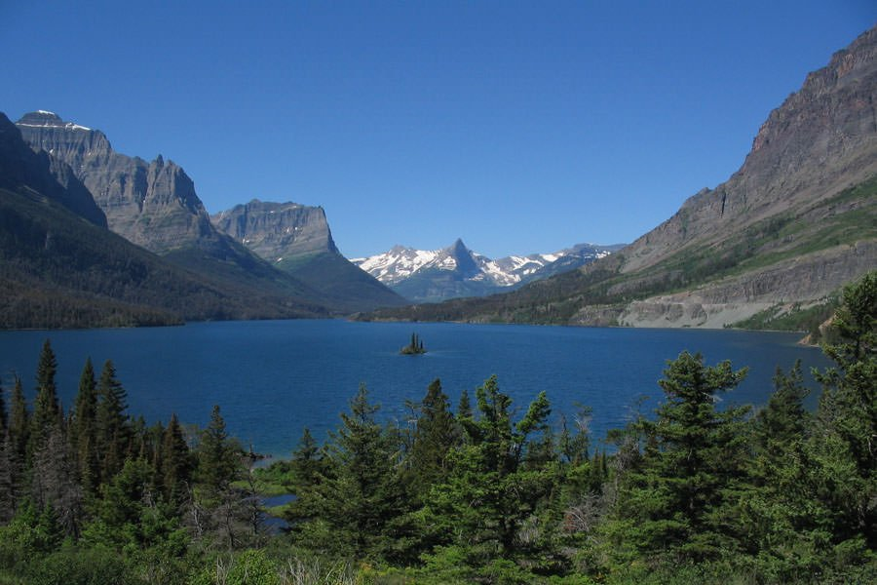
Chapter 58 Review and Recommendations Overview and updates
Zach Hawkins OPI Director Indian Education for All
August 17, 2021

Slide 2
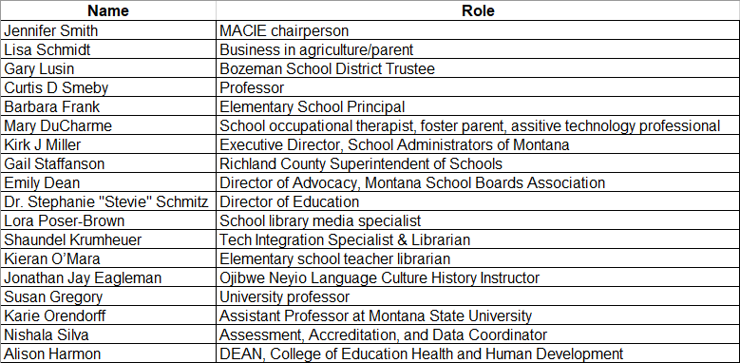
Task Force Members

Slide 3
process
Task Force
Reviews research and makes recommendations.
Legal/
Communication Team
Crafts the wording for the recommendations.
Superintendent
After the recommendations have been written by the legal/communication team they are sent back to the Task Force to review. From there the Superintendent takes to the Board of Public Ed.

Slide 4
Focus Group cross-cutting themes
High-quality educators embody both content knowledge and pedagogy
Interpersonal skills
Experiencing a variety of hands-on teaching experiences is critical.
Mentorship opportunities
Social and emotional learning and trauma informed instruction
Increased flexibility in preparation and licensure

Slide 5
Feedback group Themes
Need to be cognizant that EPP changes will not necessarily achieve the vision of the TF unless there is follow through in K-12 as well. Consistent educator evaluation important. EPAS roll out and support
Inductions can be an important component of preparation beyond the EPP experience. This hasn’t been a part of the recent conversations in MT
Eliminate the terms “learning styles” and “continuous improvement.” Replace with “personalized learning” and “continuous growth”
Not a lot of time to create entire subchapters by end of September
The bulk of student teacher placements go to A and AA schools. It’s hard to get rural school placements
Alignment between Chapter 58 and Chapter 55 is important to consider

Slide 6
Lever Topics for a quality teacher preparation program
Pedagogy – not what to teach but how to teach. Moving from content to facilitating learning. How to differentiate the learning experience. Equality of educational opportunities. More active learning, personalized/individualized learning
Real-world experiences-A year-long residency would provide hands-on experiences in diverse settings
More robust observations and mentorship (extending time)
Continuous improvement and desire for life-long learning. Accountability to outcomes
Relationships – ability to develop relationships with student, parents, and the community at large
Appropriate technical skills and knowledge

Slide 7

Questions??
Zach Hawkins: zachariah.hawkins@mt.gov; 444-0708

