Slide 1
Federal Programs Update
Ed Advocates Meeting
July 20, 2021

Slide 2
Time Line
July 13, 20, & 27, 2021. The OPI will host three ARP ESSER Webinars during the month of July to assist districts in developing and submitting District ARP ESSER Plans.
August 24, 2021. Districts must submit an ARP ESSER Plan to the OPI through the Terms of Employment, Accreditation, and Master Schedule (TEAMS). The District ARP ESSER Plan template will open July 1st and close on August 24th in TEAMS.
September 1, 2021. Due date to complete and submit ESSER II and ESSER III applications in the E-grants system.

Slide 3
MT OPI ARP-ESSER State Plan
On June 7, 2021, the Montana OPI submitted to the U.S. Department of Education (USED) its State Plan for the ARP ESSER Fund. This plan recognizes local control, removes obstacles and barriers for schools, and enhances accountability without being overly burdensome.
Find the link in the chat box to see the State Plan. http://opi.mt.gov/Portals/182/Montana_ARP_ESSER_State_Plan_Final.pdf?ver=2021-06-08-103621-223

Slide 4
District Plan 1
Safe Return to In-Person Instruction and Continuity of Services Plan -- within 30 days of receiving ARP ESSER allocation.
(June 24, 2021)
Districts must develop and make publicly available a Safe Return to In-Person Instruction and Continuity of Services Plan.
If a District developed a plan before ARP was enacted that does not address the above requirements, the District must revise its plan no later than six months after it last reviewed its plan.
Districts need to update the Safe Return to In-Person Instruction and Continuity of Services Plan at Districts every six months through September 30, 2023 and must seek public input on the plan and any revisions and must take such input into account.

Slide 5
District Plan 2
District ARP ESSER Plan – within 90 days of receiving ARP ESSER funds). August 24, 2021
The requirements for the school district plans include, at a minimum, how districts will:
use funds to implement prevention and mitigation strategies;
use the funds totaling not less than 20% to address lost instructional time;
spend its remaining 80% of ARP ESSER funds;
respond to needs of student disproportionately affected by the pandemic; and
meaningfully engage with and consult stakeholders in crafting their plans. Each of these federally required components are embedded into this school district ARP ESSER plan.

Slide 6
LEA ARP ESSER Plans
The District ARP ESSER Plan template opened July 1st and closes on August 24th in TEAMS.
The OPI will continue to release information on the OPI website under the ESSER Info page, so that LEAs can begin work in anticipation of the opening of the template in TEAMs.

Slide 7
State Components
Throughout this school district ARP ESSER plan, the OPI has emphasized local control and coordination of state initiatives and requirements so that school districts can identify and innovate solutions for unique local needs and priorities.
These components are embedded in the school district ARP ESSER plan.
Additionally, the OPI sought and received flexibility from the Board of Public Education to use the Goals section of this plan in place of the Continuous School Improvement Plan (CSIP).

Slide 8
Support and Monitoring
In addition, the USED requires the OPI to support and monitor each school district's use of ARP ESSER funds, including:
implementation of evidence-based interventions;
address the student groups specifically that were disproportionately impacted by the pandemic; and
identify, reengage, and support students who have experienced the impact of lost instructional time. The plan will provide the information necessary for the OPI to support and monitor school districts as they move forward.

Slide 9
Template sections
The template sections are as follows:
School District-Identified Priorities
Meaningful Consultation
Goals
Coordinating Funds
Creating Safe and Healthy Learning Environment
Addressing Lost Instructional Time
Supporting the Educator Workforce
Monitoring and Measuring Impact of ARP ESSER funds

Slide 10
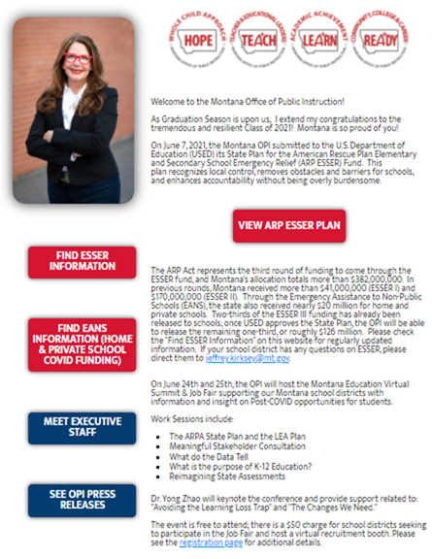
Resources on Webpage
OPI Website-ARP ESSER: opi.mt.gov

Slide 11
Funding Flexibility Waiver
Purpose of the Waiver:
To provide the OPI and its subgrantees with the flexibility needed to continue to support continuity of academic and support services during the recovery period of the COVID-19 pandemic.
The OPI will use and ensure that its subgrantees use funds under the respective programs in accordance with the provisions of all the applicable statutes, regulations, program plans, and applications not subject to these waivers, and will work to mitigate, and ensure that its subgrantees work to mitigate, any negative effects that may occur as a result of the requested waivers.

Slide 12
Funding Flexibility Waiver
Carryover limitation in section 1127(b) of the Elementary and Secondary Education Act of 1965 (ESEA) for Federal fiscal year (FY) 2020 Title I, Part A funds: the requirement that limits an SEA’s ability to grant to its LEAs a waiver of the 15 percent Title I, Part A carryover limitation in section 1127(a) more than once every three years.
Period of availability of funds in section 421(b) of the General Education Provisions Act (GEPA): to extend the period of availability of FY 2019 funds for programs in which the SEA participates under its approved consolidated State plan until September 30, 2022.

Slide 13
Waiver Timeline
June 24, 2021: Initiate public comment, by sending email to stakeholders and posting the waiver on the OPI webpage.
June 2021: Consultation with the Governor’s office
July 2021: Presentation and discussion with Education Advocates
July 14-16, 2021: Presentation and discussion with the Montana Board of Public Education
July 24, 2021: Public comment deadline
July 30, 2021: Final Draft prepared and submitted to the USED

Slide 14

Thank you!
For questions or additional information please contact Julie Murgel @ Julie.Murgel@mt.gov
Notes:
Are there any questions from this presentation?

