Slide 1
ELA Standards Revision Task Force
Orientation Meeting
April 18, 2024

Slide 2
Meeting Participation Protocols
1. Zoom Name: I’m me, are you, you?
2. To Mute or Not to Mute: that IS the question!
Remain muted to reduce background noise.
Unmute when sharing out or in breakout rooms.
Use the chat
Raise your hand
3. Always allow yourself and others to pass or participate as appropriate.
4. Cameras on build community.
5. Use private chats and organizer emails for individual follow up
6. Speak clearly and slowly. We are recording

Slide 3
Objectives
Launch the Montana ELA Standards Revision Task Force
Share the purpose, process, and deliverables of the task force.
Build community within the ELA Task Force and with OPI support staff
Initiate review of REL-NW guiding research

Slide 4
Agenda
Welcome and Introductions
Overview of Process Part 1
Team Building Small Group Breakout
Overview of Process Part 2
Bio Break
Small Group KWL or NWT
Group Share Out and Discussion (R17 Comp Center)
Individual Reflection
Bio Break
Research Introduction (REL-NW)

Slide 5
Support Staff Introductions
Montana Office of Public Instruction
Christy Mock Stutz, Assistant Superintendent
Julie Murgel, Chief Program Officer
Marie Judisch, Senior Manager of the Teaching and Learning Department
Aimee Konzen, Standards, Instruction and Professional Learning Manager
Stephanie Swigart, ELA and Literacy Instructional Coordinator
Jackie Ronning, Early Literacy Specialist
Mike Jetty, IEFA Specialist
Jennifer Stadum, IEFA Specialist
Matt Bell, Culture and Language Immersion Specialist
Crystal Hickman, Tribal Student Achievement Specialist
Michelle Henson, Tribal Student Achievement Specialist
Region 17 Comprehensive Center
Jacob Williams
Erich Stiefvater

Slide 6
Task Force Members

Slide 7
Communication Plan
Task Force:
Primary Email
Text Okay?
Public Communication
Compass Newsletter
OPI Standards Website*
*open access

Slide 8
Operating Logistics: Virtual Sharing
Workspace Collaboration Process
Sheets
Docs
Drive
Google Site
Hub Course: Google Workspace for Beginners

Slide 9
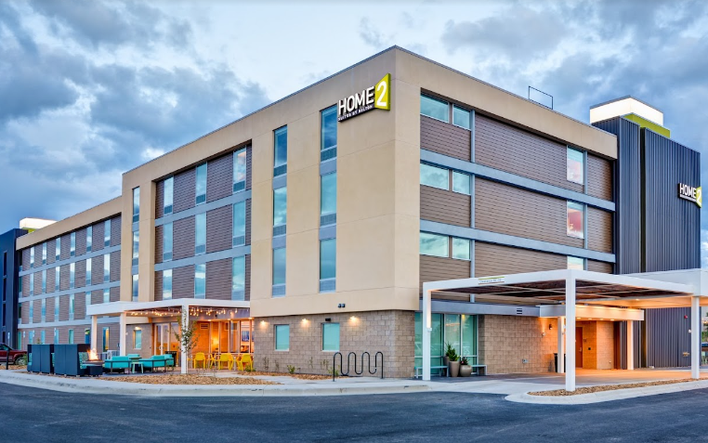
Operating Logistics: Travel
Mileage
Meals
Lodging
Lodging Form
(complete by April 22, 2024)

Slide 10
Process and Timeline
Orientation
Task Force Independent Research Review
Research Deep Dive (May 3rd)
Professional Learning Sessions
In-Person Writing Workshop (July)
In-person Revision Team Workshop
Reconciliation
Rationale Finalized
Standards Presented to the Superintendent

Slide 11
Key Deliverables
Side by Side Comparative of Standards
Rationale for all changes
Research-based?
Position Statement?
Expert Explanation
Definitions
Outline for Guidance Documents

Slide 12
2023-2025 Standards Revision Process

Slide 13
MT Board of Public Education Approved Standards Revision Timeline
Research and Review | Revisions | Negotiated Rulemaking Committee | Adoption Phase | Professional Learning for New Standards | District Implementation
September 2023 through March 2024 | April through August 2024 | September through December 2024 | January through June 2025 | June 2025 through June 2026 | July 2026

Slide 14
Research and Review Phase
September 2023 through March 2024

Slide 15
Research Step 1:
September 2023 through March 2024
Comprehensive review of other states’ ELA Standards
Consideration of assessment, curriculum, and programmatic factors
Review and development of focused research questions…

Slide 16
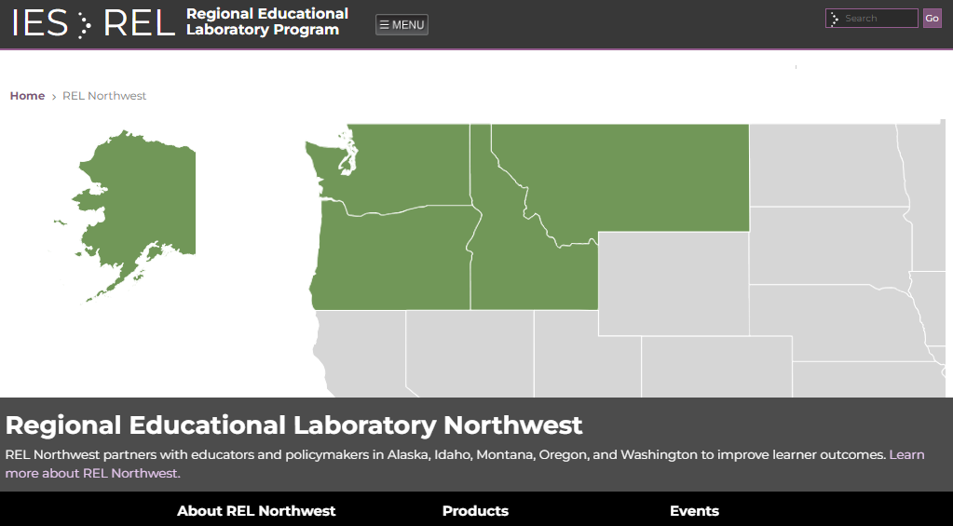
Research Step 2:
September 2023 through March 2024

Slide 17
Revisions Phase
April 2024 through August 2024

Slide 18
Revisions Phase
April 2024 through August 2024
Writing Team: Development
Review Team
Writing Team: Reconciliation
Review the Research from the REL and OPI
Collaborate to develop new standards and/ or revise existing standards language
April-July 2024
Review the Research from the REL and OPI
Review Standards and/or language changes developed by the Writing team
Provide feedback and suggestions
April-August 2024
Consider feedback from the Review Team
Reconcile changes suggested and come to consensus
Prepare final draft for Negotiated Rulemaking
August 2024

Slide 19
GOALS FOR THE TASK FORCE:
Writing Team
Goal 1: Review the research and data
Goal 2: Synthesize research, national standards, international standards, etc. to consider the implications for the current standards
Goal 3: Determine if all, some, or none of the current standards need to be rewritten to match current research
Goal 4: Write/revise ELA standards. Publish a draft of standards that ensures the highest quality education for our teachers and students in the coming years.

Slide 20
GOALS FOR THE TASK FORCE:
Review Team
Goal 1: Review the research and data
Goal 2: Review the standards produced by the writing team for:
accuracy
inclusion of necessary essential concepts
processes
IEFA
Vertical and interdisciplinary alignment
Goal 3: Review the work of the writing team and make suggestions or revisions regarding what to discard, update, or keep for each of the proposed standards to match current research, best practices, and/or for vertical alignment.

Slide 21
Negotiated Rulemaking Committee
September through December 2024

Slide 22
Negotiated Rulemaking Committee
The committee must represent the diverse circumstances of schools of all sizes across the state and must include representatives from the following groups:
School district trustees
School administrators
Teachers
School business officials
Parents/guardians
Taxpayers
Montana Tribal Nations Representative

Slide 23
Negotiated Rulemaking Committee
Roles and Responsibilities

Slide 24
Adoption Phase
January through June 2025

Slide 25
Board of Public Education: Administrative Rulemaking
Adopt a rulemaking timeline
Publish proposed revisions
Publish notices of a comment period and a public hearing
Respond to public comment
Act to adopt, adopt as revised, or not adopt proposed content standards

Slide 26
ARM Adoption Process

Slide 27
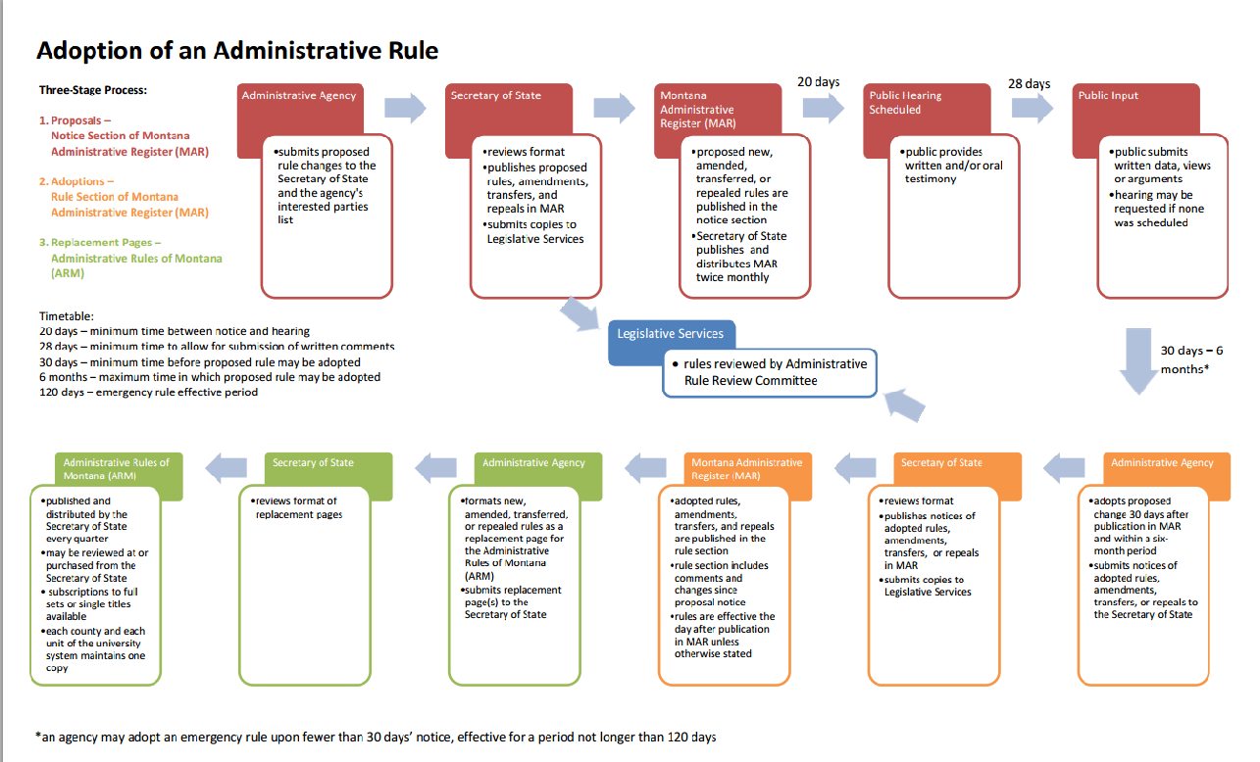
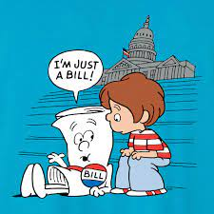

Slide 28
Implementation Phase
June 2025-September 2026

Slide 29
District Implementation Timeline
By July 2026
July 2026
September 2026
Update district curriculum review schedule to include new standards
Plan professional development
Plan curriculum review
Plan instructional materials review
Standards published in the Administrative Register of Montana (ARM)
ELA standards are ready to be implemented starting with the 26/27 school year.

Slide 30
Task Force
Team Building Breakouts
WELCOME!

Slide 31
Welcome/Introductions
Introductory Jamboard Activity
Questions:
What is your World Languages story?

Slide 32
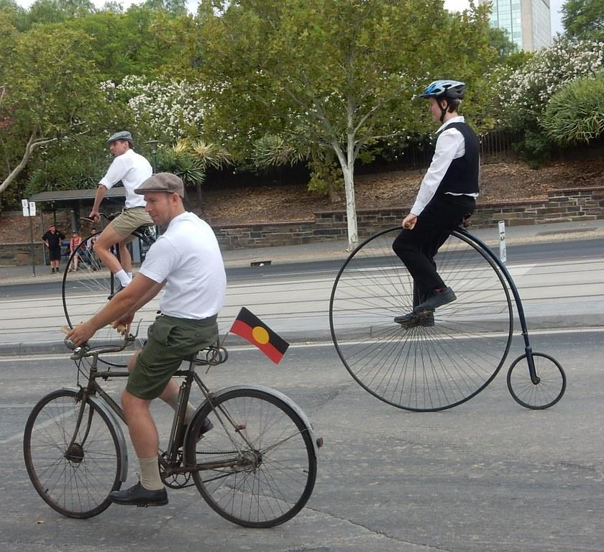
Why Revise ELA Standards?
Simplicity
Clarity
Practicality

Slide 33
Standards Requirements According to the Montana Board of Public Education and the Administrative Rules of Montana

Slide 34
The Board of Public Education Guidelines
Standards will define what all students should know and be able to do;
Standards will be challenging and rigorous;
Standards will be clear, understandable, and free of jargon;
Standards will be measurable;
Standards will address diversity, specifically fulfilling the commitment to implementing Indian Education for All;
Standards will be consistent with the grade level and grade band structures in ARM Chapter 53; and
Content standards will be consistent with the program delivery standards described in ARM Chapter 55.

Slide 35
ARM Chapter 53: Content Standards
10.53.101 EXPLANATION OF THE CONTENT STANDARDS
(1) The content standards shall be used by school districts to develop local curriculum and assessment in all the content areas including:
(b) English language arts and literacy;
(2) The K-12 content standards describe what students shall know, understand, and be able to do in these content standards. These K-12 standards define end-of-year expectations and a cumulative progression designed to enable students to meet college and career readiness expectations no later than the end of high school.

Slide 36
Indian Education for All

Slide 37
Indian Education for All
Constitution of Montana 1972
“The state recognizes the distinct and unique cultural heritage of the American Indians and is committed in its educational goals to the preservation of their cultural integrity.”
Indian Education for All (MCA 20-1-501) 1999,
(amd. Sec. 1, Ch. 718, L. 2023)
“Unique cultural heritage and contemporary contributions of American Indians…”
“Every Montanan, whether Indian or non-Indian…learn about the distinct and unique heritage of American Indians in a culturally responsive manner…”
“Every educational agency and all educational personnel will work cooperatively with Montana tribes…to include information specific to the cultural heritage and contemporary contributions of American Indians, with particular emphasis on Montana Indian tribal groups and governments.

Slide 38
Program Delivery Standards

Slide 39
10.55.1101 ENGLISH LANGUAGE ARTS AND LITERACY PROGRAM DELIVERY STANDARDS
(1) In general, a basic program in English language arts and literacy shall:
(a) meet the following conditions:
(i) promote reading, writing, speaking, and listening for creative and purposeful expression in language;
(ii) engage with high-quality literary and informational text that builds knowledge, expands experiences, and broadens views; and
(iii) emphasize reasoning and use of evidence that is essential for deliberation;
(iv) make available a variety of print and non-print materials encompassing fiction and non-fiction, classic and contemporary works, and diverse perspectives including Montana American Indian works; and
(v) promote critical reading that is necessary to navigate the vast amount of information available both in print and digitally; and

Slide 40
Montana ELA Program Delivery Standards, Cont’d
(b) include the following practices:
(i) integrate reading, literature, writing, speaking, listening, and media literacy with a balanced approach supported by current research and/or based on best practices in the field of English language arts and literacy;
(ii) emphasize multiple strategies and artistic forms to teach the conventions, demands, and responsibilities of language;
(iii) emphasize writing as a process;
(iv) provide opportunities for informal and formal speaking and listening;
(v) offer experiences in viewing, creating, and critically evaluating different types of media; and
(vi) encourage co-curricular offerings in drama, speech, debate, journalism, literary publications, and other related activities.

Slide 41
10 Minute Break!
Please Return at: 10:25

Slide 42
Small Group Breakout
KWL or NWT Jamboard

Slide 43
R-17 Comp Center Led Discussion
KWL /NWT Share-Out

Slide 44
Reflection Time
Jamboard: What is your why?

Slide 45
Regional Educational Laboratory
Research Review

Slide 46
Questions

Slide 47
Thank you!

