Slide 1
ELA Standards Revision Task Force
Notes:
Welcome! As we get settled in, please introduce yourself in the chat with the following information:
Name
Where you teach/work now?
Years in education

Slide 2
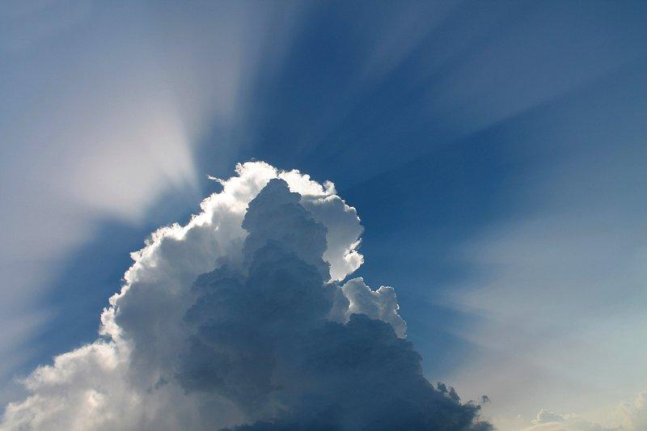
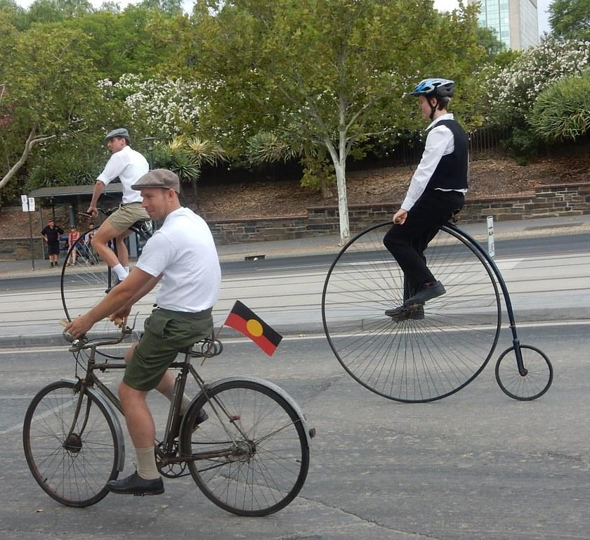
The Purpose
Simplicity
Clarity
Practicality
Notes:
Superintendent Elsie Arntzen, with approval from the Montana Board of Public Education, has opened the Montana Mathematics Standards for review.The purpose of the standards review process is to assure that Montana public schools are setting high academic standards for all children of our state. The goal is to serve our Montana students and educators with the best-possible standards to guide instruction and prepare our students for their lives beyond the classroom.
Montana has a multitude of heritage languages with experts to draw from. The diversity in linguistic backgrounds will be invaluable to the understanding of language acquisition
These standards were last updated in 1999. In fact, they are one of the last standards to still reside in chapter 53 of the ARM, most others have been migrated to chapter 54. Our goal is to update these standards to reflect the wealth of knowledge that the community has gained

Slide 3
50-minute Agenda
(3 min) Welcome and Introductions
(7 min) Information Sharing
NCTE-ILA, NAEP, and Key Shifts in Recent State Revisions, Math
(25 min) Small group Breakouts
(10 min) Whole Groups Share Out “Sales Pitch”
(5 min) Reflection and So What

Slide 4
Objectives
Identify standards formats or structures that might better support implementation of ELA instruction. student learning of ELA.
Open the door for further exploration of other states’ standards based on other groups “pitches.”
Build conversations around structural revisions ideas for each grade band.
Notes:
Recognize how Literacy is necessary in Mathematics and Science
Discover Literacy needs for in Assessment
Identifying Issues
Literacy (Sentence structure and decoding challenges) as a barrier to math and science mastery and even engagement
Vocabulary
Duplicative instruction in content area classes
Content area teacher comfort in teaching literacy skills
Writing, Speaking, and Listening skills needs within content area
Identifying overlap in existing standards and practices
Impact:

Slide 5
Guiding Question:
What big shifts can we make that have small impacts and small shifts can we make that have big impacts?

Slide 6
MT Pre-Common Core Standards
Notes:
https://drive.google.com/drive/folders/1mYzq0eGpZSijB68Gu6iR6S0Bi6i84d1X?usp=drive_link

Slide 7
NCTE/ILA Standards
Notes:
https://ncte.org/resources/standards/ncte-ira-standards-for-the-english-language-arts/

Slide 8
NAEP Standards
Notes:
https://www.nagb.gov/content/dam/nagb/en/documents/publications/frameworks/reading/2019-reading-framework.pdf

Slide 9
NAEP Framework
Text Types: Similar and different
Vocabulary is integrated in Text (Word and Author’s intent)
Cognitive targets, behaviors and skills:
locate/recall,
integrate/interpret, and
critique/evaluate
Poetry: a form of text that is rich in meaning and involves a high level of abstraction in language and ideas.

Slide 10
NAEP: Reading Is…
Understanding written text.
Developing and interpreting meaning.
Using meaning as appropriate to type of text, purpose, and situation.

Slide 11
NAEP Reference to the RAND Report
Reading comprehension [is] the process of simultaneously extracting and constructing meaning through interaction and involvement with written language. It consists of three elements: the reader, the text, and the activity or purpose for reading (p. 11).

Slide 12
NAEP Reference to PIRLS
The ability to understand and use those written forms required by society and/or valued by the individual. Young readers can construct meaning from a variety of texts. They read to learn, to participate in communities of readers, and for enjoyment (p. 3).
Notes:
e Progress in International Reading Literacy Study (PIRLS) (Campbell et al. 2001)

Slide 13
NAEP Cognitive Processes
Notes:
e Progress in International Reading Literacy Study (PIRLS) (Campbell et al. 2001)

Slide 14
State Standards Examples

Slide 15
Arkansas, 2023: Handwriting FS

Slide 16
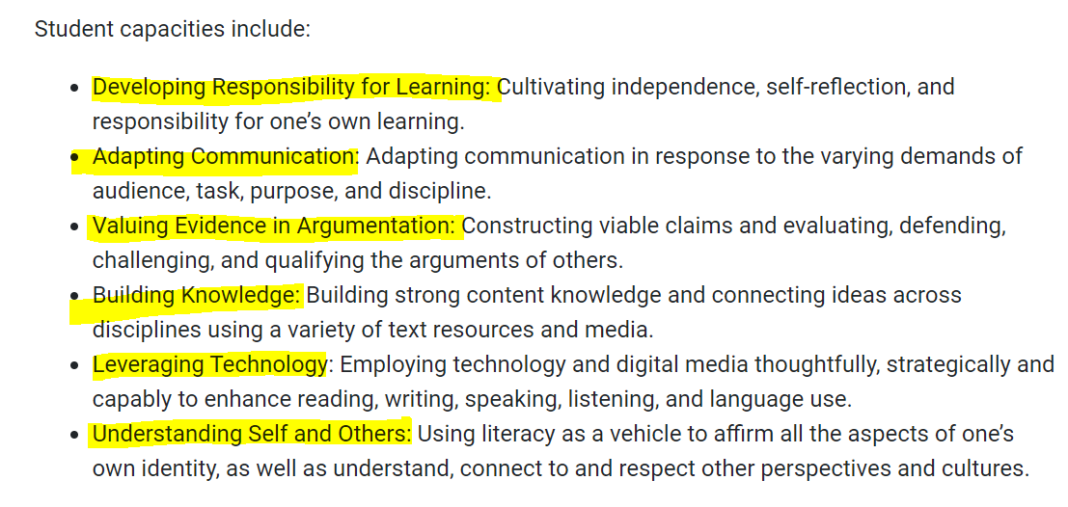
New Jersey 2023: Practices of ELA

Slide 17
ND, 2023: 4 Domains/Grade
K-5 Only
All Grades
6-12 Only

Slide 18
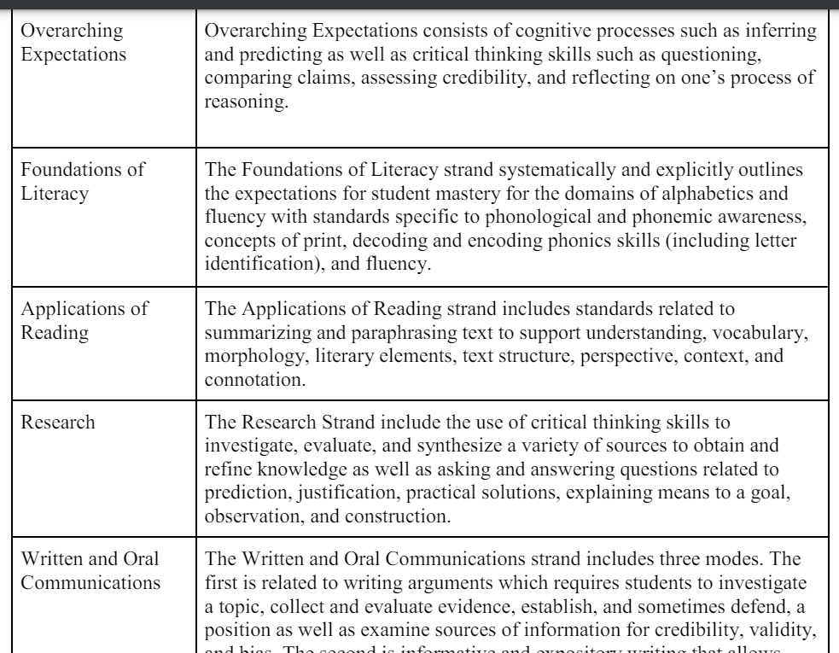
South Carolina, 2023: Strands

Slide 19
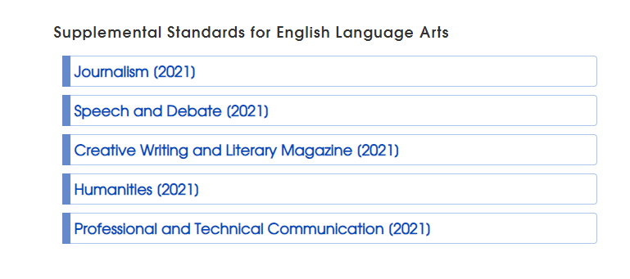
Utah, 2023: Supplemental Standards
Notes:
https://www.uen.org/core/languagearts/

Slide 20
Break out Rooms
K-2 and 3-5
Oklahoma
6-8 and 9-12
Minnesota
Review team
Maine
Notes:
tep

Slide 21
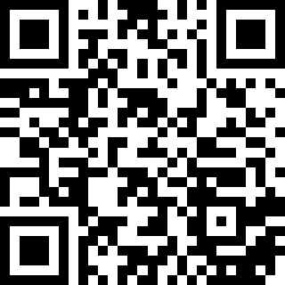
Standards link
https://tinyurl.com/ELAstdsexample

Slide 22
How to review standards
Plus (what is good) | Delta (what you’d change) | Steal (what you believe is essential to include in our work)
Put your responses in the Jamboard (next slide)
Come back with a 3 minute “Sales pitch” for what we should steal
Notes:
tep

Slide 23
Share out
Sell us on:
What should we steal?
What would you change?
What was good?
*Each group allotted 3 minutes
**Following this session review all group notes to gain learnings from their review

Slide 24
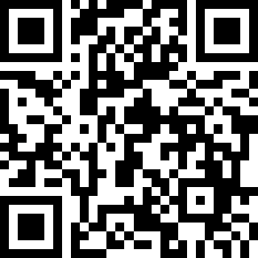
Jamboard link
https://tinyurl.com/otherstatestds

Slide 25
Small Group Breakout
Notes:
Launch the Montana ELA Standards Revision Task Force
Share the purpose, process, and deliverables of the task force.
Build community within the ELA Task Force and with OPI support staff
Initiate review of REL-NW guiding research

Slide 26
Whole Group Share Out
Notes:
Launch the Montana ELA Standards Revision Task Force
Share the purpose, process, and deliverables of the task force.
Build community within the ELA Task Force and with OPI support staff
Initiate review of REL-NW guiding research

Slide 27
Share out
Sell us on:
What should we steal?
What would you change?
What was good?
*Each group allotted 3 minutes
**Following this session review all group notes to gain learnings from their review

Slide 28
Questions

Slide 29
Thank you!
Notes:
Are there any questions from this presentation?

Slide 30
10 Minute Break!
Please Return at:
Notes:
Launch the Montana ELA Standards Revision Task Force
Share the purpose, process, and deliverables of the task force.
Build community within the ELA Task Force and with OPI support staff
Initiate review of REL-NW guiding research

