Slide 1
ELA Standards Revision Task Force
Research Deep Dive
May 3, 2024
Notes:
Welcome! As we get settled in, please introduce yourself in the chat with the following information:
Name
Where you teach/work now?
Years in education

Slide 2
Meeting Participation Protocols
1. Zoom Name: I’m me, are you, you?
2. To Mute or Not to Mute: that IS the question!
Remain muted to reduce background noise.
Unmute when sharing out or in breakout rooms.
Use the chat
Raise your hand
3. Always allow yourself and others to pass or participate as appropriate.
4. Cameras on build community.
5. Use private chats and organizer emails for individual follow up
6. Speak clearly and slowly. We are recording
Notes:
Please Check your Zoom Name and make sure you are you today. You can rename yourself in the participants tool in zoom.
2. To Mute or not to Mute:
Remain muted when others are speaking to reduce background noise.
Come off mute to share your thoughts and participate in discussions
Please use the chat freely and often to ask questions and share thoughts
Feel free to use the raise hand option if you can’t find a natural break in the conversation
3. Always allow yourself and others to pass or participate as appropriate.
4. Cameras on build community.
5. Use private chats and organizer emails for individual follow up when appropriate.
6. Speak clearly and slowly. We are recording for those who are unable to be with us today and we have enabled live transcripts to allow all participants to access the information and conversation in the way that serves them best.

Slide 3
Objectives and Intended Outcomes:
Build community within the ELA Task Force and with OPI support staff
Refine our collective priorities and purpose
Engage deeply with one ELA standards revision guiding research brief from the REL-NW
Notes:
Launch the Montana ELA Standards Revision Task Force
Share the purpose, process, and deliverables of the task force.
Build community within the ELA Task Force and with OPI support staff
Initiate review of REL-NW guiding research

Slide 4
Support Staff Introductions
Montana Office of Public Instruction
Christy Mock Stutz, Assistant Superintendent
Julie Murgel, Chief Program Officer
Marie Judisch, Senior Manager of the Teaching and Learning Department
Aimee Konzen, Standards, Instruction and Professional Learning Manager
Stephanie Swigart, ELA and Literacy Instructional Coordinator
Jackie Ronning, Early Literacy Specialist
Mike Jetty, IEFA Specialist
Jennifer Stadum, IEFA Specialist
Matt Bell, Culture and Language Immersion Specialist
Crystal Hickman, Tribal Student Achievement Specialist
Michelle Henson, Tribal Student Achievement Specialist
Region 17 Comprehensive Center
Jacob Williams
Erich Stiefvater

Slide 5
Task Force Members
Notes:
Task Force: https://docs.google.com/document/d/1zYzKQdWV_cWm308sgKfy-AkQS2tT0ovLL6EV3wVBGz4/edit?usp=sharing

Slide 6
Agenda
9:00-9:10 Introduction, Welcome
9:10-9:20 Housekeeping: Travel, Documents, Drive, Website, etc.
9:20-9:40 Revisiting Our Why Breakout Groups
9:40-10:20 Task Force Introductions (Bios)
10:20-10:30 Break
10:30-12:00 REL Deep Dive Activity with the 5 D’s

Slide 7
Process and Timeline
Orientation
Task Force Independent Research Review
Research Deep Dive (May 3rd)
Professional Learning Sessions (June 10-13)
In-Person Writing Workshop (July)
In-person Revision Team Workshop
Reconciliation
Rationale Finalized
Standards Presented to the Superintendent
Notes:
Next Meetings July:

Slide 8
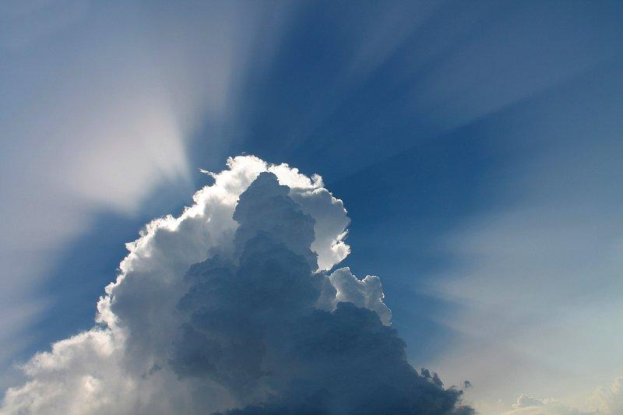
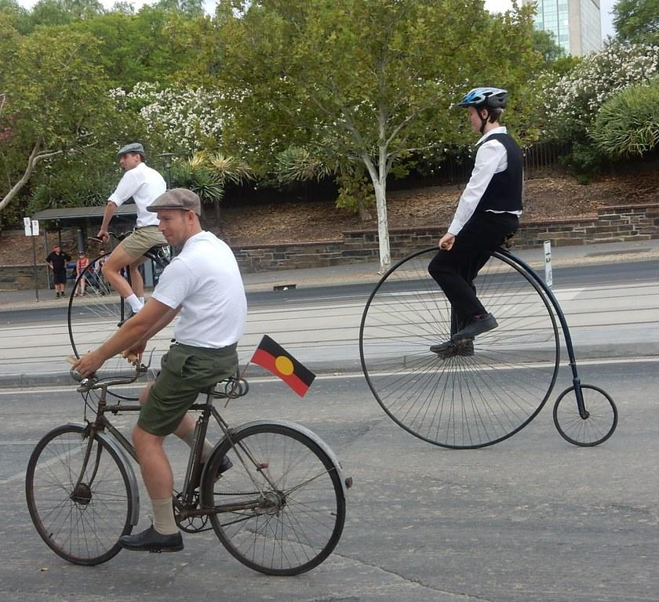
Why Revise ELA Standards?
Simplicity
Clarity
Practicality
Notes:
Superintendent Elsie Arntzen, with approval from the Montana Board of Public Education, has opened the Montana Mathematics Standards for review.The purpose of the standards review process is to assure that Montana public schools are setting high academic standards for all children of our state. The goal is to serve our Montana students and educators with the best-possible standards to guide instruction and prepare our students for their lives beyond the classroom.
Montana has a multitude of heritage languages with experts to draw from. The diversity in linguistic backgrounds will be invaluable to the understanding of language acquisition
These standards were last updated in 1999. In fact, they are one of the last standards to still reside in chapter 53 of the ARM, most others have been migrated to chapter 54. Our goal is to update these standards to reflect the wealth of knowledge that the community has gained

Slide 9
Communication Plan
Task Force:
Primary Email
Public Communication
Compass Newsletter
OPI Standards Website*
*open access
Notes:
Michelle Paste please: OPI Standards Revision Website https://opi.mt.gov/Educators/Teaching-Learning/K-12-Content-Standards/Standards-Revision
The Task Force’s Primary communication will be via email.
Public communication will be through the Compass Newsletter and linked on the OPI Standards website, with open, public access to view most materials. (Every effort will be made to protect your Personally Identifiable Information, but please be aware that most documents, will be posted for public transparency)

Slide 10
Operating Logistics: Virtual Sharing
Workspace Collaboration Process
Google Drive
Google Task Force Landing Page
Hub Course: Google Workspace for Beginners
Notes:
Michelle/Marie

Slide 11
Key Deliverables
Side by Side Comparative of Standards
Rationale for all changes
Research-based?
Position Statement?
Expert Explanation
Definitions
Outline for Guidance Documents
Notes:
What are the critical documents or outputs that the Task Force must create to meet its charge?
At the end of the revision process, the committee will have a draft document of the new ELA standards to present to the Superintendent of Public Instruction. The Superintendent will review the standards.

Slide 12
Writing Into the Day Padlet Waterfall!
What is a Standard?

Slide 13
Standards Requirements According to the Montana Board of Public Education and the Administrative Rules of Montana

Slide 14
The Board of Public Education Guidelines
Standards will define what all students should know and be able to do;
Standards will be challenging and rigorous;
Standards will be clear, understandable, and free of jargon;
Standards will be measurable;
Standards will address diversity, specifically fulfilling the commitment to implementing Indian Education for All;
Standards will be consistent with the grade level and grade band structures in ARM Chapter 53; and
Content standards will be consistent with the program delivery standards described in ARM Chapter 55.
Notes:
https://rules.mt.gov/gateway/ChapterHome.asp?Chapter=10%2E53
https://rules.mt.gov/gateway/ChapterHome.asp?Chapter=10%2E55
https://opi.mt.gov/Portals/182/Page%20Files/Task%20Forces/Chapter%2055/MASTER%20Chapter55%20_BPE.pdf?ver=2023-01-10-112826-340

Slide 15
ARM Chapter 53: Content Standards
10.53.101 EXPLANATION OF THE CONTENT STANDARDS
(1) The content standards shall be used by school districts to develop local curriculum and assessment in all the content areas including:
(b) English language arts and literacy;
(2) The K-12 content standards describe what students shall know, understand, and be able to do in these content standards. These K-12 standards define end-of-year expectations and a cumulative progression designed to enable students to meet college and career readiness expectations no later than the end of high school.
Notes:
https://rules.mt.gov/gateway/RuleNo.asp?RN=10%2E53%2E101

Slide 16
Indian Education for All

Slide 17
Indian Education for All
Constitution of Montana 1972
“The state recognizes the distinct and unique cultural heritage of the American Indians and is committed in its educational goals to the preservation of their cultural integrity.”
Indian Education for All (MCA 20-1-501) 1999,
(amd. Sec. 1, Ch. 718, L. 2023)
“Unique cultural heritage and contemporary contributions of American Indians…”
“Every Montanan, whether Indian or non-Indian…learn about the distinct and unique heritage of American Indians in a culturally responsive manner…”
“Every educational agency and all educational personnel will work cooperatively with Montana tribes…to include information specific to the cultural heritage and contemporary contributions of American Indians, with particular emphasis on Montana Indian tribal groups and governments.
Notes:
https://opi.mt.gov/Portals/182/Page%20Files/Indian%20Education/Indian%20Education%20101/ArticleX_IEFA.pdf
Stephanie:
In Montana we are fortunate to have Indian Education For All encoded in both legislation and our Montana State Constitution.
In 1972, Montana citizens rewrote the state’s Constitution and at this historic gathering they included a unique Constitutional mandate to teach about American Indians.
Article ten on EDUCATION AND PUBLIC LANDS declares that the state recognizes the distinct and unique cultural heritage of the American Indians and is committed in its educational goals to the preservation of their cultural integrity.
Then, in 1999, The Indian Education for All Act (MCA 20-1-501) was passed by our Montana Legislature with bipartisan support. The act states that “in Recognition of American Indian cultural heritage–legislative intent (1) It is the constitutionally declared policy of this state to recognize the distinct and unique cultural heritage of American Indians and to be committed in its educational goals to the preservation of their cultural heritage.
(2) It is the intent of the legislature that in accordance with Article X, section 1(2), of the Montana constitution:
(a) every Montanan, whether Indian or non-Indian, learn about the distinct and unique heritage of American Indians in a culturally responsive manner; and
(b) every educational agency work cooperatively with Montana tribes or those tribes that are in close proximity, when providing instruction or when implementing an educational goal or adopting a rule related to the education of each Montana citizen, to include information specific to the cultural heritage and contemporary contributions of American Indians, with particular emphasis on Montana Indian tribal groups and governments.
(3) It is also the intent of this part, predicated on the belief that all school personnel should have an understanding and awareness of Indian tribes to help them relate effectively with Indian students and parents, that educational agencies provide means by which school personnel will gain an understanding of and appreciation for the American Indian people.

Slide 18
Program Delivery Standards

Slide 19
10.55.1101 ENGLISH LANGUAGE ARTS AND LITERACY PROGRAM DELIVERY STANDARDS
(1) In general, a basic program in English language arts and literacy shall:
(a) meet the following conditions:
(i) promote reading, writing, speaking, and listening for creative and purposeful expression in language;
(ii) engage with high-quality literary and informational text that builds knowledge, expands experiences, and broadens views; and
(iii) emphasize reasoning and use of evidence that is essential for deliberation;
(iv) make available a variety of print and non-print materials encompassing fiction and non-fiction, classic and contemporary works, and diverse perspectives including Montana American Indian works; and
(v) promote critical reading that is necessary to navigate the vast amount of information available both in print and digitally; and
Notes:
History: Mont. Const. Art. X, sec. 9, 20-2-114, 20-2-121, 20-7-101, MCA; IMP, Mont. Const. Art. X, sec. 9, 20-2-121, 20-3-106, 20-7-101, MCA; NEW, 1989 MAR p. 342, Eff. 7/1/89; AMD, 2001 MAR p. 953, Eff. 6/8/01; AMD, 2023 MAR p. 255, Eff. 7/1/23.
The English Language Arts and Literacy Program Delivery Standards Can be Found in Rule Chapter 10:55.1101. They were recently reviewed by the Office of Public Instruction, before going before a Negotiated Rulemaking Committee as part of the 2023 review and revision of Chapter 55 adopted by the Board of Public Education.

Slide 20
Montana ELA Program Delivery Standards, Cont’d
(b) include the following practices:
(i) integrate reading, literature, writing, speaking, listening, and media literacy with a balanced approach supported by current research and/or based on best practices in the field of English language arts and literacy;
(ii) emphasize multiple strategies and artistic forms to teach the conventions, demands, and responsibilities of language;
(iii) emphasize writing as a process;
(iv) provide opportunities for informal and formal speaking and listening;
(v) offer experiences in viewing, creating, and critically evaluating different types of media; and
(vi) encourage co-curricular offerings in drama, speech, debate, journalism, literary publications, and other related activities.
Notes:
History: Mont. Const. Art. X, sec. 9, 20-2-114, 20-2-121, 20-7-101, MCA; IMP, Mont. Const. Art. X, sec. 9, 20-2-121, 20-3-106, 20-7-101, MCA; NEW, 1989 MAR p. 342, Eff. 7/1/89; AMD, 2001 MAR p. 953, Eff. 6/8/01; AMD, 2023 MAR p. 255, Eff. 7/1/23.
The English Language Arts and Literacy Program Delivery Standards Can be Found in Rule Chapter 10:55.1101. They were recently reviewed by the Office of Public Instruction, before going before a Negotiated Rulemaking Committee as part of the 2023 review and revision of Chapter 55 adopted by the Board of Public Education.

Slide 21
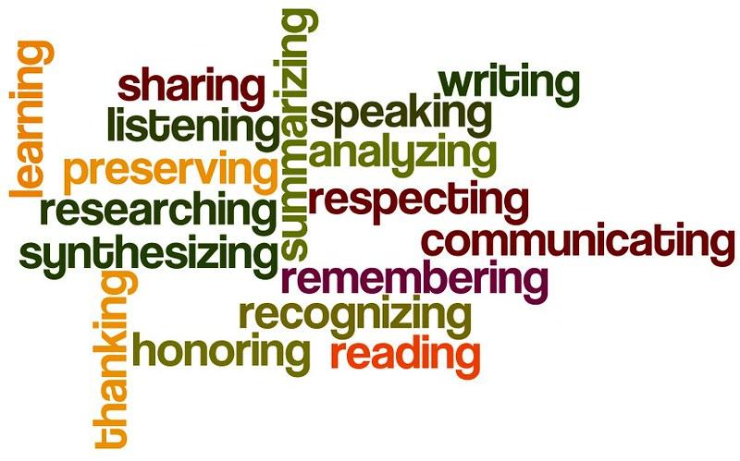
Component Synthesis Writing Activity
5 Minute Free Write
3 min Padlet Summary
Break (10 min)
Breakout Room Share Out
=18-20 minutes total!

Slide 22
Task Force
Team Building Breakouts
Notes:
Paste in chat!
In Breakout Rooms:
1 Introduce yourself (again?)
2. Share your Padlet Synthesis responses
3. Discuss your “Why” and the “Why” of other task force members from the Jamboard slide 12 https://jamboard.google.com/d/1pU1IDcQNJGZrnlT_1bjzX_LGDF8vg8QsIz43RZWv7FI/viewer?f=11

Slide 23
Share Out
Jamboard: Bios
Notes:
Launch the Montana ELA Standards Revision Task Force
Share the purpose, process, and deliverables of the task force.
Build community within the ELA Task Force and with OPI support staff
Initiate review of REL-NW guiding research

Slide 24
10 Minute Break!
Please Return at:
Notes:
https://jamboard.google.com/d/1pU1IDcQNJGZrnlT_1bjzX_LGDF8vg8QsIz43RZWv7FI/viewer?f=12
Slides 14-15

Slide 25
Regional Educational Laboratory
Research Deep Dive
Notes:
Launch the Montana ELA Standards Revision Task Force
Share the purpose, process, and deliverables of the task force.
Build community within the ELA Task Force and with OPI support staff
Initiate review of REL-NW guiding research

Slide 26
Questions

Slide 27
Thank you!
Notes:
Are there any questions from this presentation?

Slide 28
2023-2025 Standards Revision Process

Slide 29
MT Board of Public Education Approved Standards Revision Timeline
Research and Review | Revisions | Negotiated Rulemaking Committee | Adoption Phase | Professional Learning for New Standards | District Implementation
September 2023 through March 2024 | April through August 2024 | September through December 2024 | January through June 2025 | June 2025 through June 2026 | July 2026
Notes:
Arm Chapter 10.53.104 STANDARDS REVIEW SCHEDULE
(1) Montana's content standards shall be reviewed and revised on a recurring schedule.
(2) A schedule for review of content standards shall be established as a collaborative process with the Office of Public Instruction and the Board of Public Education with input from representatives of accredited schools. The schedule shall ensure that each program area is reviewed and revised at regular intervals.
(3) The standards review process shall use context information, criteria, processes, and procedures identified by the Office of Public Instruction with input from representatives of accredited schools.
The ElA Standards will follow the following schedule: Research and Review opened September 1, 2023 and will run through March 2024. The Revisions phase will begin in April of 2024 and run through August 2024 followed by Negotiated Rulemaking. The standards will then go to the Board of Public Education for review, public comment and Adoption. Starting in June of 2025, following the adoption of the standards by the BPE, The OPI will lead professional Learning for the new standards throughout the following academic year including coordinating educator leaders to develop the state curriculum guide to support the implementation of the new standards. Let’s look a little deeper at how to

Slide 30
Research and Review Phase
September 2023 through March 2024

Slide 31
Research Step 1:
September 2023 through March 2024
Comprehensive review of other states’ ELA Standards
Consideration of assessment, curriculum, and programmatic factors
Review and development of focused research questions…
Notes:
Your Montana OPI has been working hard to prepare for the opening of the ELA standards by gathering input from key stakeholder groups such as the Montana Association of the Teachers of English Language Arts, our Montana Professional Educator Preparation Program leaders, and the Montana Literacy Association. We have been conducting internal research, and reviewing other states standards, the ELA program delivery standards in Chapter 55, and key assessment considerations such as the new MAST through-year assessments innovative assessments pilot program and the new early literacy legislation requiring early screening and support for students who are identified as at risk of not being grade-level proficient by grade 3. This preliminary research is done in part to support the development of high-quality research questions that we provide to the REL NW to guide their research support of our standards process.

Slide 32
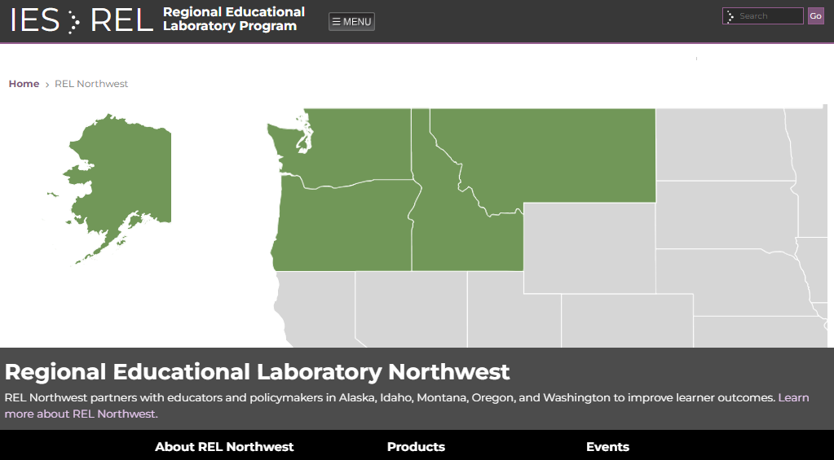
Research Step 2:
September 2023 through March 2024
Notes:
Funded by the US Department of Education’s Institute of Educational Sciences, the ten Regional Educational Laboratories (RELs) partner with educators and policymakers nationwide. to provide support for development of programs, services, and guidelines. For nearly 60 years, the RELs have collaborated with school districts, state departments of education, and other education stakeholders to help generate and apply evidence, with the goal of improving learner outcomes. REL work is change-oriented, rigorous, and high-leverage, supporting consequential local, regional, or statewide decisions about education policies, programs, and practices. RELs contribute to the growing body of research on how experiences within the nation’s education system differ by context and student group, thereby impacting outcomes and identifying potential solutions.
WestEd operates Regional Educational Lab Northwest in partnership with Marzano Research to serve the states of Alaska, Idaho, Montana, Oregon, and Washington.

Slide 33
Revisions Phase
April 2024 through August 2024

Slide 34
Revisions Phase
April 2024 through August 2024
Writing Team: Development
Review Team
Writing Team: Reconciliation
Review the Research from the REL and OPI
Collaborate to develop new standards and/ or revise existing standards language
April-July 2024
Review the Research from the REL and OPI
Review Standards and/or language changes developed by the Writing team
Provide feedback and suggestions
April-August 2024
Consider feedback from the Review Team
Reconcile changes suggested and come to consensus
Prepare final draft for Negotiated Rulemaking
August 2024
Notes:
Arm Chapter 10.53.104 STANDARDS REVIEW SCHEDULE
(1) Montana's content standards shall be reviewed and revised on a recurring schedule.
(2) A schedule for review of content standards shall be established as a collaborative process with the Office of Public Instruction and the Board of Public Education with input from representatives of accredited schools. The schedule shall ensure that each program area is reviewed and revised at regular intervals.
(3) The standards review process shall use context information, criteria, processes, and procedures identified by the Office of Public Instruction with input from representatives of accredited schools.
The ElA Standards will follow the following schedule: Research and Review opened September 1, 2023 and will run through March 2024. The Revisions phase will begin in April of 2024 and run through August 2024 followed by Negotiated Rulemaking. The standards will then go to the Board of Public Education for review, public comment and Adoption

Slide 35
GOALS FOR THE TASK FORCE:
Writing Team
Goal 1: Review the research and data
Goal 2: Synthesize research, national standards, international standards, etc. to consider the implications for the current standards
Goal 3: Determine if all, some, or none of the current standards need to be rewritten to match current research
Goal 4: Write/revise ELA standards. Publish a draft of standards that ensures the highest quality education for our teachers and students in the coming years.
Notes:
Marie
1 minute

Slide 36
GOALS FOR THE TASK FORCE:
Review Team
Goal 1: Review the research and data
Goal 2: Review the standards produced by the writing team for:
accuracy
inclusion of necessary essential concepts
processes
IEFA
Vertical and interdisciplinary alignment
Goal 3: Review the work of the writing team and make suggestions or revisions regarding what to discard, update, or keep for each of the proposed standards to match current research, best practices, and/or for vertical alignment.
Notes:
Marie
1 minute

Slide 37
Negotiated Rulemaking Committee
September through December 2024

Slide 38
Negotiated Rulemaking Committee
The committee must represent the diverse circumstances of schools of all sizes across the state and must include representatives from the following groups:
School district trustees
School administrators
Teachers
School business officials
Parents/guardians
Taxpayers
Montana Tribal Nations Representative
Notes:
1 minute

Slide 39
Negotiated Rulemaking Committee
Roles and Responsibilities
Notes:
1 minute
Rules proposing or amending standards of accreditation must go through formal negotiated rule making pursuant to the Montana Administrative Procedures 2-5-101
Proposed rules amending or adopting accreditation standards must follow a formal negotiated rule-making process as required in § 20-7-101, MCA. The OPI Legal Division will assist with the process.
At the conclusion of the negotiated rulemaking process, the Superintendent of Public Instruction will make a recommendation for adoption of proposed content standards to the Board of Public Education

Slide 40
Adoption Phase
January through June 2025

Slide 41
Board of Public Education: Administrative Rulemaking
Adopt a rulemaking timeline
Publish proposed revisions
Publish notices of a comment period and a public hearing
Respond to public comment
Act to adopt, adopt as revised, or not adopt proposed content standards
Notes:
1 minute
BOARD OF PUBLIC EDUCATION RULES
When the rules being amended/repealed/adopted are under the authority of the BPE, the proposed
rules should be presented to the BPE at least three times at publicly noticed BPE meetings.
a. The first presentation to the BPE may be a draft of the proposed rules. This is an
informational item on the BPE’s agenda. A timeline of the proposed rulemaking may
be presented to the BPE for approval.
b. The second presentation to the BPE is the proposed rules as they will be published by
the Secretary of State in the Montana Administrative Register with Notice of Public
Hearing. This is an agenda item for BPE action. The BPE will be asked to approve the
rules as proposed and set a hearing date for public comment.
c. The third presentation to the BPE is the proposed rules in their final form with
summarized public comments and responses to those comments. This is an agenda
item for BPE action. The BPE will be asked to approve the proposed rules as finalized
after the public hearing and consideration of all public comments.

Slide 42
ARM Adoption Process
Notes:
1 minute

Slide 43
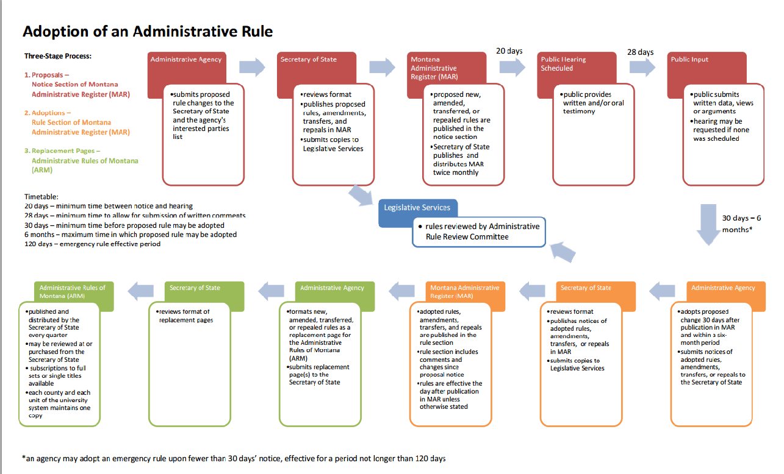
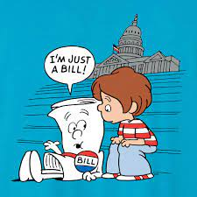
Notes:
30 seconds

Slide 44
Implementation Phase
June 2025-September 2026

Slide 45
District Implementation Timeline
By July 2026
July 2026
September 2026
Update district curriculum review schedule to include new standards
Plan professional development
Plan curriculum review
Plan instructional materials review
Standards published in the Administrative Register of Montana (ARM)
ELA standards are ready to be implemented starting with the 26/27 school year.
Notes:
1 minute
Aaaaand you made it! Let’s take some time in breakout rooms to do some team building exercises.

Slide 46
Operating Logistics: Travel
Mileage
Meals
Lodging
Notes:
Travel Reimbursement Plan: Montana ELA Content Standards Revision Task Force (Small Change for Direct Bill)
Forms available onsite and linked on the travel plan for mileage rimbrusement and meal reimbursement while in travel status. Sheri Harlow, will also have hard copies for you to fill out on the day of.
We are working hard to set up a direct bill for the Home2Suit

