Slide 1
Learning Design Lab: Goals
Notes:
Link to reflection handout: https://docs.google.com/document/u/3/d/12yZ1nA0kXWfwXSMlxgacM-G9svlzVtyzRsB95CJh9rI/copy
Link to design template: https://docs.google.com/document/d/1sGK6GXy7lQVvpelPZxKJqiRaXNoJZ4nhBmTMlPpdpzw/copy

Slide 2
What do you know about Universal Design for Learning?

Slide 3
What do you know about UDL?
1
5
10
Heard of it
I’ve seen the Guidelines
I’m always learning, but I can teach about UDL too.
Notes:
Write, draw, create a venn diagram...whatever you need to do to think about this question.

Slide 4
I’m Missy
I’m a relentless advocate for learning and learners, and I have a simple mantra:
“I’m not asking you to change; I’m asking you to learn.”

Slide 5
What to Expect Today
We’ll be here together for 30 minutes.
You’ll think that you’re not ready to think this deeply about goals. You may even question the practicality of going so deep on understanding goals.
There will be quiet thinking time and time to process in multiple ways that you choose. There will be timers to guide us but not limit us. We will also utilize breakout rooms for discussion.
Putting your thinking in the chat is encouraged. If it distracts you as a learner, use the arrow to hide the chat.

Slide 6
Today’s Learning Goal
Review the goal of UDL
Recognize the continuum of clearly defined goals
Make the connection between clearly defined goals, learner agency, and expert learners
Notes:
Building off your “why’s” we’re going to position a focus on thinking for this hour. Connect what your learning experiences to learning experience you design and support for your learners –The three goals for the session
What we’re doing today is challenging, but we’ve worked hard to make sure everyone can be successful. Please use the chat box with any questions. This session will not be recorded, but content about UDL and the tech tools will be created and put on our project website which is under construction! I’ll put the DPI webpage with the current information about UDL Forward! in the chat box.
UDL Forward! Project - DPI Webpage: https://dpi.wi.gov/cares/education-stabilization-funds/educator-training-online-and-remote-instruction

Slide 7
Tell us in the chat!
How deeply or how often do you consider the goal when designing experiences in your classroom?

Slide 8
UDL Always Begins with...
Goals

Slide 9
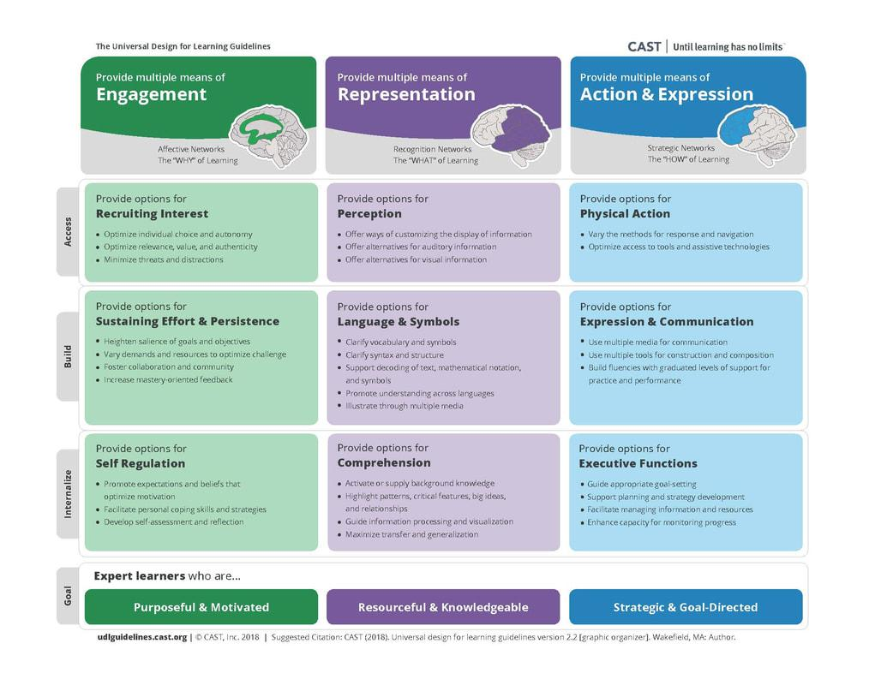
You have likely seen these guidelines...
Downloadable Guidelines

Slide 10
The Goal: Create Expert Learners
Purposeful and Motivated
Strategic and Goal Directed
Resourceful and Knowledgeable

Slide 12
Time for some inquiry
What is learner agency?
Notes:
I’m going to give you 5 minutes to explore this question on the Googles…or wherever you want… What will you do first…commit to a learning plan (it’s only 5 minutes…but what is your plan… put it in the chat)

Slide 13
Digging deeply into goals…
Makes developing learner agency possible.
And…it’s more than voice and choice.

Slide 14
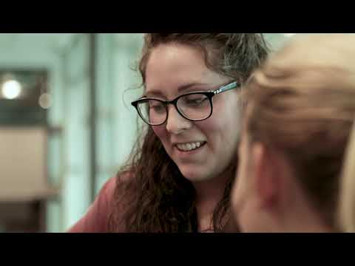
Notes:
A clearly defined goal is the basis for learning, without it our internal GPS doesn’t know where the journey is going to take us. Learners and educators must work together to create meaning of the target shared by the educator and the learner in order for the goal to become personally meaningful to them. This process is not done in isolation or in the course of a lesson or unit, this process takes time. It is the journey of learning. The learning community must work together to create an environment of learning that works towards learners becoming expert learners who understand that the goal they are trying to achieve will take them through emotions, with high and low moments. Learner agency is developed when the learner experiences these moments, makes choices, receives feedback, and adjusts the path to achieving the goal.
This chart captures that journey. The chart is meant to show the journey of learners becoming expert learners driven by a goal. When viewing you may look at it in a variety of ways, but I wanted to share my thinking as I designed.
The chart is organized for all who use it to enter where it makes sense to them. As I see the process we all begin somewhere, and in education that usually begins with starting at implementation and ends with us internalizing it to become our mindset, habits, and ways of being. That is what the left to right flow of the rows in this chart represent. You may come in and out of these phases, but when UDL is your way of being you will live more in the right column with learners in your learning community.

Slide 15
There is a lot to consider when creating goals
So much that we created a chart…

Slide 16
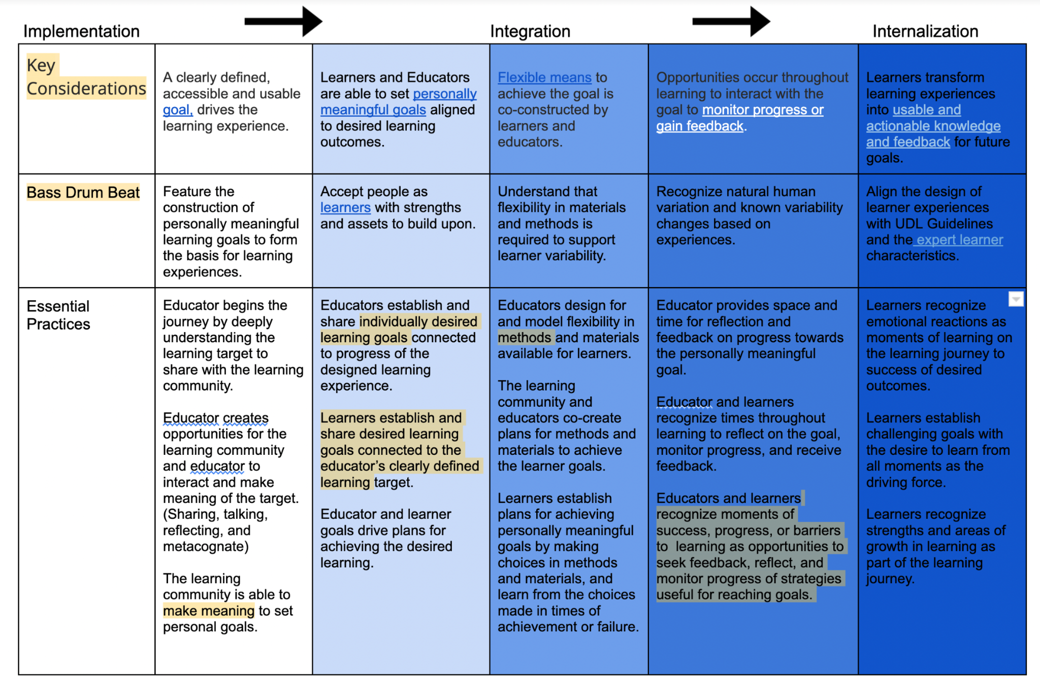
Notes:
Take a breath…There is a lot to this chart, and I promise to go over each piece of it.
A clearly defined goal is the basis for learning, without it our internal GPS doesn’t know where the journey is going to take us. Learners and educators must work together to create meaning of the target shared by the educator and the learner in order for the goal to become personally meaningful to them. This process is not done in isolation or in the course of a lesson or unit, this process takes time. It is the journey of learning. The learning community must work together to create an environment of learning that works towards learners becoming expert learners who understand that the goal they are trying to achieve will take them through emotions, with high and low moments. Learner agency is developed when the learner experiences these moments, makes choices, receives feedback, and adjusts the path to achieving the goal.
This chart captures that journey. The chart is meant to show the journey of learners becoming expert learners driven by a goal. When viewing you may look at it in a variety of ways, but I wanted to share my thinking as I designed.

Slide 17
Key Considerations When Setting Goals
Notes:
Let’s first look at the key considerations.
The chart is organized for all who use it to enter where it makes sense to them. As I see the process we all begin somewhere, and in education that usually begins with starting at implementation and ends with us internalizing it to become our mindset, habits, and ways of being. That is what the left to right flow of the rows in this chart represent. You may come in and out of these phases, but when UDL is your way of being you will live more in the right column with learners in your learning community.

Slide 18
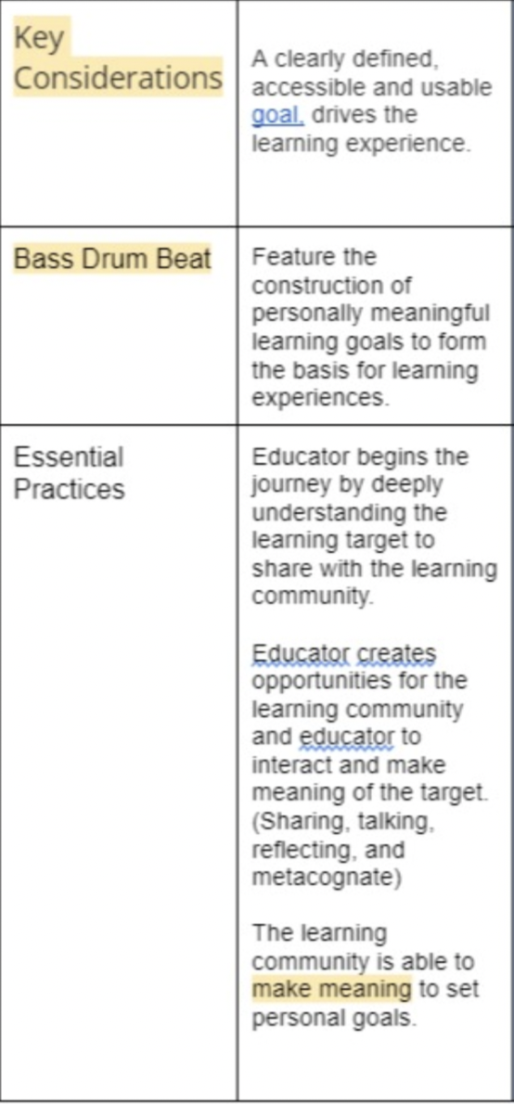
Notes:
When we move up and down the chart in columns we now see more of the context of what it means to be on the journey of learning.
The Key Consideration lays the foundation for what we want to achieve.
The Bass Drum Beat allows us to connect this foundation to the beliefs we hold as a statewide UDL team in Wisconsin. Learn more here.
The Essential Practices give us the details of how this may look in practice.

Slide 19
Notes:
Take a breath…There is a lot to this chart, and I promise to go over each piece of it.
A clearly defined goal is the basis for learning, without it our internal GPS doesn’t know where the journey is going to take us. Learners and educators must work together to create meaning of the target shared by the educator and the learner in order for the goal to become personally meaningful to them. This process is not done in isolation or in the course of a lesson or unit, this process takes time. It is the journey of learning. The learning community must work together to create an environment of learning that works towards learners becoming expert learners who understand that the goal they are trying to achieve will take them through emotions, with high and low moments. Learner agency is developed when the learner experiences these moments, makes choices, receives feedback, and adjusts the path to achieving the goal.
This chart captures that journey. The chart is meant to show the journey of learners becoming expert learners driven by a goal. When viewing you may look at it in a variety of ways, but I wanted to share my thinking as I designed.

Slide 20
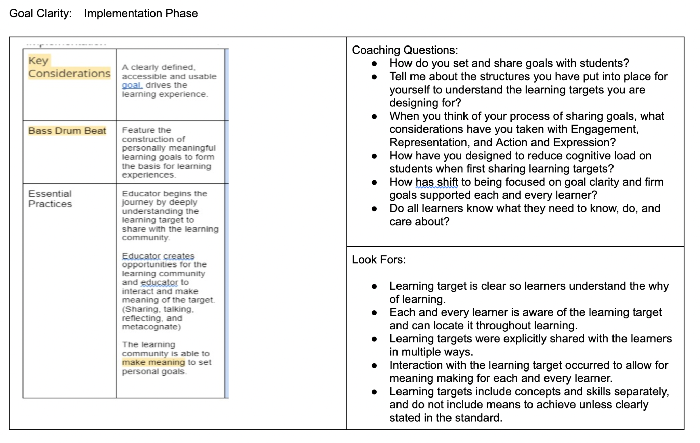

Slide 21
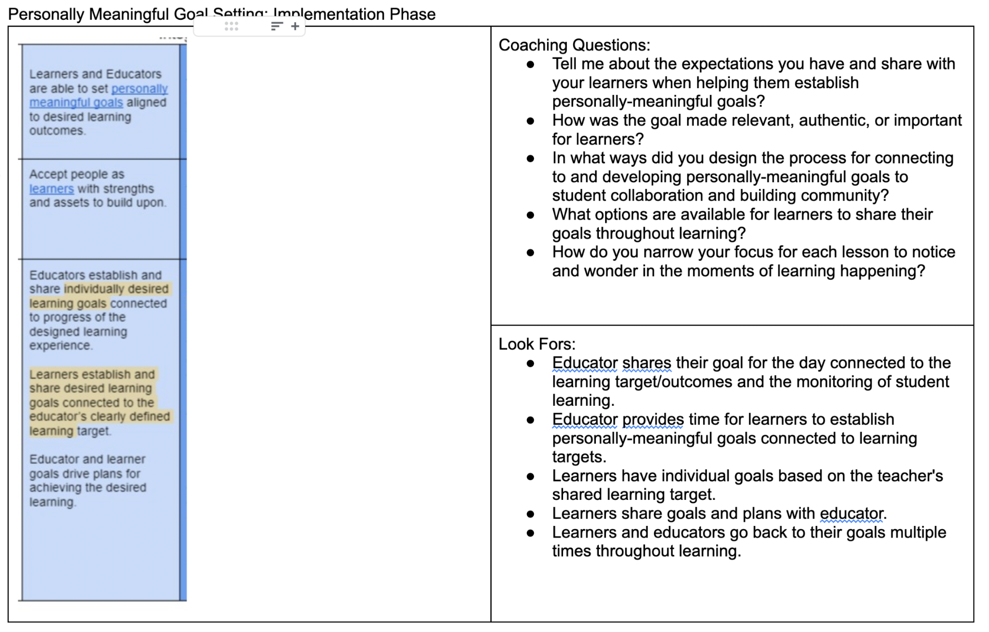

Slide 22
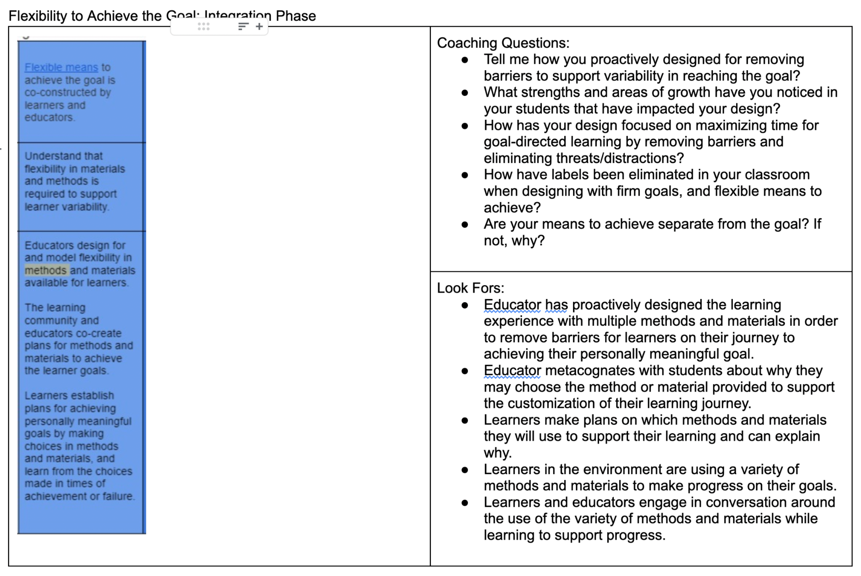

Slide 23
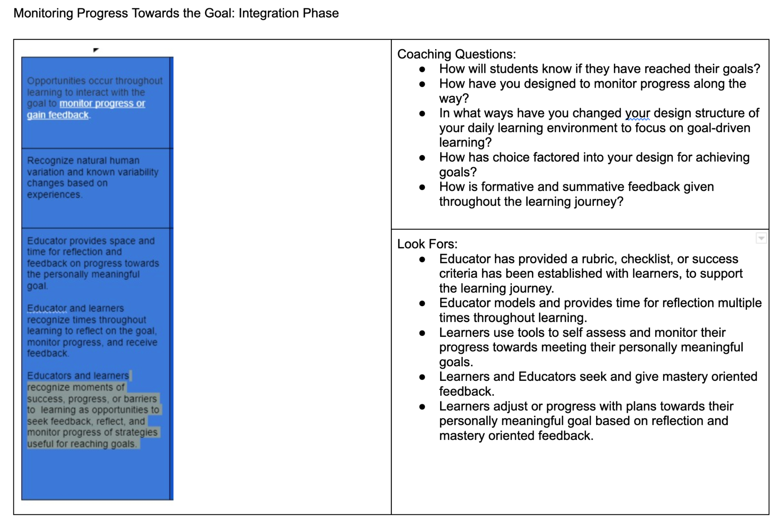

Slide 25
What are you thinking?
In breakout rooms, discuss with others what is coming to your mind as you preliminarily review the key considerations for setting clear goals.

Slide 26
You’re Invite
To explore this idea more in depth in our upcoming Learning Design Lab.
Details will be in the community!
UDLforward.community

