Slide 1
ELA Standards Revision Task Force
Assessment Requirements & Considerations

Slide 2
The Purpose
Provide considerations for assessment when developing & reviewing ELA standards

Slide 3
Introductions
Cedar Rose, OPI Assessment Director
Erin de Graw, OPI Assessment Specialist
Marcy Fortner, OPI Assessment Specialist

Slide 4
Objectives
Understand state and federal assessment requirements
Create connections between standards, assessment, and accountability
Consider assessment requirements in standards development

Slide 5
50-minute Agenda
Welcome and Introductions
Clarify learning: Statewide assessment & requirements
Groundwork: Standards, assessment, and accountability
Current statewide ELA assessment transition
Aligning assessment to standards
Break out rooms: Writing items to assess standards
Reflection

Slide 6
Information Sharing
Targeted Information, Calibration of Terms, Groundwork

Slide 7
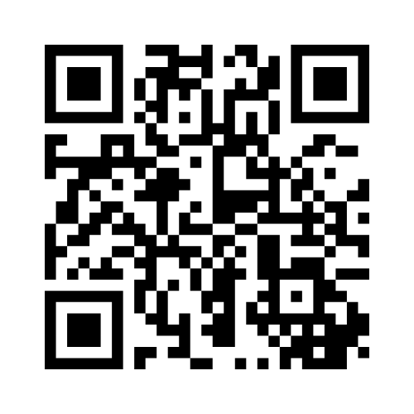
When you think of Statewide Testing…
https://www.menti.com/al8k5t5me5kr
Notes:
Mentimeter: https://www.menti.com/al8k5t5me5kr

Slide 8
What I heard as a teacher…
“Why do we have to take these tests?”
…and what I hear as an
assessment director…

Slide 9
Federal Statewide Assessment Requirements
ESSA Section 1111(b)(2) Academic Assessments
(A) IN GENERAL.—Each State plan shall demonstrate that the State educational agency, in consultation with local educational agencies, has implemented a set of high quality student academic assessments in mathematics, reading or language arts, and science. The State retains the right to implement such assessments in any other subject chosen by the State.
(B) REQUIREMENTS.—The assessments under subparagraph (A) shall— (i) except as provided in subparagraph (D), be— (I) the same academic assessments used to measure the achievement of all public elementary school and secondary school students in the State; and (II) administered to all public elementary school and secondary school students in the State; (ii) be aligned with the challenging State academic standards, and provide coherent and timely information about student attainment of such standards and whether the student is performing at the student’s grade level;

Slide 10
ARM Chapter 56: Assessment
10.56.101 Statewide Assessment
(1) By the authority of 20-2-121(12), MCA and ARM 10.55.603, the Board of Public Education adopts rules for state-level assessment in the public schools and those private schools seeking accreditation.
(2) The Board of Public Education (board) recognizes that the primary purpose of assessment is to serve learning. A balanced assessment system including formative, interim, and summative assessments aligned to state content standards, will provide an integrated approach to meeting both classroom learning needs and school and state level information needs. A balanced assessment system is structured to continuously improve teaching and learning and to inform education policy.

Slide 11
ARM Chapter 56: Assessment
10.56.102 Participation
(1) By the authority of 20-2-121(11), MCA, and ARM 10.55.603, the Board of Public of Education (board) adopts rules for statewide assessment in all public and accredited nonpublic schools.
(2) Statewide assessments approved by the Board shall be administered in all public and accredited nonpublic schools.
(3) School districts shall annually administer statewide assessments to all students in accordance with state and federal laws and regulations that meet or exceed the following specifications:
(a) English language arts and mathematics assessments shall be aligned to Montana content standards in English language arts and mathematics and administered in grades 3-8 and 11;
(b) Science assessments shall be aligned to Montana content standards for science and administered in grades 5, 8, and 11; and
(c) Assessments shall be administered in the spring of each year.
(4) State-level assessments aligned to Montana-English language proficiency standards shall be administered to all students identified as English Learners (EL) in grades (K-12). These assessments shall be administered mid-school year.

Slide 12
Peer Review Requirements
Critical Element 1.1:
State Adoption of Academic Content Standards for All Students
The State formally adopted challenging academic content standards for all students in reading/language arts, mathematics and science and applies its academic content standards to all public elementary and secondary schools and students in the State.
Critical Element 1.2:
Coherent and Rigorous Academic Content Standards
The State’s academic content standards in reading/language arts, mathematics and science specify what students are expected to know and be able to do by the time they graduate from high school to succeed in college and the workforce; contain content that is coherent (e.g., within and across grades) and rigorous; encourage the teaching of advanced skills; and were developed with broad stakeholder involvement.

Slide 13
Peer Review Requirements
Critical Element 1.3:
Required Assessments
The State’s assessment system includes annual general and alternate assessments (based on grade-level academic achievement standards or alternate academic achievement standards) in:
Reading/language arts and mathematics in each of grades 3-8 and at least once in high school (grades 10-12);
Science at least once in each of three grade spans (3-5, 6-9 and 10-12).

Slide 14
All that policy adds up to…
Each state has to adopt grade-level content standards in math, reading/language arts, and science
AND
Standards must be assessed through an assessment system on a yearly basis (grades 3-8 and 11) in ELA and math, once in each grade band (grades 5, 8, and 11) in science, and annually in grades K-12 if an identified English learner.
But what happens with all those scores?

Slide 15
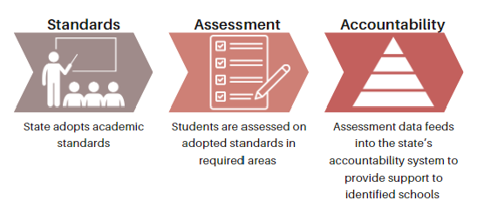
The Big Picture

Slide 16
Accountability
intended to help the public understand individual school performances on achievement indicators and to measure inequalities across schools, so all students have equitable opportunities to access high-quality education

Slide 17
MT’s Accountability System
1-4 Federally Required Indicators
Academic Achievement on Statewide Assessments: ELA/Reading & Math
Academic Growth on Statewide Assessments ELA/Reading & Math (K-8 Only)
English Learner Progress
Graduation Rates (HS only)
5th Indicator for Montana Flexibility
Attendance
College & Career Ready (HS Only)
Science Assessment

Slide 18
Discussion
Explore Central Ideas or Higher Level Messaging

Slide 19
Group Debrief
What are the larger implications of standards beyond what students are expected to learn by the end of the school year?
How do standards ultimately affect schools identified for additional support?
What are the key implications of keeping assessment in mind while reviewing and changing standards?

Slide 20
Small Group Breakout

Slide 21
Assessing Standards
Through Items-Jamboard
In your grade band groups:
Pick one of the provided ELA standards in your grade band
Write an assessment item that could be used to assess that standard as written.
Discussion (as a group)
What made the standard easy to assess with an item?
What made the standard challenging to assess?
What are some considerations for assessing this standard in a format conducive to large-scale assessment.
Notes:
https://jamboard.google.com/d/1BTxnxXjnFuZ1lDDmzuoZYB-3HGcz6FATsSkOocoOyFA/edit?usp=sharing

Slide 22
Whole Group Share Out

Slide 23
Share Out
What made a standard easy to assess?
What made a standard challenging to assess?
What are some considerations for assessing standards in a format conducive to large-scale assessment?

Slide 24
Reflection Time

Slide 25
Questions & Final Thoughts

Slide 26
Thank you!
Notes:
Are there any questions from this presentation?

