Slide 1
Education Advocates-ARP ESSER May 18, 2021
Julie Murgel
OPI Senior Manager
School Innovation and Improvement Department

Slide 2
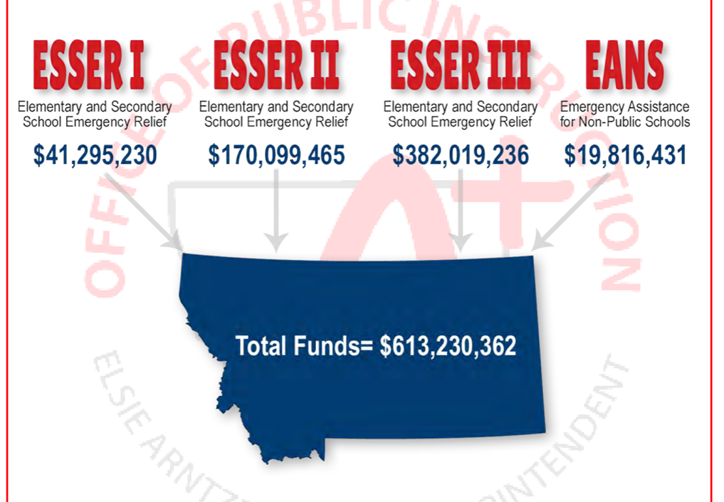
ESSER Summary
Elementary and Secondary School Emergency Relief Fund (ESSER):
3 Rounds of ESSER funds have been authorized by Congress in response to COVID-19 pandemic.

Slide 3
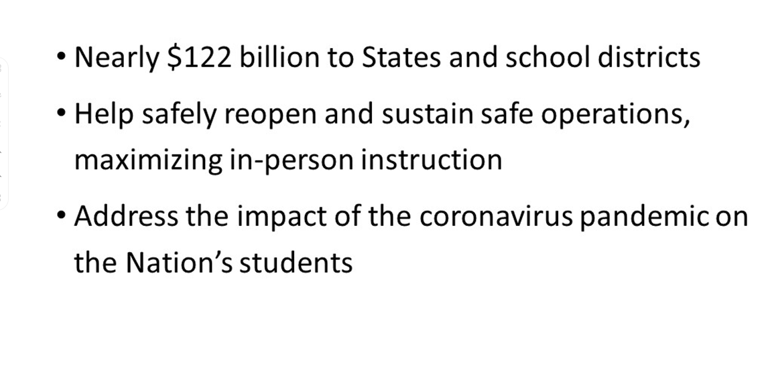
ARP ESSER Overview

Slide 4
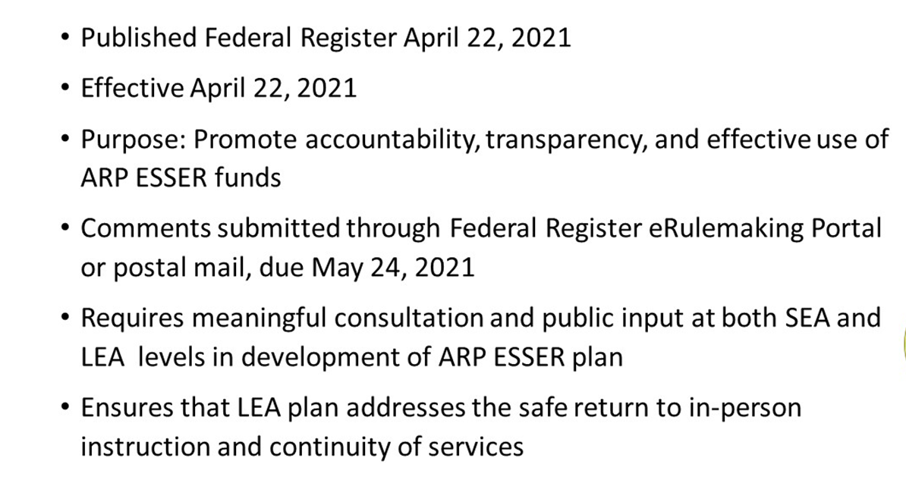
Interim Final Rule

Slide 5
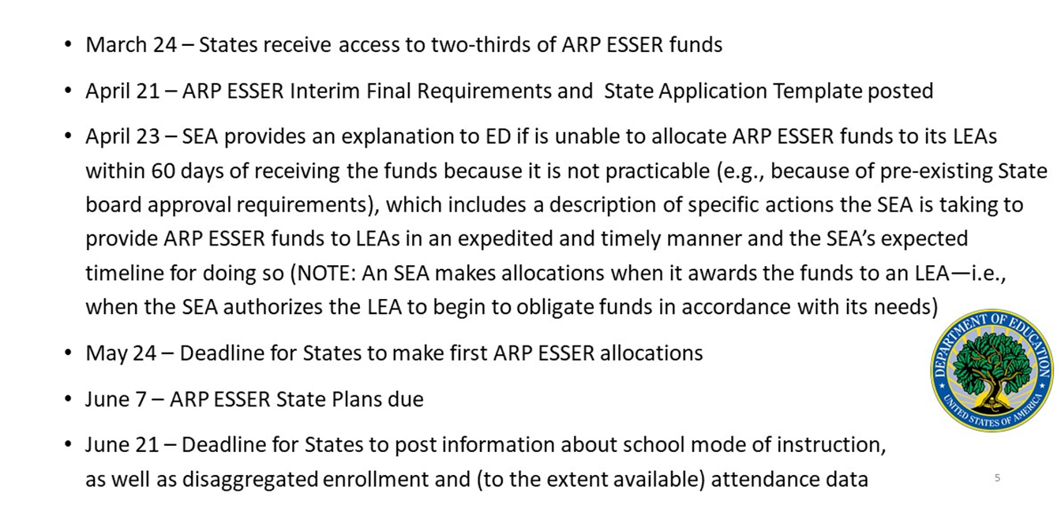
ARP ESSER Timeline

Slide 6
ARP-ESSER Due Dates for the MT OPI
May 24, 2021. MT OPI must allocate the school district share of the ARP ESSER funds received on March 24, 2021 within 60 days unless it is not practicable.
June 7, 2021. Due date for submitting the ARP ESSER State Plan to ED.
June 21, 2021. No later than June 21, 2021, but as soon as possible, the OPI must make information available on its website about the numbers of schools in the state providing each mode of instruction, student enrollment data for each mode of instruction by all students and disaggregated by subgroup, and if available student attendance data.

Slide 7
APR-ESSER Due Dates for School Districts
Safe Return to In-Person Instruction and Continuity of Services Plan -- within 30 days of receiving ARP ESSER allocation.
June 24, 2021
Districts must develop and make publicly available a Safe Return to In-Person Instruction and Continuity of Services Plan.
If a District developed a plan before ARP was enacted that does not address the above requirements, the District must revise its plan no later than six months after it last reviewed its plan.
Districts need to update the Safe Return to In-Person Instruction and Continuity of Services Plan at Districts every six months through September 30, 2023 and must seek public input on the plan and any revisions and must take such input into account.

Slide 8
APR-ESSER Dues Dates for Districts
District ARP ESSER Plan – within a reasonable timeline established by the OPI August 24, 2021
• How ARP ESSER funds will be used by the District to implement prevention and mitigation strategies,
• How the District will use the mandatory 20% set-aside for to address the academic impact of “lost instructional time” through the implementation of evidence-based interventions,
• How the District will use the remaining ARP ESSER funds consistent with statutory requirements,
• How the District will ensure that the ARP ESSER funded interventions, including but not limited to the 20% set-aside, will respond to the academic, social, emotional, and mental health needs of all students, and particularly those students disproportionately impacted, and
• Consultation with a wide variety of stakeholders when developing the plan.

Slide 9
OPI Project Team Deliverables
What are the critical documents or outputs that the Project team must create to meet its charge?
Montana ARP-ESSER Application
Stakeholder input and consultation
OPI website-school mode of instruction, enrollment, and attendance
LEAs Technical Assistance for Safe Return to In-person instruction and Continuity of Service Plan
District template for ARP-ESSER funding
Notes:
Notes: The current state and federal policy environment was built to service a more traditional school model. The COVID-19 pandemic has highlighted the various forms of friction between what educators need to enable and empower continuity of learning and what policy encourages or allows. Flexibilities provide relief from state and federal policies and regulations that put-up barriers. Flexibilities allow students to keep on learning and educators to rethink and transform education, drive meaningful change, build capacity, and support student health and well-being.

Slide 10
Key Topics
Allocation of Funds
State Plan Template
District Plans
Consultation
Evidenced-based interventions
Maintenance of Equity
Reporting

Slide 11
State Plan Template Sections
Describing the State’s Current Status and Needs
Safely Reopening Schools and Sustaining their Safe Operations
Planning for the Use and Coordination of ARP ESSER Funds
Maximizing State-Level Funds to Support Students
Supporting LEAs in Planning for and Meeting Student Needs
Supporting the Educator Workforce
Monitoring and Measuring Progress

Slide 12
ARP-ESSER Stakeholder Input
Timeline outlining the process with stakeholder involvement:
May 11, 2021: Launched survey
May 14, 2021: Presentation to the Montana BPE
May 17, 2021: Webinar 1 for public input, 9:00am-10:30am
May 17, 2021: Webinar 2 for public input, 4:00pm to 5:30pm
May 18, 2021: Discussion with Education Advocates
May 18, 2021: Webinar 3 for public input, 10:30am-12:00pm
May 21, 2021: Survey for public comment deadline
May 2021: Consultation with the Governor’s office
June 7, 2021: Final Draft prepared and submitted to the DOE

Slide 13
ARP ESSER Survey
The Montana Office of Public Instruction is seeking public comment on the ARP-ESSER State template.
Stakeholder survey link
Survey closes: 5/21/2021

Slide 14
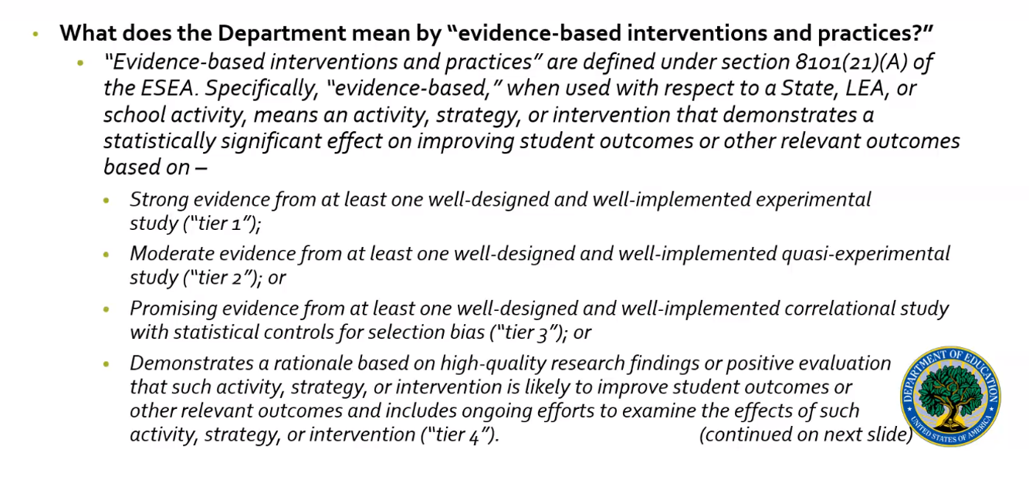
Evidenced-based interventions

Slide 15
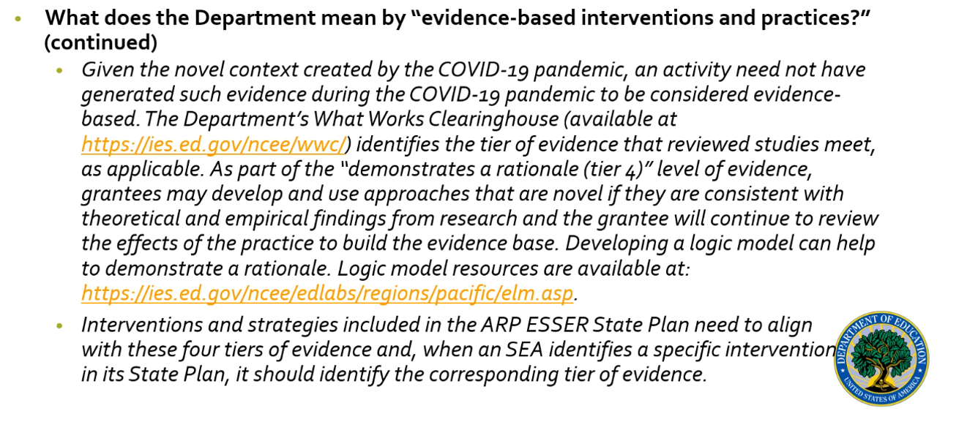
Evidence-based interventions

Slide 16
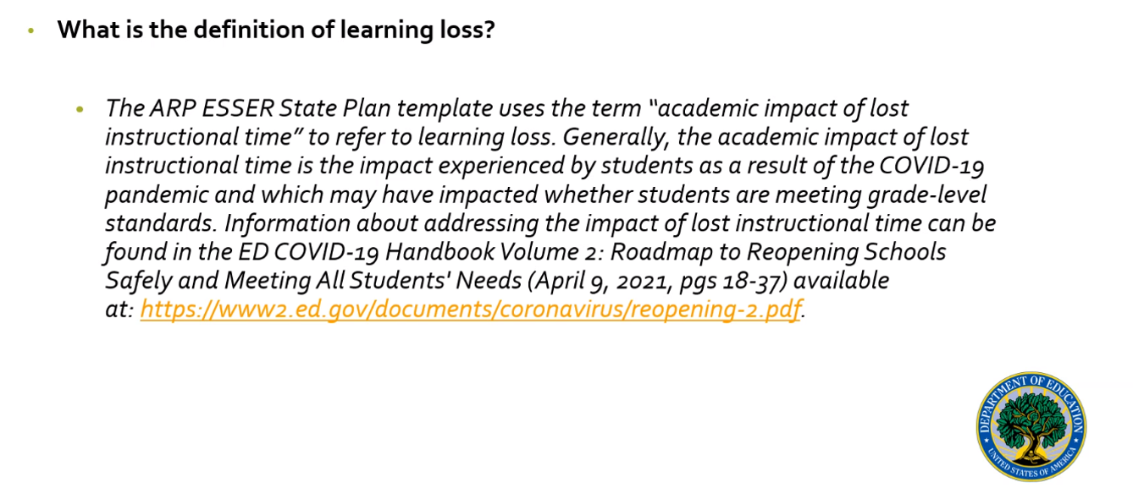
Definition

Slide 17
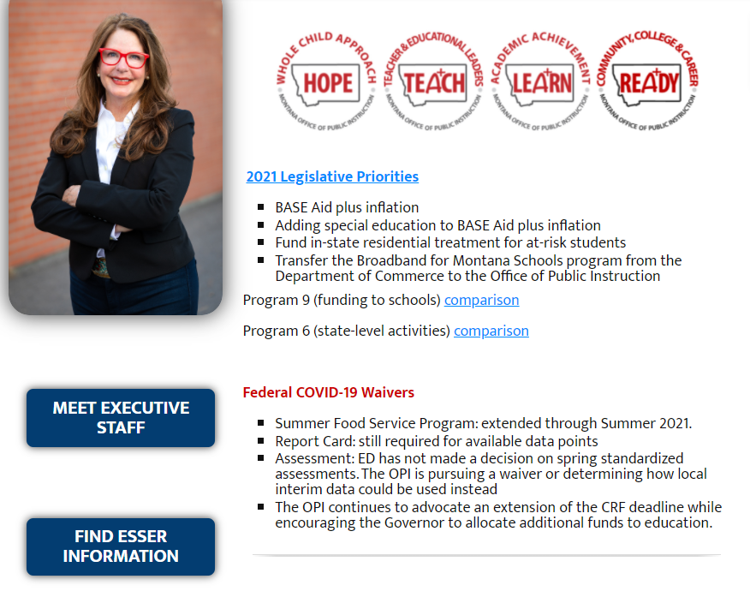
Resources
OPI Website-ARP ESSER: opi.mt.gov

Slide 18
3 Webinars
The OPI has also scheduled three, 90-minute webinars for you to choose a time that works for you to give public input.
May 17, 2021: Webinar 1 and 2 for public input, 9:00am-10:30am and 4:00pm to 5:30pm
May 18, 2021: Webinar 3 for public input, 10:30am-12:00pm
Zoom Link
Meeting ID: 814 8185 9343
Password: 710609

