Slide 1
Education Advocates-ARP ESSER June 15, 2021
Montana Office of Public Instruction

Slide 2
MT OPI ARP-ESSER State Plan
On June 7, 2021, the Montana OPI submitted to the U.S. Department of Education (USED) its State Plan for the ARP ESSER Fund. This plan recognizes local control, removes obstacles and barriers for schools, and enhances accountability without being overly burdensome.
Find the link in the chat box to see the State Plan.

Slide 3
ESSER Funding
The ARP Act represents the third round of funding to come through the ESSER fund, and Montana's allocation totals more than $382,000,000.
In previous rounds, Montana received more than $41,000,000 (ESSER I) and $170,000,000 (ESSER II).
Through the Emergency Assistance to Non-Public Schools (EANS), the state also received nearly $20 million for home and private schools.
Two-thirds of the ESSER III funding has already been released to schools; once USED approves the State Plan, the OPI will be able to release the remaining one-third, or roughly $126 million.

Slide 4
Highlights of State Plan
Section A: Top 3 strategies used during the past year
Integrating Social and Emotional Learning
On-line Professional Learning Opportunities
Flexibility for School Nutrition Programs

Slide 5
Highlights of State Plan
Section A: Top 3 current needs facing students
Student Mental Health
Integrating Social and Emotional Learning
Impacted Learning

Slide 6
Highlights of State Plan
Section C: Stakeholder Input Process
The OPI developed and utilized two survey tools:
Stakeholder Engagement survey- The purpose was to engage in meaningful consultation with stakeholders on the ARP-ESSER State template and the two LEA plans. It provided stakeholders an opportunity to share their experiences, needs, and concerns as a result of the pandemic.
OTL survey: The purposes were to gain a better understanding of learning experiences, student access to educational resources, and learning conditions during the 2020-2021 school year.

Slide 7
LEA ARP-ESSER Plans
Section E: LEA ARP ESSER Plans
The OPI is requiring districts to use a uniform template. LEAs must submit an ARP ESSER Plan to the OPI through the TEAMS. The uniform template will allow:
Efficient gathering of data and information for USED Reporting requirements, measurement and impact
Streamlined plans—the OPI will be presenting to the BPE for consideration to use the LEA ARP ESSER Plan in place of the CSIP.
Leverage local control and allow for local solutions for local needs.
Notes:
collecting the evidence to support continued funding for strategies that work. Through further data analysis, continued stakeholder engagement, and a landscape analysis of promising practices within districts, the CSDE will make further decisions about what initiatives are sustainable and scalable under ARP ESSER.One-time investments that are self-sustaining such as “train the trainer” programs and programs that have high start-up costs but have a lower or sustainable cost for long-term maintenance. • Investments that are heavily focused on measurement and impact so that once the ARP ESSER funding runs out, there is demonstrable proof that the programs merit long-term investment through private philanthropy, and state and local funds.

Slide 8
LEA ARP ESSER Plans
The District ARP ESSER Plan template will open July 1st and close on August 24th in TEAMS.
The OPI will continue to release information on the OPI website under the ESSER Info page, so that LEAs can begin work in anticipation of the opening of the template in TEAMs.

Slide 9
Key Dates
June 8, 15, 22, & 29, 2021. Weekly virtual Q & A Sessions to address questions related to ARP ESSER district plans and budgets.
June 15, 2021. Education Advocates Monthly Partnership Meeting
June 18, 2021. Final day to submit cash requests for June payment for all Federal programs, including ESSER.
June 24, 2021. Districts must make publicly available the Return to In-Person Instruction and Continuity of Services Plan.
June 24-25, 2021. The virtual Montana Education Summit (MTEdx-21) to support districts with educational planning opportunities.
July 1, 2021. The District ARP ESSER Plan template will open through the TEAMS

Slide 10
Key Dates
July 13, 20, & 27, 2021. ARP ESSER Webinars to assist districts in developing and submitting District ARP ESSER Plans.
August 3-5, 2021. Regional Summit for all schools in Comprehensive Status. There will be designated times for school leadership teams to meet, plan, and coordinate programming and funding from Title I, ESSER II, ESSER III, Impact Aid, and School Improvement Support.
August 24, 2021. Districts must submit the ARP ESSER Plan to the OPI through TEAMS.
September 1, 2021. Due date to complete and submit ESSER II and ESSER III applications in the E-grants system.
Notes:
to spark innovation for districts as they determine how to best meet their students’ needs.

Slide 11
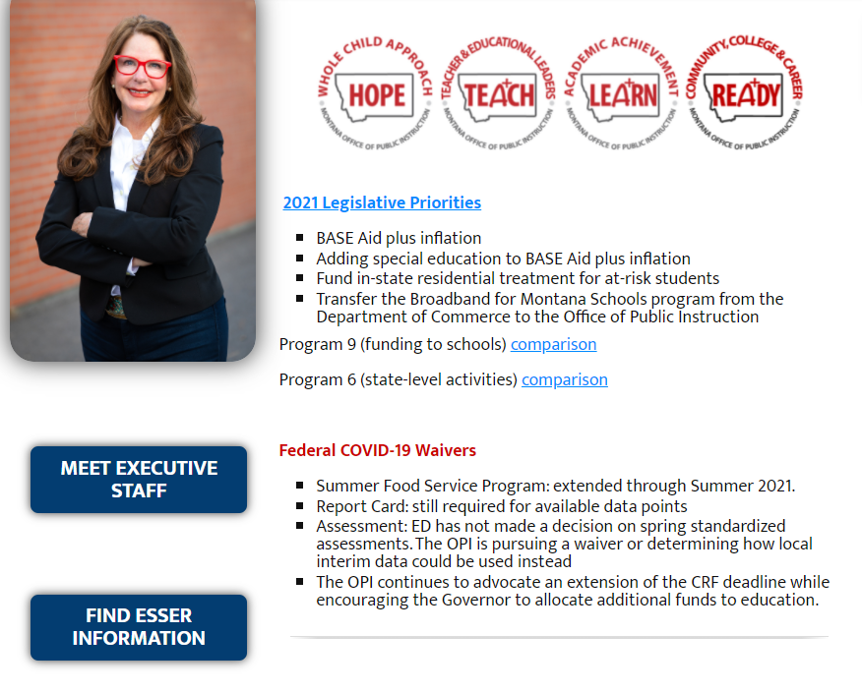
Resources
OPI Website-ARP ESSER: opi.mt.gov

Slide 12

Thank you!
For questions or additional information please contact Jeff Kirksey @ Jeffrey.Kirksey@mt.gov
Notes:
Are there any questions from this presentation?

