Slide 1
District ARP ESSER Plan Review and Data Collection Webinar Meeting Federal Compliance Requirements
November 17, 2021

Slide 2
ession Purpose
Provide a brief overview of ESSER Funds including key dates.
Explain the process of District Plan Update and provide State support.
Forecast the upcoming Data Collection for ESSER I, II, & III.
Field Question you have related to the Plan Update Process.
Notes:
Jeff

Slide 3
Session Details
The requirements in section 2001(i) of the ARP Act relating to the ARP ESSER funds are published in the Federal Register and also outlined by the Department in the ESSER and GEER FAQ document.
The OPI has developed a FAQ document to provide LEAs information about the grant, including eligibility, and grant requirements.
ESSER II and ESSER III guidance documents are available on the OPI website, which outlines allowable uses for the grant.
Disclaimer: Similar to the FAQ document issued by the USED on ESSER and GEER, “the contents of this document do not have the force and effect of law and are not meant to bind the public in any way. The information is subject to change as additional information is released by the USED.”

Slide 4
Presenter Introductions
WELCOME!
4

Slide 5
OPI Staff
Dr. Julie Murgel, Senior Manager, Department of School Innovation and Improvement
Chris Noel, Data Operations Manager
Jeff Kirksey, ESSER Program Manager
Notes:
Each person introduces themselves

Slide 6
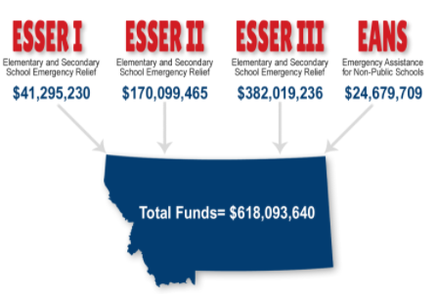
ESSER Summary
Elementary and Secondary School Emergency Relief Fund (ESSER):
3 Rounds of ESSER funds have been authorized by Congress in response to COVID-19 pandemic.
A full ESSER I, II, & III Comparison is available on the OPI website.
Notes:
Jeff

Slide 7
Key ESSER Dates
November 10, 2021: Districts received feedback on their ARP ESSER Plan.
November 16, 2021: Districts received access to their ARP ESSER Plan Update tool.
November 17, 2021: Technical Assistance Webinars 10 AM and 1 PM
November 18, 2021: Technical Assistance Virtual Office Hours 2:30 PM to 4:oo PM
Week of November 29, 2021: Weekly ESSER Bulletin Commences
December 17, 2021: District ARP ESSR Plan Update submitted to OPI and updated version posted to school websites.
December 17, 2021: Safe Return and Continuity of Services plans must be updated and posted to school websites.
TBD: Data Collection
September 30, 2022, 2023 & 2024: Fund obligation dates for ESSER I, II & III respectively

Slide 8
District ARP ESSER Plan and State Support
Two plans:
Return to In-Person Instruction and Continuity of Services Plan (Due 6/24/21)
District ARP ESSER Plan (Due 8/24/21)
District ARP ESSER Plan Public Access:
https://opi.mt.gov/COVID-19-Information/ESSER/LEA-Plans
Understandable
Uniform format
ADA compliant
Notes:
Jeff

Slide 9
Updating and Reviewing ARP ESSER Plan
How often does the District ARP ESSER Plan need to be revised?
Answer: The plan must be updated no less than every six months, until September 30, 2023, and must include stakeholder input and public comment when revisions are necessary.
Notes:
Jeff

Slide 10
Key Dates and Check Points
Key Dates for the District ARP ESSER plan
November 16 – December 17, 2021 District ARP ESSER Plans Open for any necessary corrections
OPI Check-points for Return-Continuity Plans
The OPI will monitor the plans every six months through September 30, 2023 at the following checkpoints: July 2021, December 2021, June 2022, December 2022, and June 2023.
Notes:
Jeff

Slide 11
Updating and Reviewing Return Plan
How often does the District Safe Return Plan need to be revised?
Answer: The plan must be updated no less than every six months, until September 30, 2023, and must include stakeholder input and public comment when revisions are necessary.
If the LEA revises its plan, the revised plan must address each of the aspects of safety currently recommended by the CDC at the time of the revision or, if the CDC has updated its safety recommendations at the time the LEA is revising its plan, each of the updated safety recommendations.
Notes:
Jeff

Slide 12
Return to In-Person Instruction and Continuity of Services Plan
Is it a requirement for a district to adopt CDC guidance as part of the development of the Return to In-Person Instruction and Continuity of Services Plan?
Answer: No, the Interim Final Rule (IFR) clarifies that: “the requirement does not mandate that an LEA adopt the CDC guidance, but only requires that the LEA describe in its plan the extent to which it has adopted the key prevention and mitigation strategies identified in the guidance.”
Notes:
Jeff

Slide 13
Stakeholder Input
Does meaningful consultation require the LEA to include all of the subgroups listed by the USED?
Answer: Yes, to the fullest extent practicable.
Notes:
Jeff

Slide 14
Stakeholder Input Continued
What are recommended best practices for LEAs to meet the stakeholder input requirement?
Answer: Best practices might include a community-wide public notice and comment process with an optional survey to gather input from the various required stakeholder groups. School board meetings, small group meetings and public forums would also supplement the process. Regardless of the process followed, the LEA must document that all the applicable stakeholder groups were included in the process and that meaningful consultation occurred. Documentation of all plans and public comment need to be saved locally as OPI may request the documents as part of compliance monitoring of ESSER grantees.
Note: Public comment should be sought in a manner that is consistent with your existing local procedures.
Notes:
Jeff

Slide 15
Data Reporting and Monitoring
Will LEAs and schools be monitored? Will there be a data collection?
Answer: The OPI will monitor district implementation of ESSER funds based on standard risk assessment procedures.
The OPI anticipates a USED response soon on the data collection due to the USED regarding state and local ESSER expenditures.
Notes:
Jeff

Slide 16
Federal Data Collection
ESSER Data Collection
The first round of ESSER data collection public comments were due to USED by August 31, 2021.
The OPI did submit a response to USED regarding our concerns with the data-collection requirements that will be applied to the Montana OPI and school districts under ESSER I, ESSER II and ARP ESSER.
On October 29, 2021, USED released update ESSER data collection for public comment. Comments are due by November 29, 2021
OPI is crafting a response to this update.
We are waiting for the USED to finalize the data collection requirements.
Notes:
Jeff

Slide 17
Federal Data Collection Elements
The proposed data collection requirements are in 3 categories: fiscal, programming, and personnel (6 subcategories).
Expenditure Details | 20% Lost Instr. Time | School Safety & Infrastructure | Technology and Remote Supports | Personnel | Equitable Support
Total amounts of actual expenditures, disaggregated by activity type, within each grant and funding source with the reporting period. | Combination of y/n, numeric and open-ended responses from LEAs regarding evidence -based practices used to accelerate learning disaggregated by activity type. | Includes combination of y/n and open-ended responses from LEAs regarding policies and plans to re-engage students disaggregated by activity type. | Combination of y/n, numeric and open-ended responses for LEAs regarding technology and technology services provided to improve student connectivity disaggregated by support provided type. | FTE data by position type supported with all ESSER funds for both hiring and retention by categories and position type. | Combination of y/n, numeric and open-ended responses for LEAs regarding how each LEA allocated funds for students most impacted by COVID
Data disaggregated by each fund and activity. | Disaggregated student participation data by activity type. | Disaggregated data by activity type and linkage to public-facing policy. | Disaggregated student participation data by support type. | FTE counts for each school in the LEA, disaggregated by position type, including apportioned FTE across schools. | Disaggregated student participation data by activity type.
Notes:
Jeff

Slide 18
Feedback on District ARP ESSER Plan
On November 10, 2021, districts received:
Feedback on their ARP-ESSER plans from the OPI, including any necessary corrections to meet federal requirements.
A copy of a uniform and understandable plan converted from the submitted template
Notes:
Julie

Slide 19
General Feedback on District ARP ESSER Plans
Coordination with existing programs and services within the LEA is highly encouraged.
Continuing stakeholder consultation is critical.
Ensure consistency between the groups identified for support within the plan and the target audience for services.
Ensure the budget in E-grants is clearly aligned with programmatic activities identified in the LEA ARP ESSER Plan and updated synchronously.
Narrow and measurable! As you work through your plan revision you may find that you have additional information now that will allow you to narrow or further define the specifics on your priorities and goals.
Notes:
Julie

Slide 20
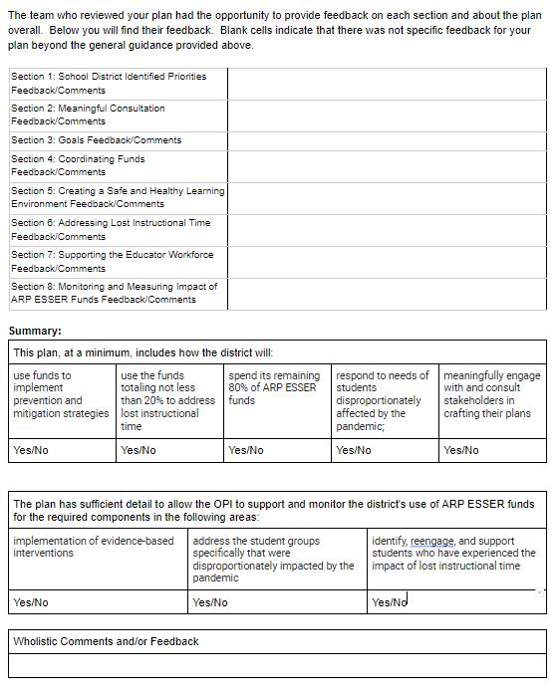
Feedback Template
Notes:
Julie

Slide 21
District ARP ESSER Update Process
On November 16, 2021, districts received:
A new link for districts to:
Make any necessary corrections (Due 12/17/21), and/or
Continuously monitor and update the ARP ESSER Plan at a minimum of every six months.
The tool available at the link will have the same format and allow both districts and the OPI to track changes over time.
Notes:
Chris

Slide 22
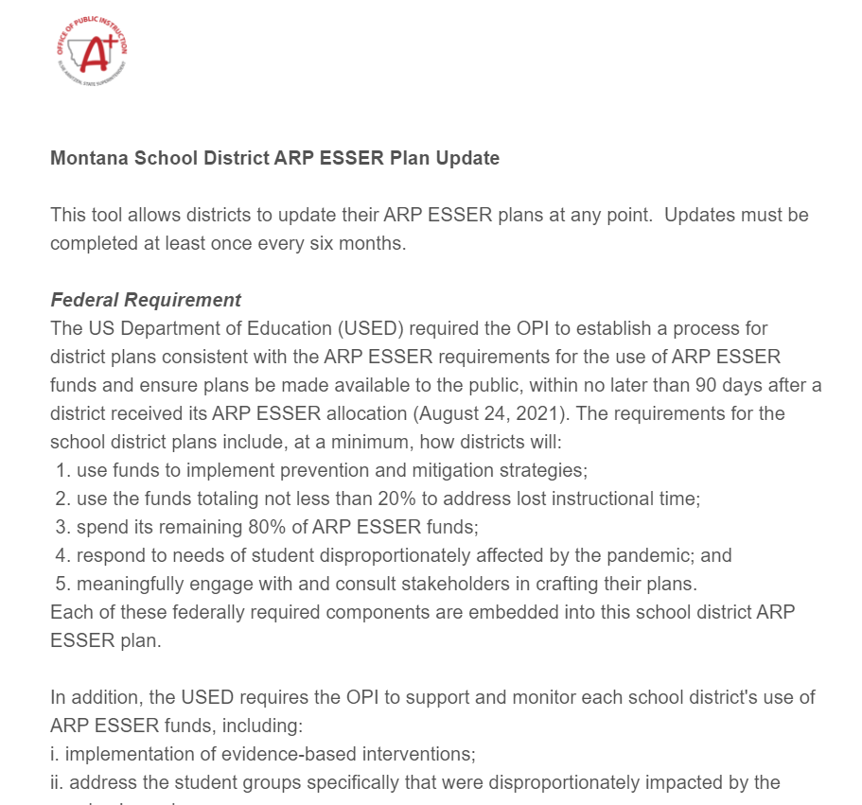
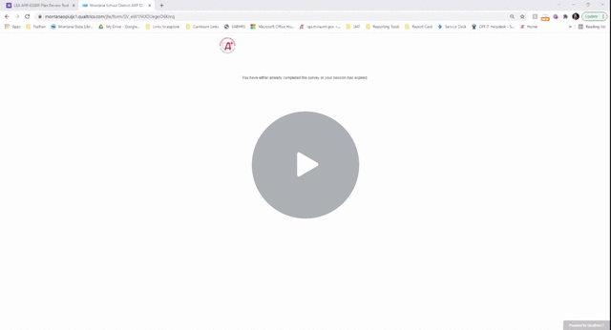
District ARP ESSER Plan Update Tool
Montana School District ARP ESSER
Walk-Through
Step 1: Click on Link in Email
Step 2: Use Login Information from Email
Step 3: Update Plan Details
Step 4: Submit
Video Overview Link
Notes:
Chris

Slide 23
Open Questions
What questions do you have?
Do you have any clarifying questions about the content provided here today?
Notes:
Jeff

Slide 24
ESSER I Reminder!
As of November 30, 2021, there is only
10 MONTHS left
to spend down your ESSER I Funds!
Statewide there is still $10 million dollars to utilize.
Now is a good time to review your ESSER I budgets and
make spending decisions.
Notes:
Jeff

Slide 25
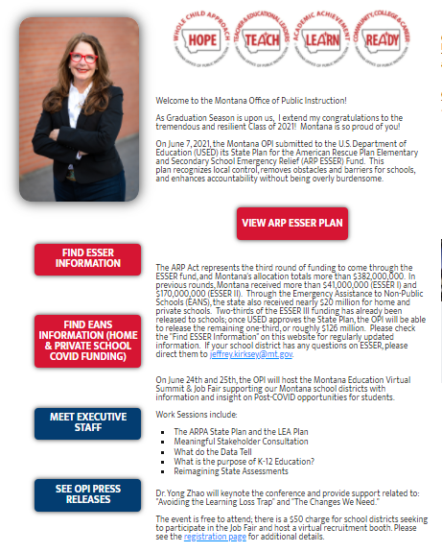
Resources
OPI Website:
opi.mt.gov
Notes:
Jeff

Slide 26
Thank you!
For questions or additional information please contact
Jeff Kirksey: Jeffrey.Kirksey@mt.gov (406)444-0783

